Slide 1
Measuring the Changing Generational Economy
Longitudinal NTA
14th NTA conference, February 2023

Slide 2
The generational economy in the 20th century

Slide 3
The generational economy in the 20th century
Emergence of retirement
Integration of all workers in public retirement schemes (constant reitrement age)
Rising life expectancy
=> Growth of public intergenerational transfers
Extension of youth/young adulthood
Extension of education period
Lower and later fertility
increasing investments per child (time + money)
Large increases in income and consumption

Slide 4
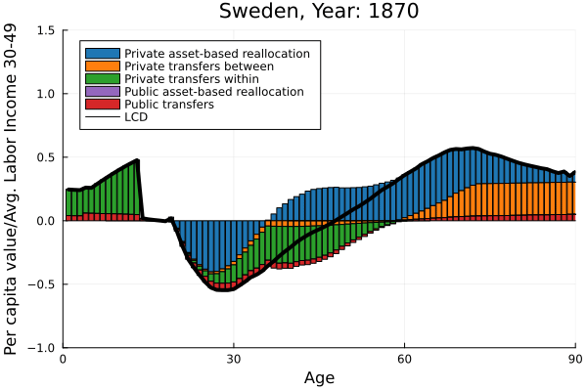
The generational economy in the 20th century
Source: Miguel Sanchez-Romero:
Reconstructing historical changes in the inter-age resource reallocation system

Slide 5
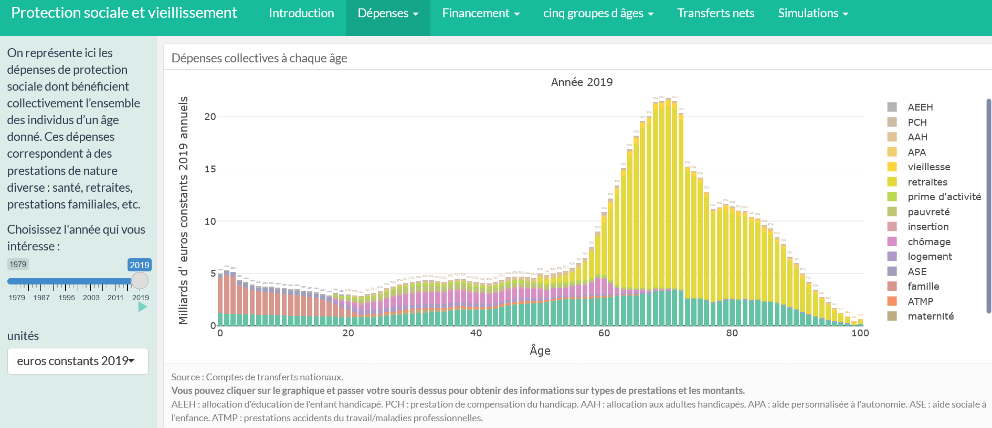
The gold-standard of longitudinal NTA: France 1979 - 2019

Slide 6
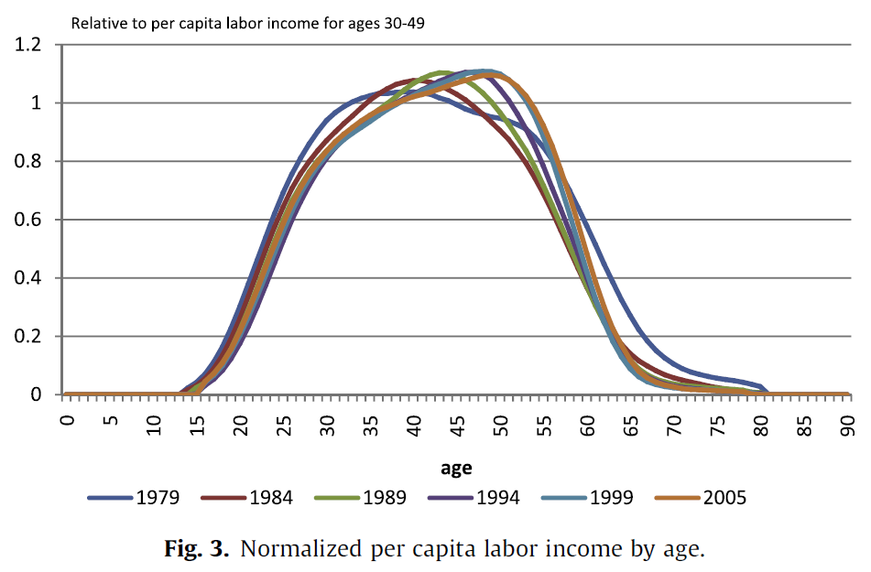
The LCD in France 1979-2005
The lifecycle deficit in France, 1979–2005
Hippolyte d’Albis, Carole Bonnet, Julien Navaux, Jacques Pelletan, Hector Toubon, François-Charles Wolff
Journal of the Economics of Ageing (2015)

Slide 7
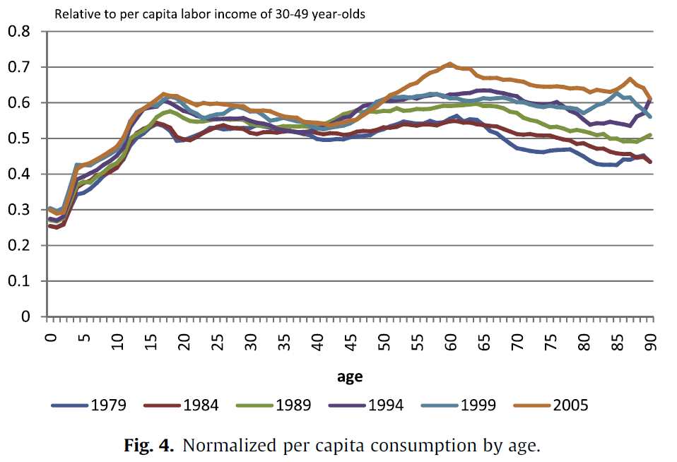
The LCD in France 1979-2005

Slide 8
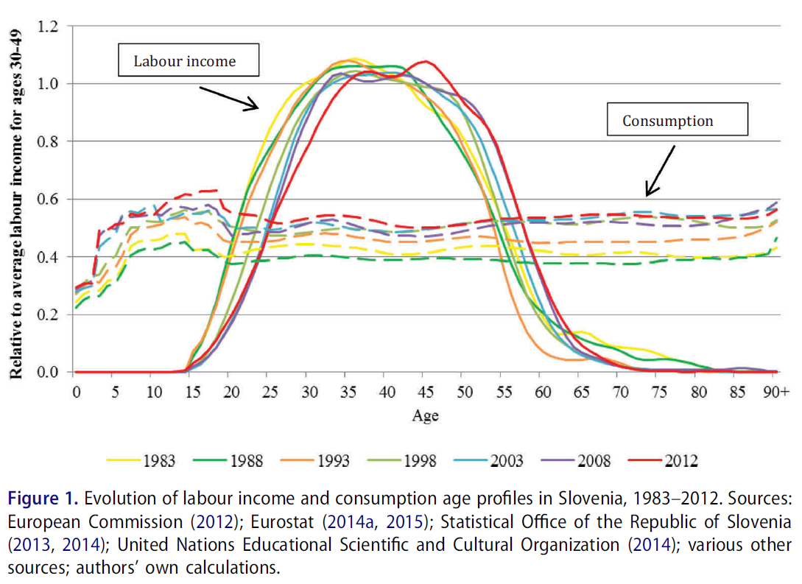
Income and Consumption in Slovenia 1983 - 2012
Tanja Istenič & Jože Sambt (2019)
Changing patterns of transfers in Slovenia
in the last three decades: transition from a socialist economy to a market economy
Post-
Communist Economies, 31:5, 579-602, DOI: 10.1080/14631377.2019.1578585

Slide 9
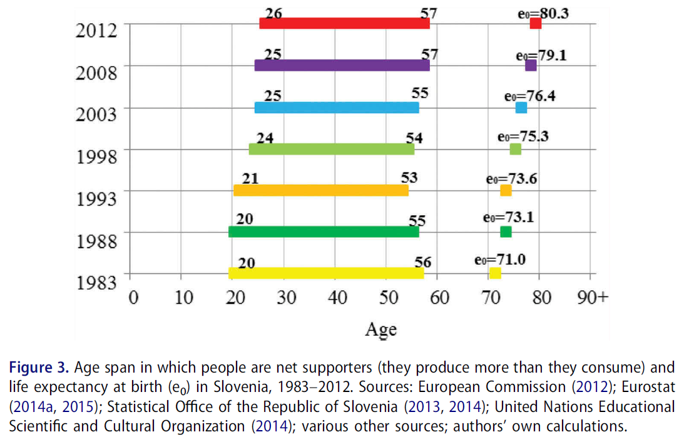
Income and Consumption in Slovenia 1983 - 2012

Slide 10
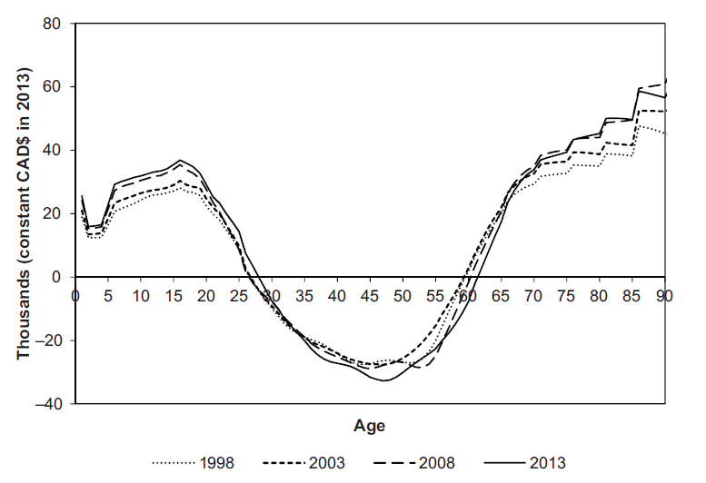
The LCD in Canada 1998 - 2013
MARCEL MÉRETTE AND JULIEN NAVAUX (2019)
Population Aging in Canada:
What Life Cycle Deficit Age Profiles Are Telling us about Living Standards.
Canadian Public Policy

Slide 11
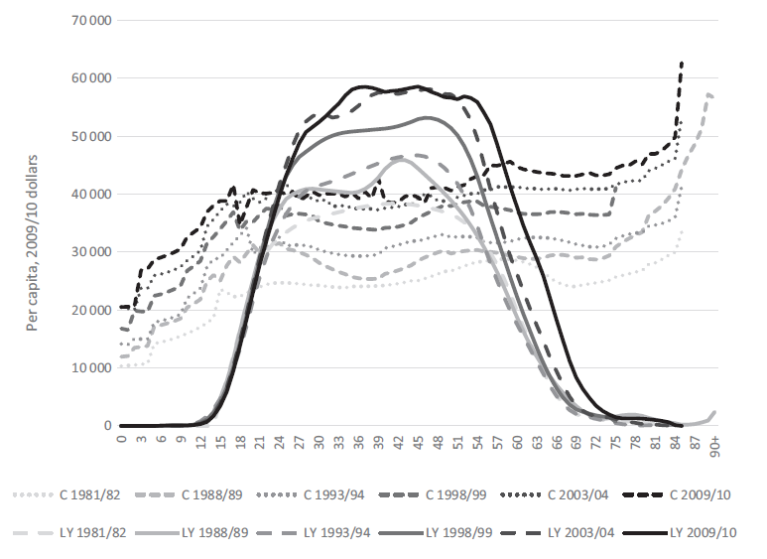
Income and Consumption in Australia 1981 - 2010
James Mahmud Rice, Jeromey B. Temple, Peter F McDonald (2017).
Ageing and the economic life cycle: The National Transfer Accounts Approach. Australian Journal of Ageing

Slide 12
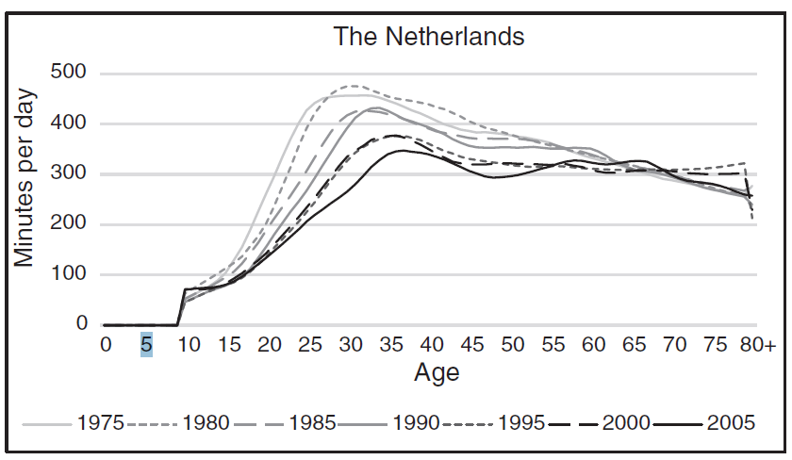
Unpaid work of women in the Netherlands 1975 - 2005
Ana Seme, Lili Vargha, Tanja Istenic and Joze Sambt;
Historical patterns of unpaid work in Europe: NTTA results by age and gender
Vienna Yearbook of Population Research 2019 (Vol. 17), pp. 121–140

Slide 13
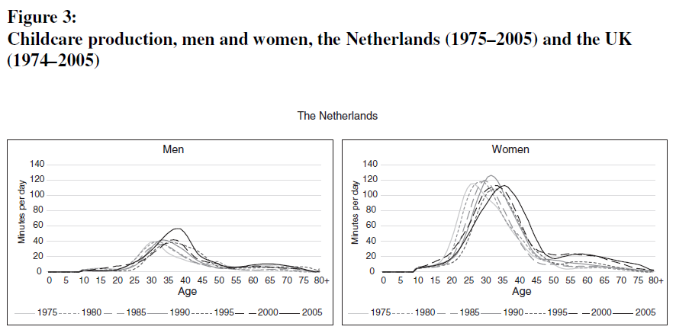
Unpaid work in the Netherlands 1975 - 2005

Slide 14
Summary: Generational Economy in the 20th Century
Extension of education
Postponement of childbearing
Women entering formal labour market
Emergence of a long retirement period financed by public transfers
Increasing income and consumption
Interrelated with:
Economic growth (based on cheap fossile energy)
Demographic transition: lower fertility, demographic dividend
Integration of Asia, Eastern Europe into the global market

Slide 15
The generational economy at the beginning of the 21st century

Slide 16
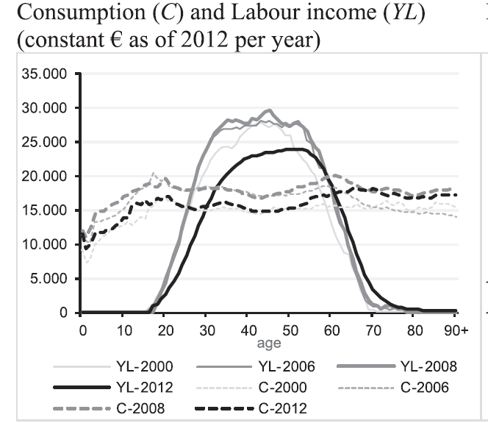
Consumption and Labour income in Spain 2000 - 2012
Meritxell Soléa, Guadalupe Souto, Elisenda Renteriac, Giorgos Papadomichelakisa,
Concepció Patxota
Protecting the elderly and children in times of crisis: An analysis based on
National Transfer Accounts
Journal of the economics of ageing (2020)

Slide 17
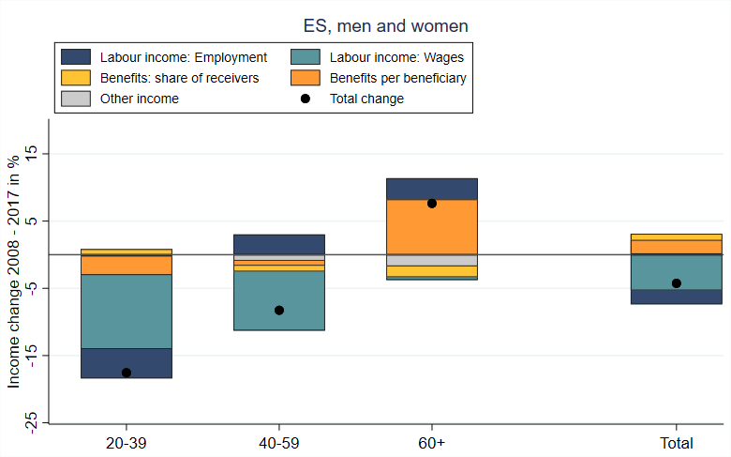
Decomposition of income changes 2008 - 2017: Spain
Hammer, B., Spitzer, S. & Prskawetz, A. (2021). Age-Specific Income Trends in Europe: The Role of Employment, Wages, and Social Transfers. Social Indicators Research (2021). https://doi.org/10.1007/s11205-021-02838-w

Slide 18
The generational economy at the beginning of the 21st century
Frequent economic crisis
A slowdown of growth in many countries
Beginning retirement of the baby-boomer
Asian and Eastern Europe is ageing fast, their LCD increases
Environmental challenges
Inflation
Increasing difficultues to finance public pensions
Increasing labour shortage in health, care, education
=> Factors thtat shaped the generational economy during the 20th century turn into the opposite direction

Slide 19
The future of the generational economy in the 21st century?

Slide 20
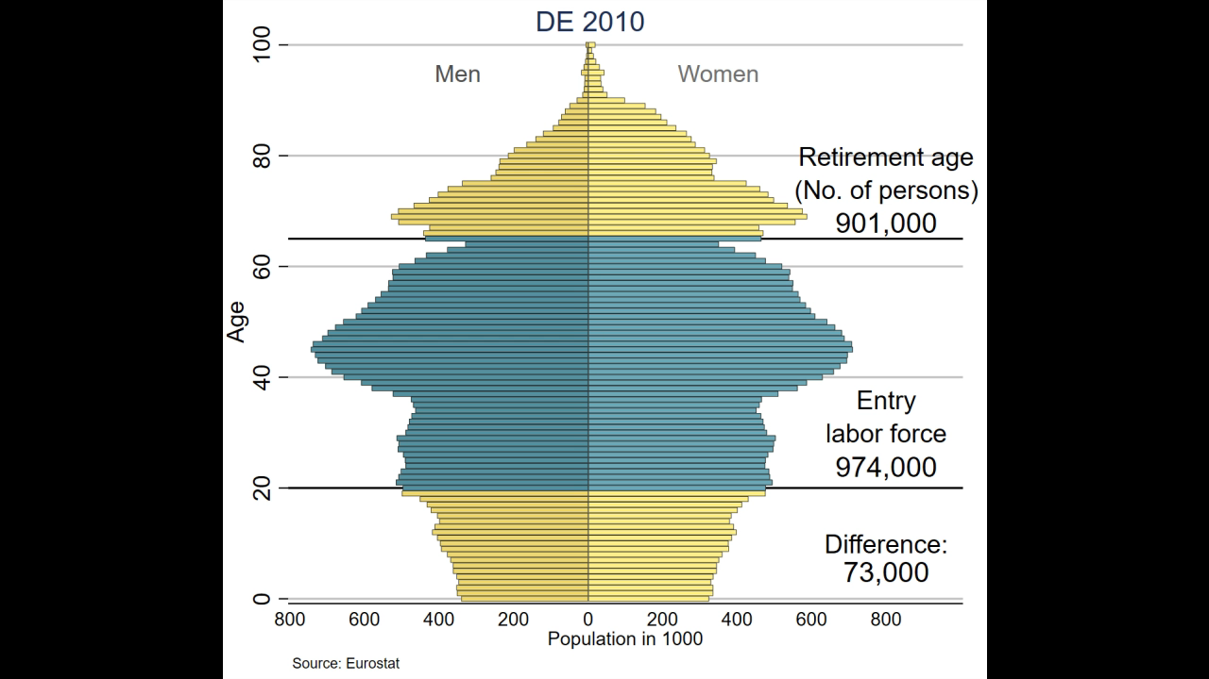
The future of the generational economy in the 21st century

Slide 21
The future of the generational economy in the 21st century
NTA data and indicators should improve decisions:
Inform about the performance of the generational economy
Improve the understandng of current developments
Identify risks and problems
Assessment of our options to (re-)act

Slide 22
The future of the generational economy in the 21st century
NTA data and indicators should improve decisions:
Inform about the performance of the generational economy
Improve the understandng of current developments
Identify risks and problems
Assessment of our options to (re-)act
What is the most important development, risk or problem that you expect for the generational economy in the next decades?

