Slide 1


Accounting for Unpaid Care Work in India:
National Time Transfer Accounts Analysis
Aparna Roy and T.V. Sekher
International Institute for Population Sciences

Slide 2
The invisible economy
“We are familiar with household production as with many other common place things, yet really know very little about it”- Margaret Reid (1934).
The neglect of household production arises because we are often blind to what is closest to us, but even more so because the household is not a money-making institution.
Age- Economic lifecycle-NTA- Gender matters-NTTA
Notes:
Age is key to economic behavior
Economic lifecycle: Young & old consume more than they produce, while working-age individuals produce more than they consume (United Nations, 2013).
Generational economy: Age-based resource production, consumption, sharing, and saving (Lee & Mason, 2011).
NTA framework developed to address the lack of age-based insights in national accounts (Donehower, 2023; United Nations, 2013).
National Transfer Accounts (NTA) track economic flows across generations in a country within a given year (Lee & Mason, 2011).
Gender matters in generational economies, but NTA does not differentiate between men and women.
Men and women differ as providers and receivers of generational support.
Applying NTA separately by gender is possible, but it lacks a key component—household production.
Household production is missing in NTA, leading to an undervaluation of women's economic contributions.
Women contribute more to unpaid work, making the standard NTA framework systematically biased toward men’s contributions.

Slide 3
India:
Population: ~1.43 billion (Largest in the world)
Median Age: ~28.2 years (Young population)
Population by Age Groups (2022):
  0–14 years: 25.4%
  15–64 years: 68.6%
  65 years and over: 6.1%
Youth Dividend: Large working-age population
Aging population: Elderly (60+) expected to double by 2050.
Rural-Urban Shift: Rapid urbanization and changes in family structures.

Slide 4
LFPR for female of age 15 years above in usual status 41.7% during July 2023 – June 2024.
Women’s Low Labor Force Participation (LFP): India’s female LFP is still lower than the global average.
Double Burden: Even when employed, women perform most household tasks, leading to fatigue and limited career advancement.
Men’s Limited Role in Care Work: Traditional norms restrict men’s participation in unpaid labor, reinforcing gendered divisions of labor.

Slide 5
Aim
The aim of this article is to account for economic flows from unpaid care work for men and women in time and monetary units.

Slide 6
Methodology
Data Sources:
  Time Use Survey 2019
  Periodic Labour Force Survey 2019-20
Time Use Survey 2019 (NSSO)
  Coverage: 1,38,799 households (Rural: 82,897 | Urban: 55,902)
  Respondents: 4,47,250 individuals (Age 6+)
Used ICATUS-2016 classification for activity categorization.
Estimated annual time used for each activity.

Slide 7
Calculated production Schedule, Consumption Schedule,Net Transfers, Total Inflow & Outflow by age and gender.
Followed by smoothing and adjusting of age profiles.
Find appropriate wages to impute the value of the time spent on those activities
  Wages for NTTA activities are sourced from Periodic Labour Force Survey (PLFS) 2019-2020.
  PLFS has occupation codes from the National Classification of Occupations-2004
  Hourly wages from PLFS are converted to annual wages.
  Time profiles (in hours per week) are annualized by multiplying by 52.
  Monetary age profiles are created by multiplying annualized time by hourly wages.

Slide 8
Results
Differences in average time spent on individual activities by age between males and females, India.

Slide 9
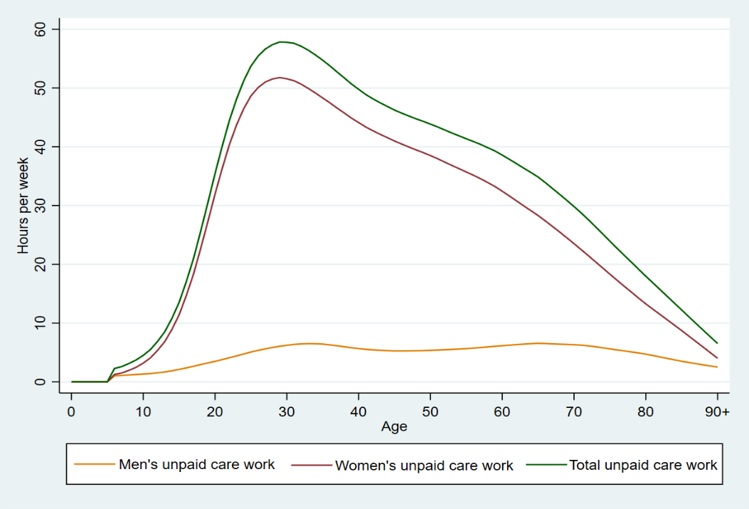
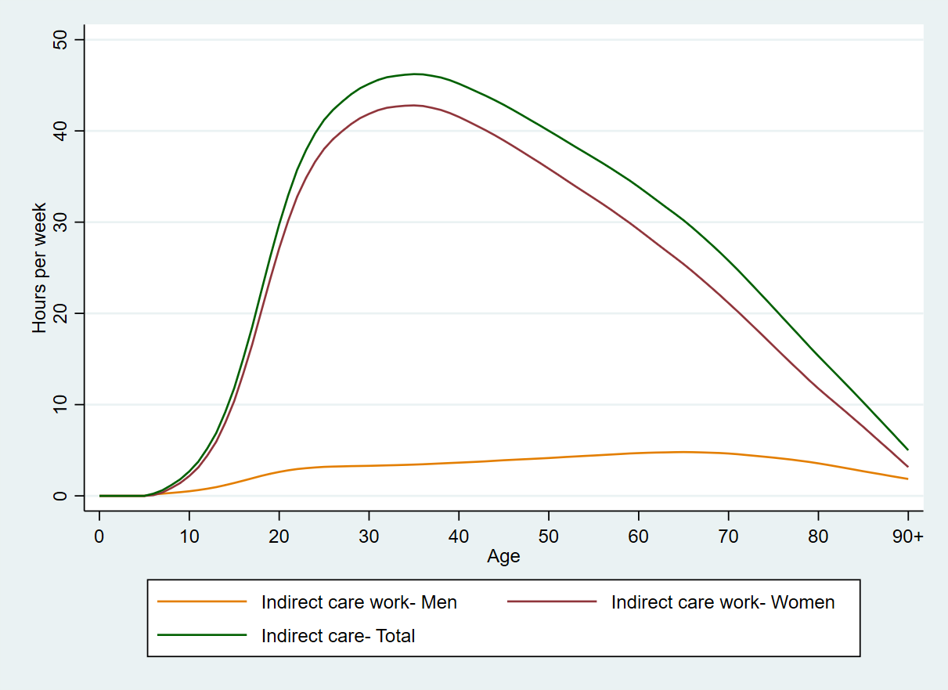
Age- and gender-specific time spent on the production of ‘Unpaid care work’, India
Age- and gender-specific time spent on the production of indirect unpaid care work, India.

Slide 10
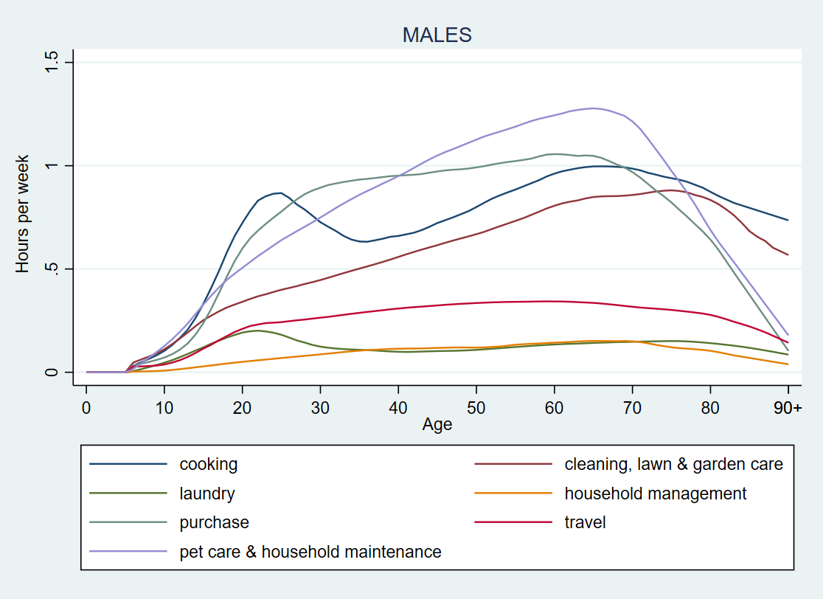
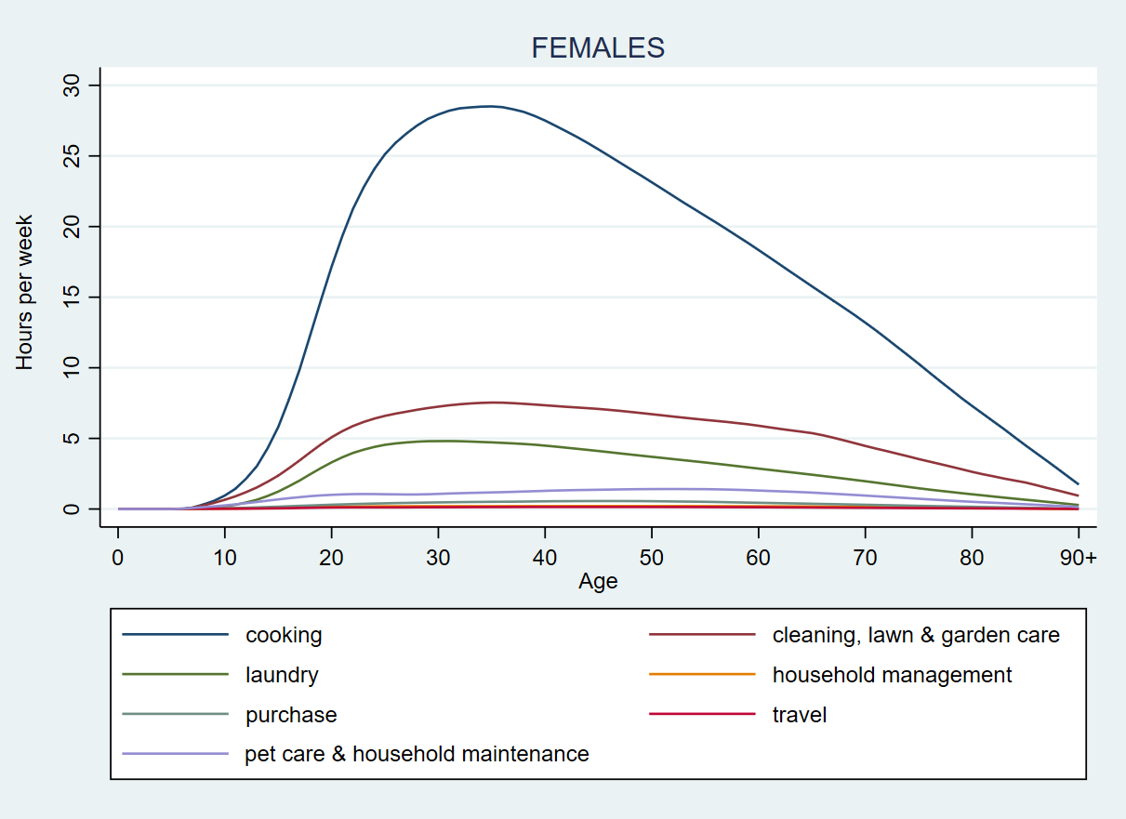
Average time spent on selected activities of indirect unpaid care work by age among males, India.
Average time spent on selected activities of indirect unpaid care work by age among females, India.

Slide 11
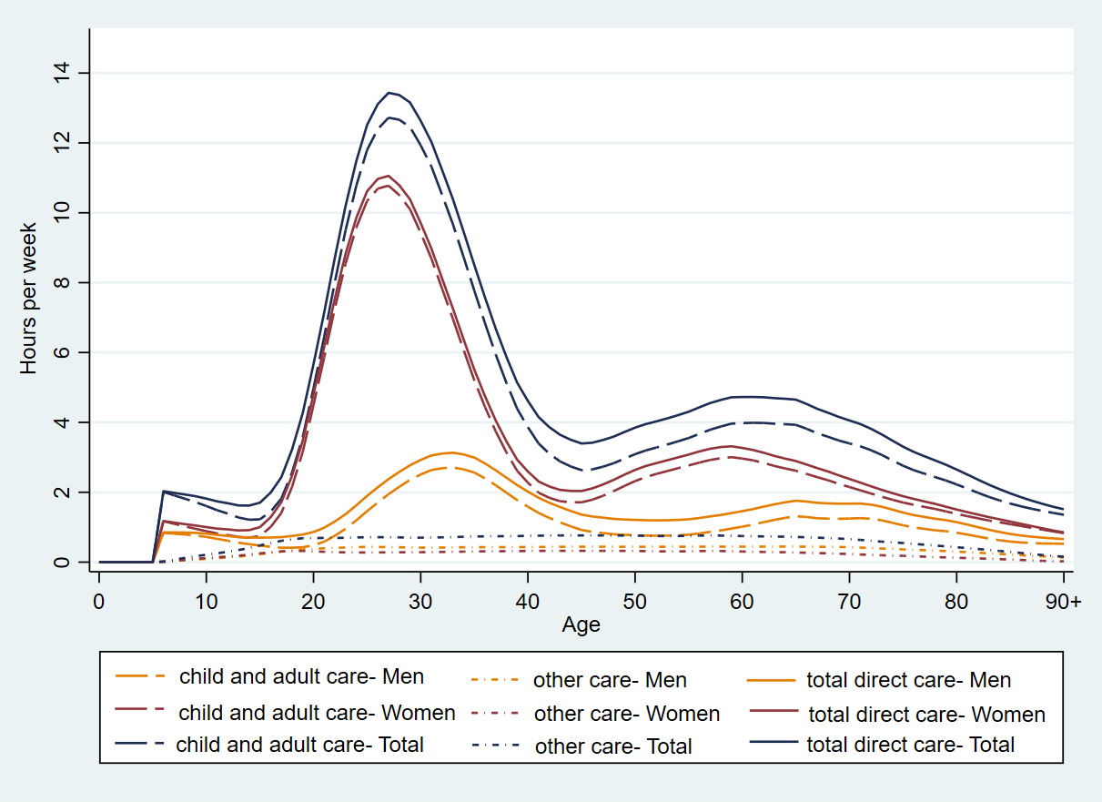
Age- and gender-specific time spent on various direct care work, India

Slide 12
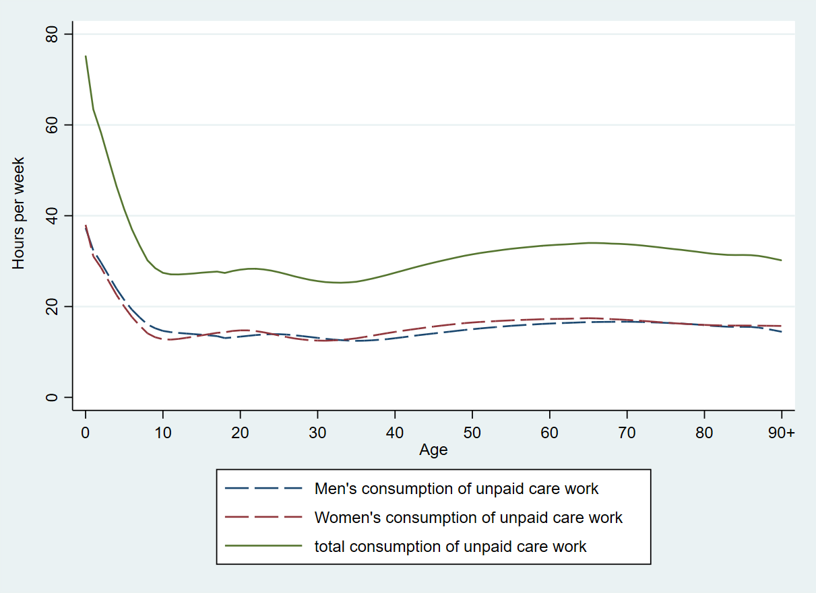
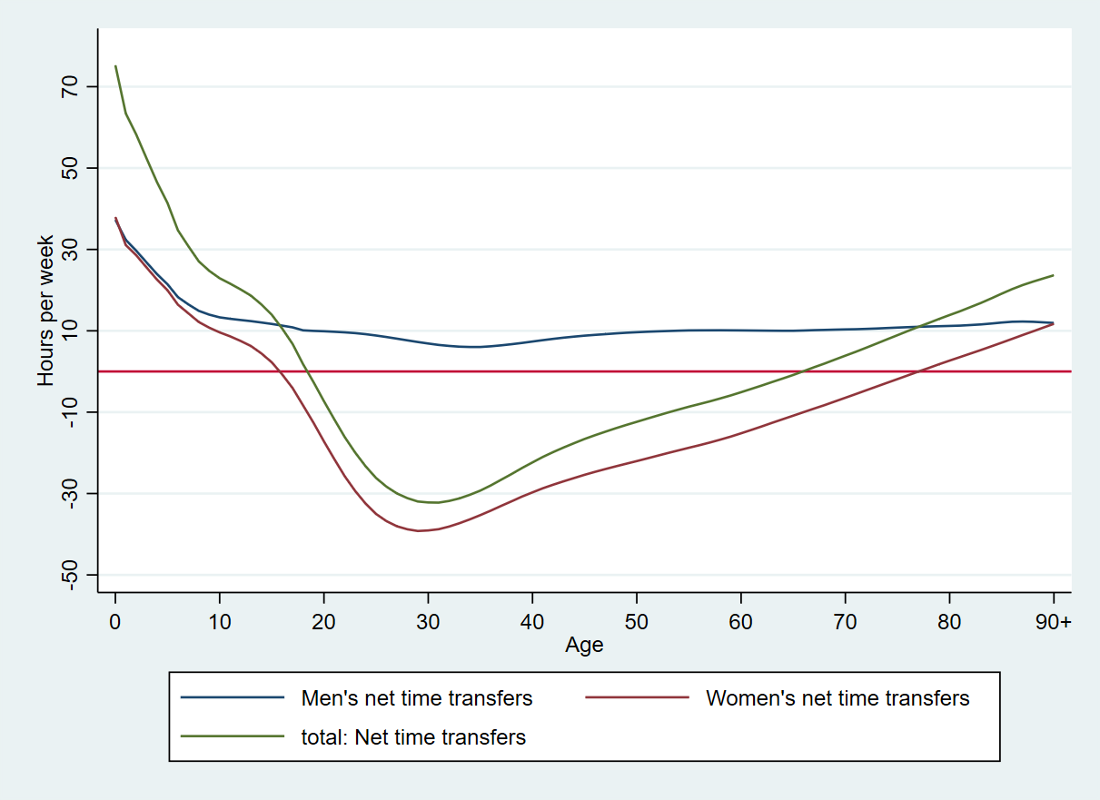
Age- and gender-specific consumption of unpaid care work, India
Net time transfers of unpaid care work by age and gender in hours per week

Slide 13
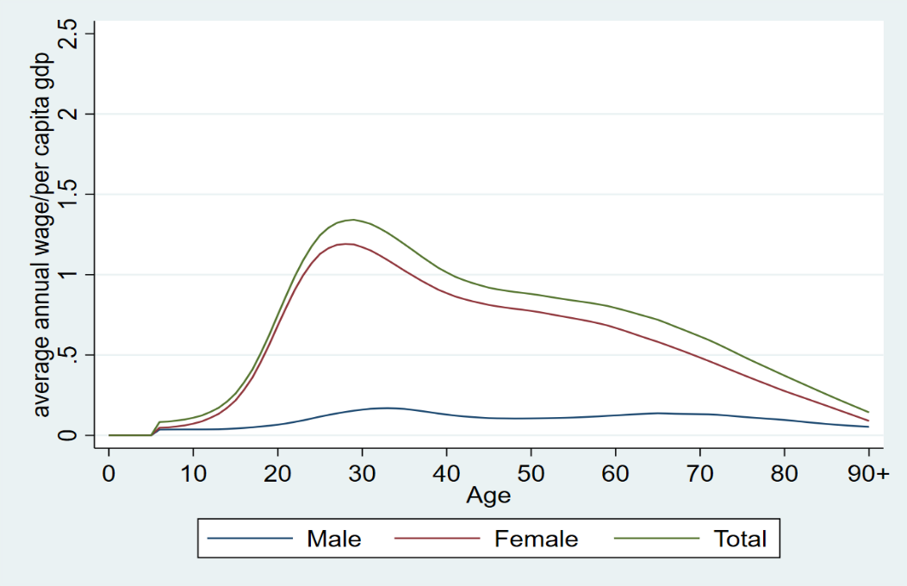
NTTA production, consumption and net time transfer age profiles in monetary terms:
The aggregate value of unpaid care work estimated from the Periodic Labour Force Survey 2019 was estimated as a share of GDP at current prices. We obtain GDP from the Handbook of Statistics on the Indian Economy 2019-20 (Reserve Bank of India 2020). Using the input pricing method, unpaid care work was valued at 26.6 percent of GDP.
Production of Unpaid care work in monetary terms by age and gender, India
Notes:
Adolescence and Early Adulthood (Ages 15–30)
The contribution of females rises to unpaid care work, peaking around this phase, reaches approximately 150% to 200% of per capita GDP at ithis peak.
In contrast, male contribution rises only slightly, remaining well below 50% of per capita GDP.
This sharp divergence reflects traditional gender roles, where women disproportionately shoulder unpaid household and caregiving tasks.
Peak Contribution Phase (Ages 30–50)
Women’s unpaid care work remains high, sustaining levels close to 150% of per capita GDP before gradually declining.
Men’s contribution shows a slight upward trend but stays minimal, emphasizing a gender imbalance in caregiving responsibilities.
Older Ages (60+)
Even at older ages, women’s contributions are about 50% to 70% of per capita GDP, whereas men’s contributions stay low.

Slide 14
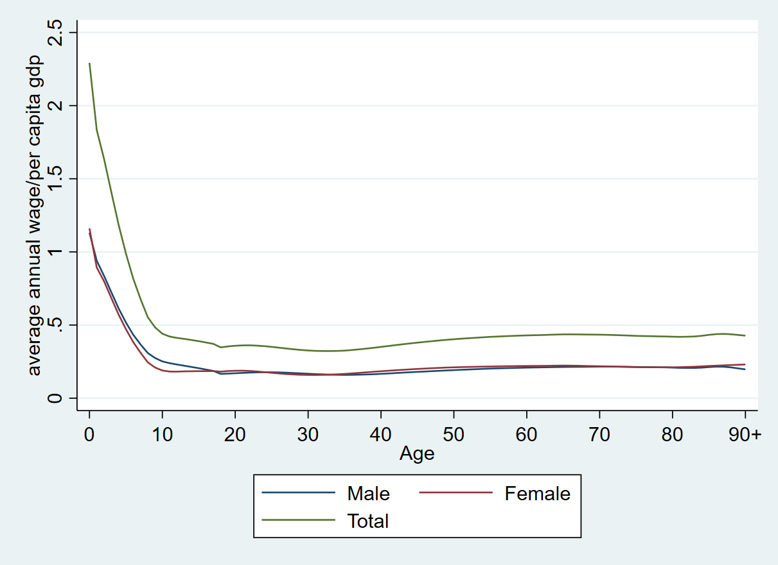
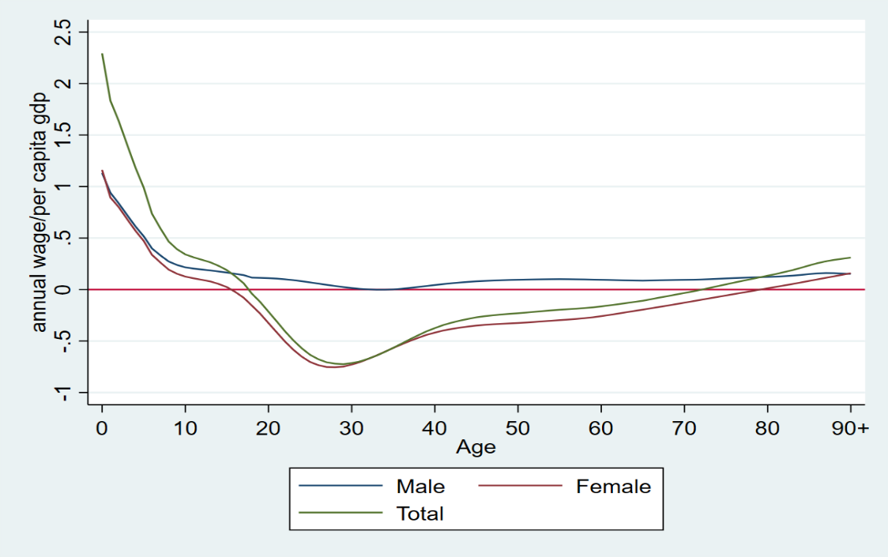
Net transfers of Unpaid care work in monetary terms by age and gender, India
Consumption of Unpaid care work in monetary terms by age and gender, India
Notes:
Graph 1:
Infancy (Ages 0-1)
Total Consumption peaks at approximately 230% of per capita GDP.
Males and Females have similar consumption patterns, both exceeding 200% of per capita GDP.
By age 10, consumption stabilizes around 40-60% of per capita GDP, with minimal gender differences.
During adulthood, consumption levels for both genders remain relatively stable at about 20-30% of per capita GDP.
Consumption rises gradually in later years, with both genders converging around 40-50% of per capita GDP by age 80 and above.

Slide 15
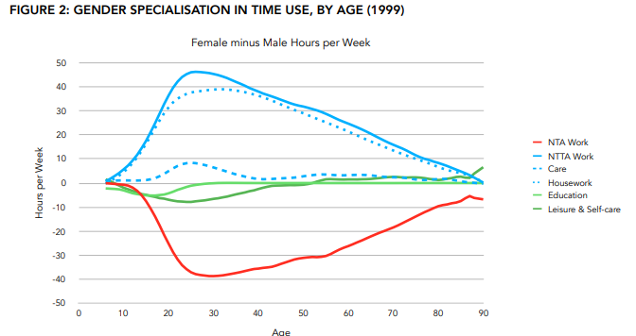
Discussion & Way forward
Differences in average time spent on individual activities by age between males and females, India- comparison for 1999 & 2019
Source: Ladusingh,L. (N.D.) The market and the household in India: Counting women’s work, country report No:2
Source: Aparna Roy & T.V. Sekher (2024), Accounting for Unpaid Care Work in India-2019, unpublished manuscript

Slide 16
Global scenario:
Magnitude of Unpaid Care Work: Globally, 16.4 billion hours per day are spent on unpaid care work, with women contributing 76.2% of this total—equivalent to 2 billion full-time workers, representing 66.9% of the world’s working-age population (Addati et al., 2018).
Economic value of Unpaid Care Work: ILO estimates founded on data from 53 countries representing 63.5 percent of the global working-age population show that unpaid care work would amount to 9.0 percent of global GDP were a monetary value given to the hours devoted to its provision, based on the hourly minimum wage (opportunity cost approach).
Gender Gap in Unpaid Work: Women spend an average of 265 minutes per day on unpaid care work, while men contribute only 83 minutes. This translates to 201 working days per year for women versus just 63 for men (Addati et al., 2018).

Slide 17
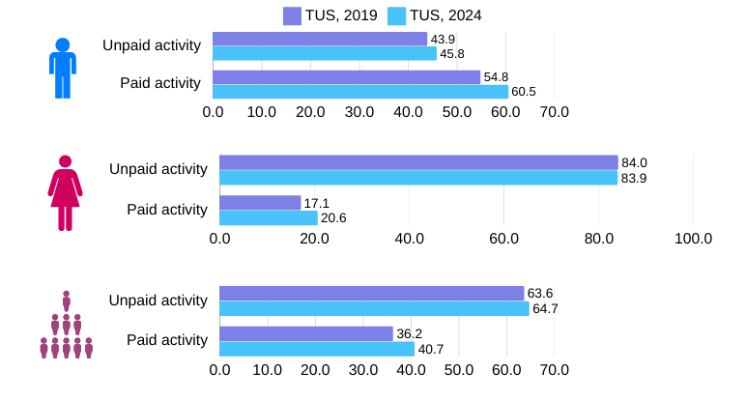
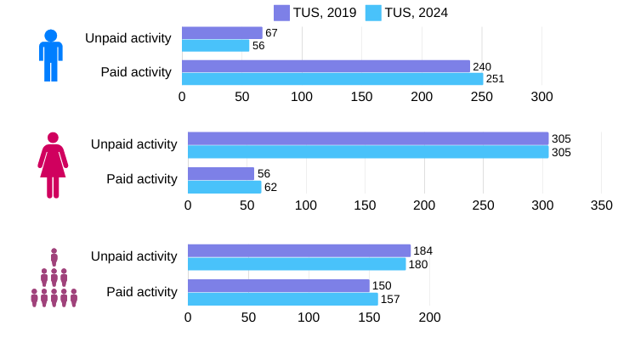
Participation rate (in per cent) in unpaid and paid activities during TUS, 2019 and TUS, 2024
Average time spent (in minutes) in a day per person in unpaid and paid activities during TUS, 2019 and TUS, 2024

Slide 18
The 5R Framework by ILO
Recognize, Reduce and Redistribute unpaid care work,
Measure all forms of care work and take unpaid care work into account in decision-making
Invest in quality care services, care policies and care-relevant infrastructure
Promote active labour market policies that support the attachment, reintegration and progress of unpaid carers into the labour force
Enact and implement family-friendly working arrangements for all workers
Promote information and education for more gender-equal households, workplaces and societies
Ensure care-friendly and gender-responsive social protection systems
Implement gender-responsive and publicly funded leave policies for all women and men
Promote social dialogue

Slide 19
THANK YOU

