Slide 1
Population aging in the ESCAP region and its economic and intergenerational consequences
Ronald Lee, Univ Calif Berkeley
NTA15 Bangkok, March 11 2025
Policy and the Generational Economy
Regional Studies Session

Slide 2
1. Introduction
Based on a report and journal article I did for ESCAP.
Rich data for region.
Often use old data because new not yet public.

Slide 3
2. Basic LCD profiles for the region

Slide 4
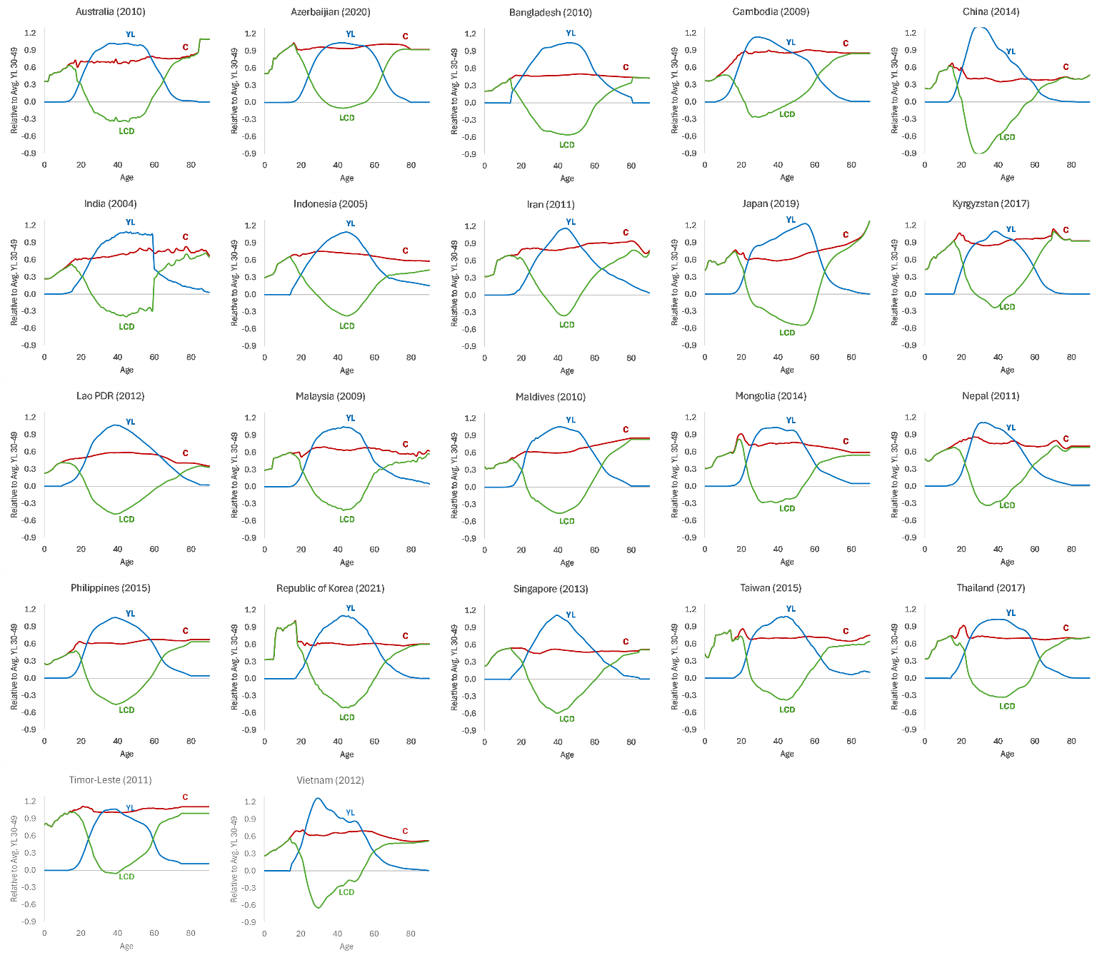
Labor inc and cons for 22 ESCAP, various dates
China and Vietnam: early yl peaks
Young benefit from very rapid econ and education growth.
Problem projecting because growth will slow and yl shape become normal.

Slide 5
Great variation in adult surplus.
*Azerbaijian (oil revenues)
*China (high savings, low cons)

Slide 6
3. Investment: Assets and Human Capital

Slide 7
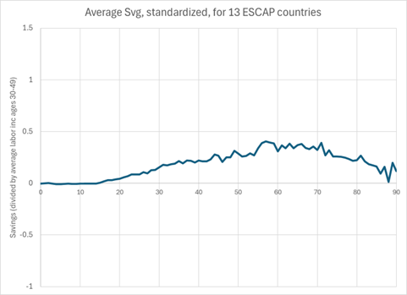
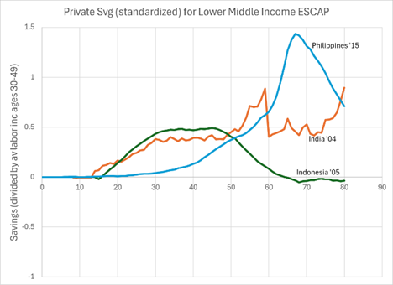
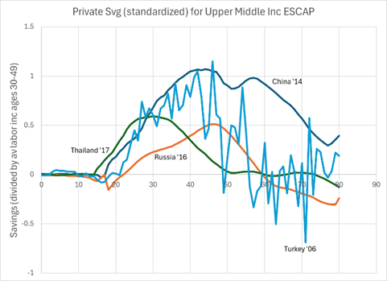
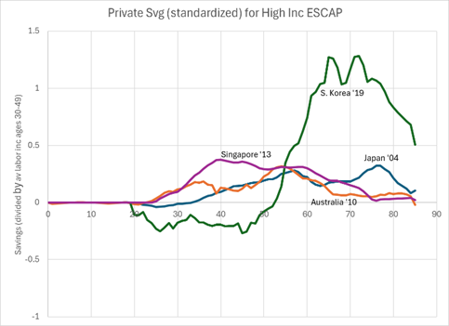
Savings (divided by av labor income ages 30-49)
Elderly have positive savings (except Russia).
Young adults save (except S. Korea).
Russia
S. Korea

Slide 8
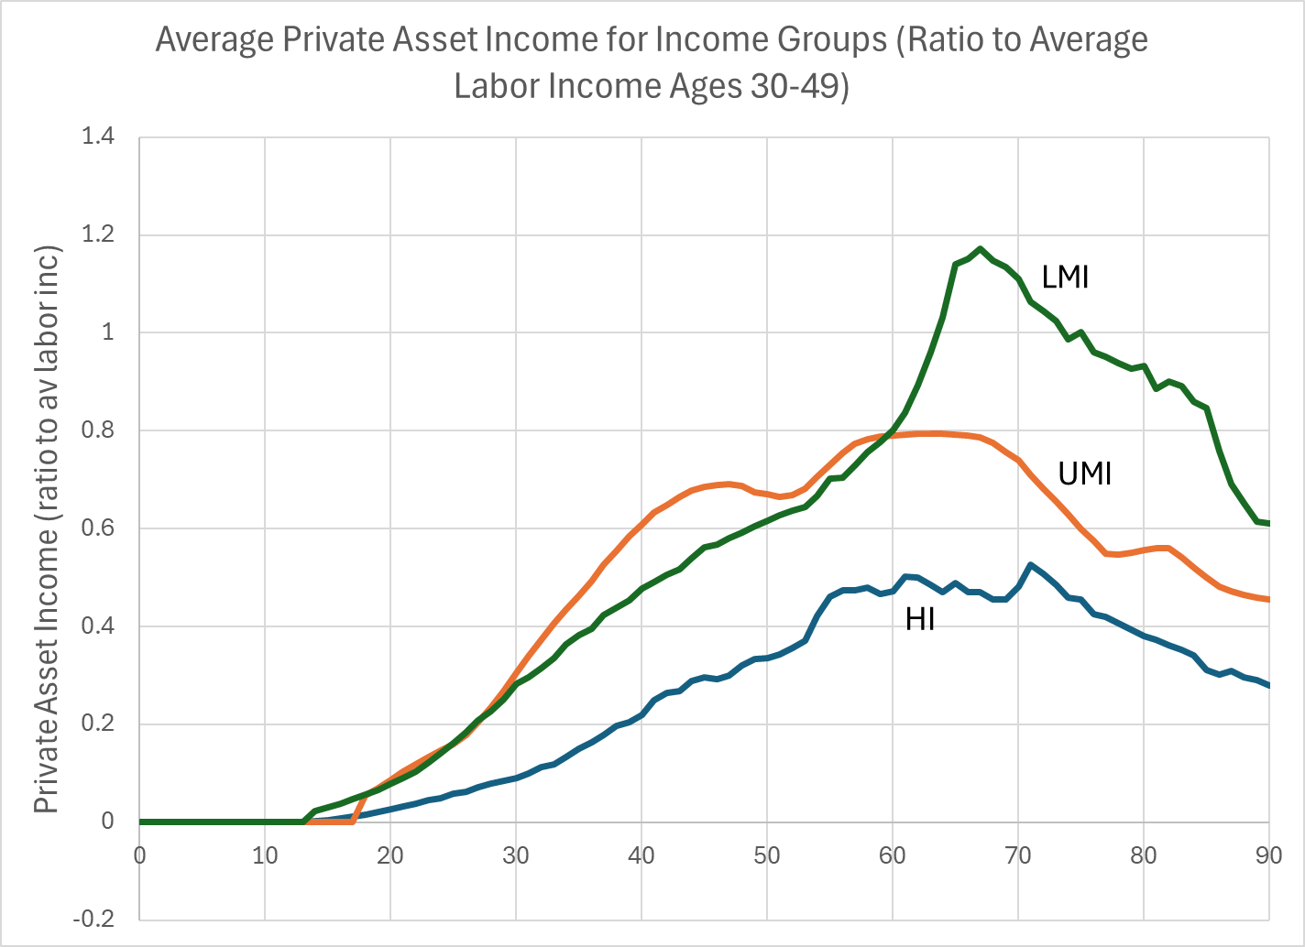
Saving is only one source of asset accumulation.
Also:
  Inheritance
  Inter vivos transfers
  Capital Gains
Note: HI includes Australia 2010, Japan 2019, Singapore 2013, ROK 2021, and Taiwan Province of China 2015. UMI includes China 2014 and Thailand 2017. LMI includes Indonesia (as of 2005), India 2004, and Philippines 2015.

Slide 9
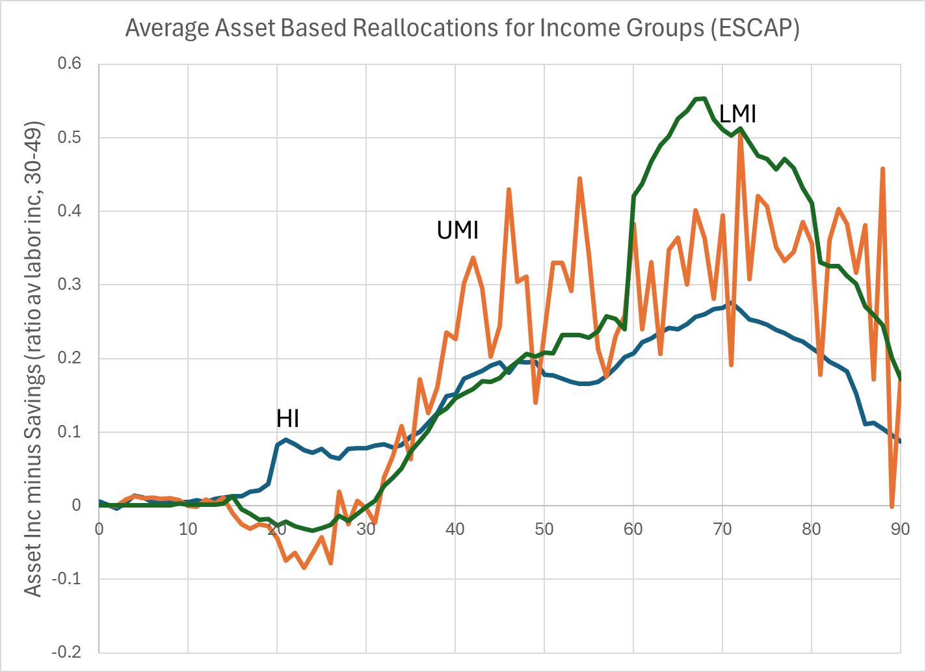
Average asset based reallocations in 11 ESCAP economies.
HI includes Australia 2010, Japan 2004, Singapore 2013, and Taiwan Province of China 2015. UMI includes China 2014, Turkey 2006, Russia 2016, and Thailand 2017. LMI includes Philippines 2015, Laos 2012, India 2004, Indonesia 2005

Slide 10
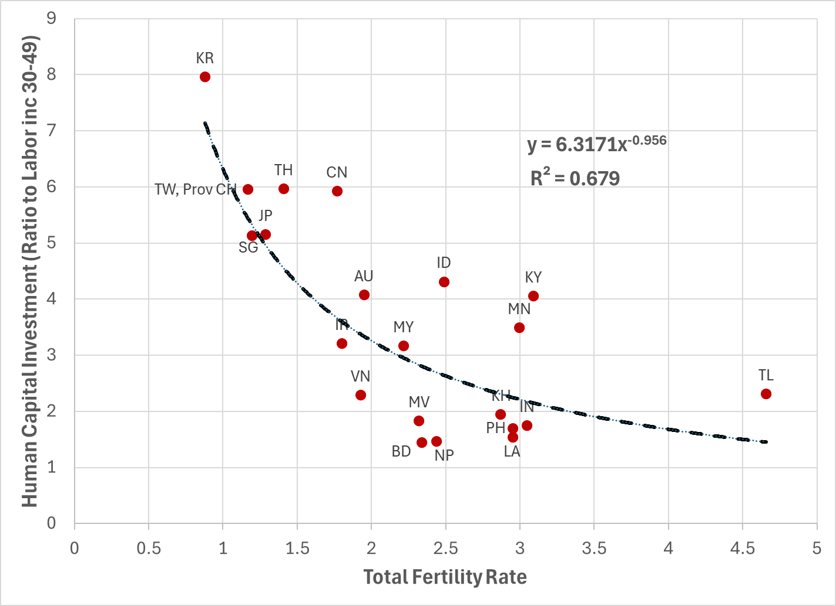
Investment in human capital is also important
HK investment per childe in 22 ESCAP economies
Approximately HK = 6 years/TFR
  TFR = 1 corresponds to 6 years of yl30-49 invested per child
  TFR=3 corresponds to 2 years of yl30-49 invested per child

Slide 11
4. How consumption 65+ is funded

Slide 12
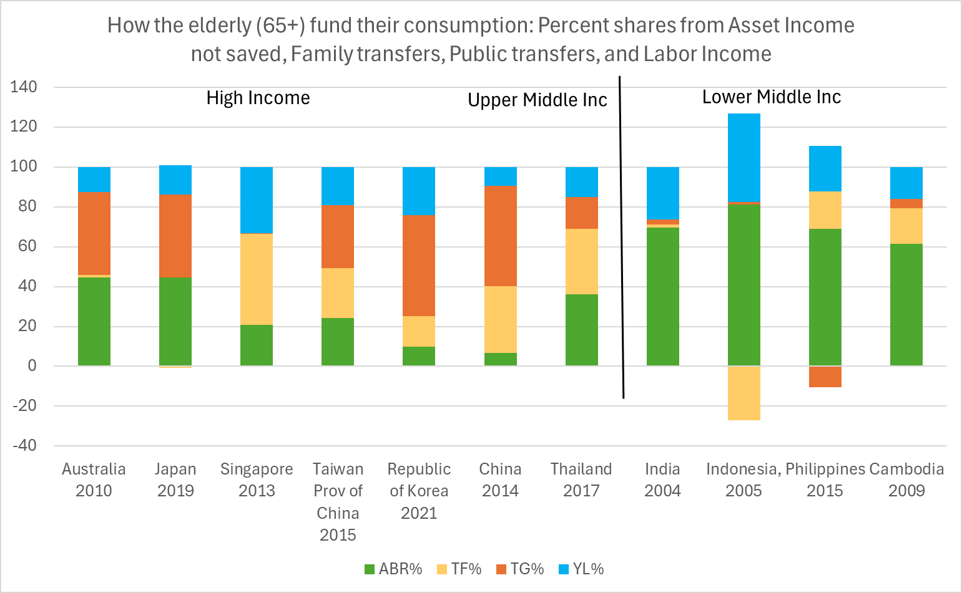
How consumption for 65+ is financed-- Percents: asset income not saved (ABR), family transfers (TF), public transfers (TG) and labor income (YL).
Smaller Macro economic impact of pop aging when elderly self-fund their consumption more.
65+ in LMIs self-fund 80% or more.
In UMIs 50% or less.
In HIs about 50% but S. Korea 30%. Singapore is striking.
labor inc
Public trans
Family trans
Asset inc not saved

Slide 13
5. Linking these to the macroeconomy

Slide 14
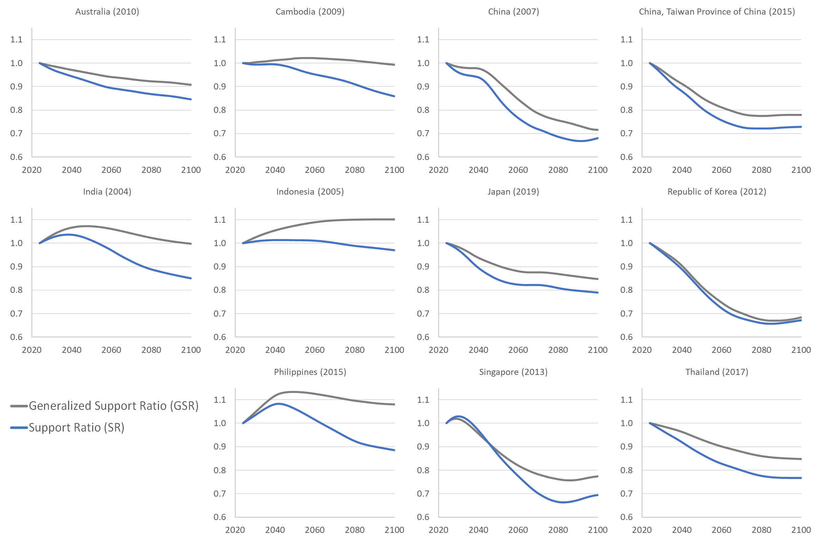
Blue Line (Basic Support Ratio, Yl numerator)
Grey Line (General Support Ratio, Yl+Ya in numerator)
Demog Dividends are bigger and last longer with GSR.

Slide 15
Declining Support Ratios indicate Population Aging.
In Korea, Singapore, China, GSR declines by 33 % 2025 to 2080.
Age-adjusted cons will rise .7%/yr slower than otherwise.
To balance must consume 33% less or transfer 50% more!
Thailand, Taiwan, Singapore, Japan also have costly aging.

Slide 16
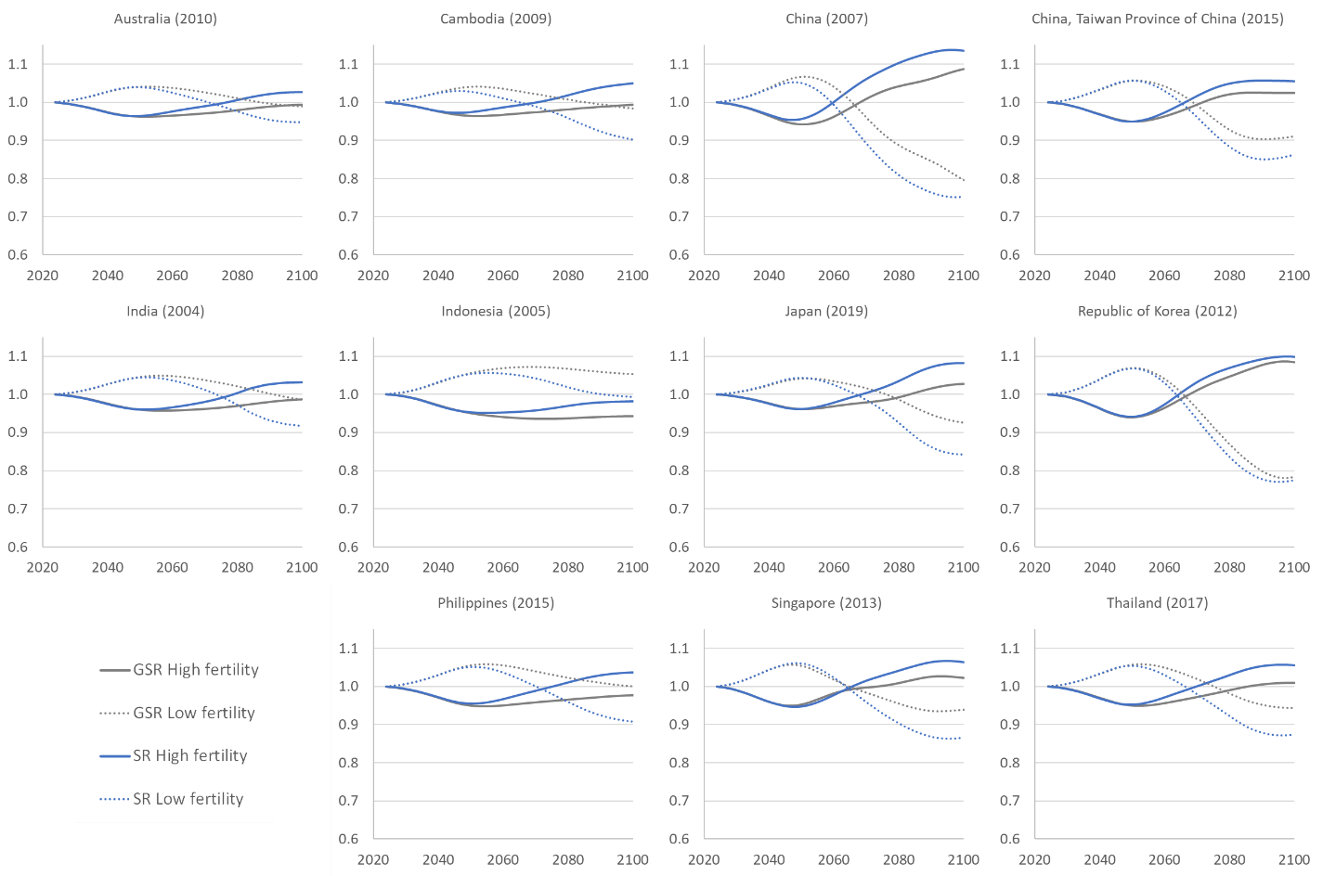
Would higher fert help?
Ratios of UN High fert and low fert SR and GSR to Middle fert.
For first 45-60 years, high fertility gives worse outcome.
Two measures, same result
Blue = Support ratio (labor inc only)
Grey = General support ratio

Slide 17
Would higher fert help?
Ratios of UN High fert and low fert SR and GSR to Middle fert.
For first 45-60 years, high fertility always gives worse outcome.
Solid lines: High fert
Dotted lines: Low fert
S. Korea
Lower fert gives higher SR, GSR
Higher fert big help after 2065

Slide 18
6. Intergenerational transfers, public and private
NTA countries transfer around 50% of GDP across age/generation, so primary uses differ greatly from primary income.
  In lower inc countries, redistribution is mostly through family
  In higher inc countries, mostly through public transfers.

Slide 19
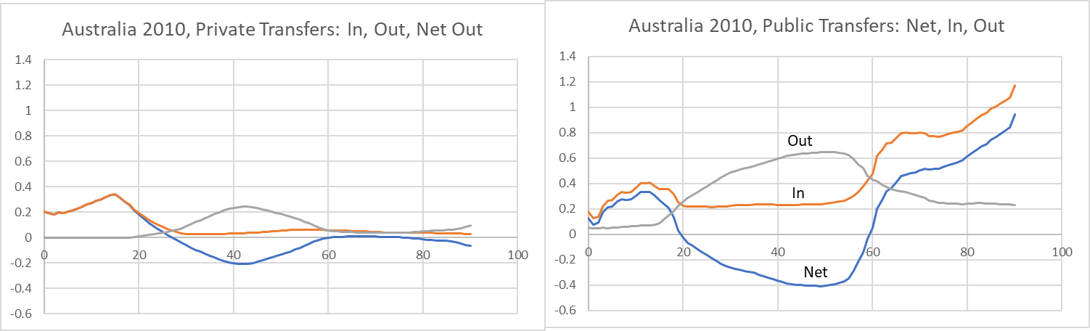
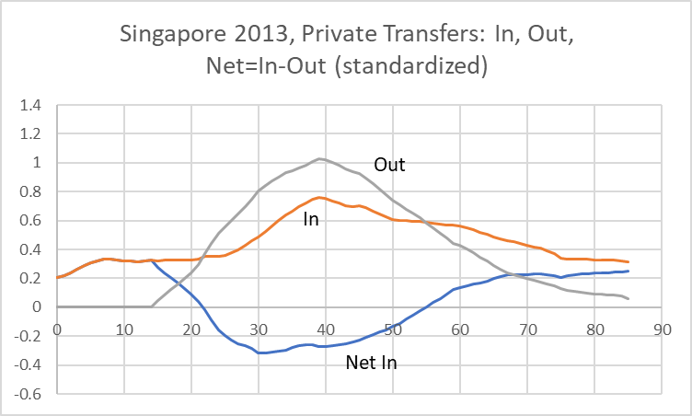
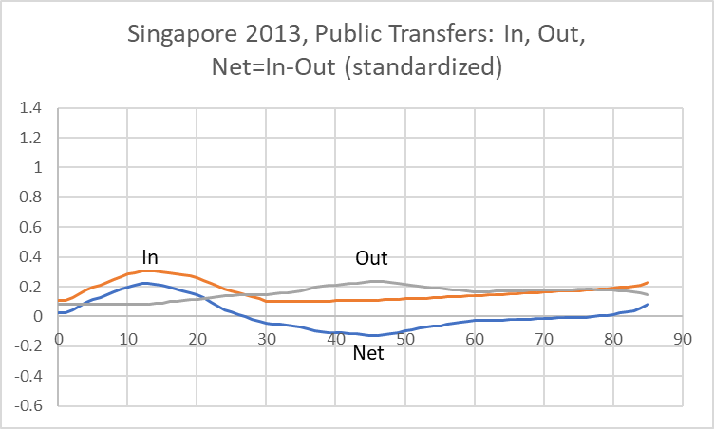
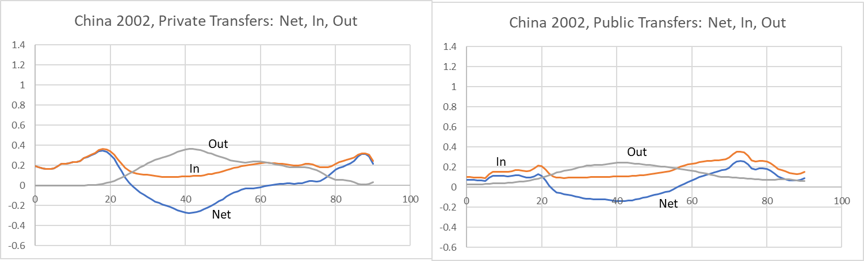
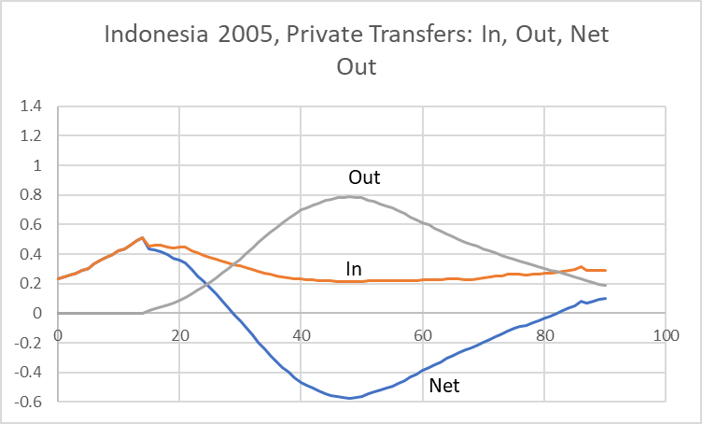
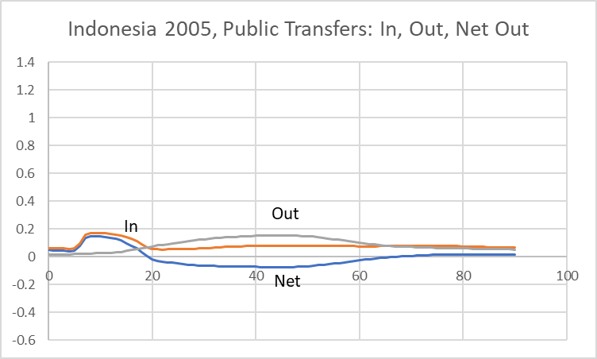
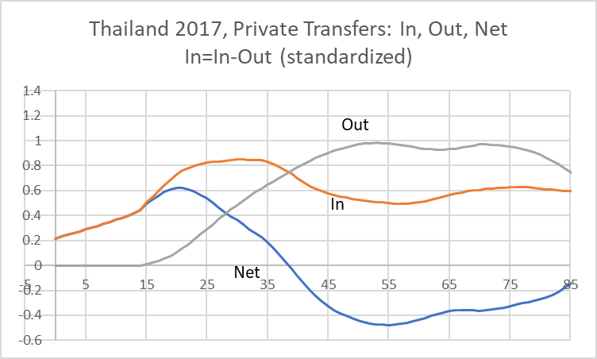
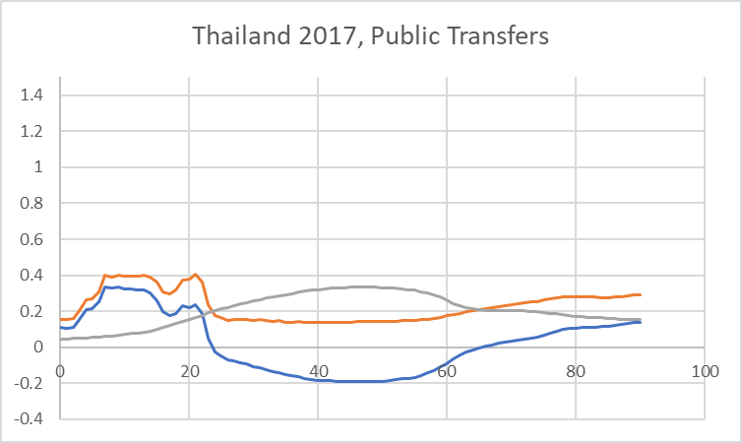
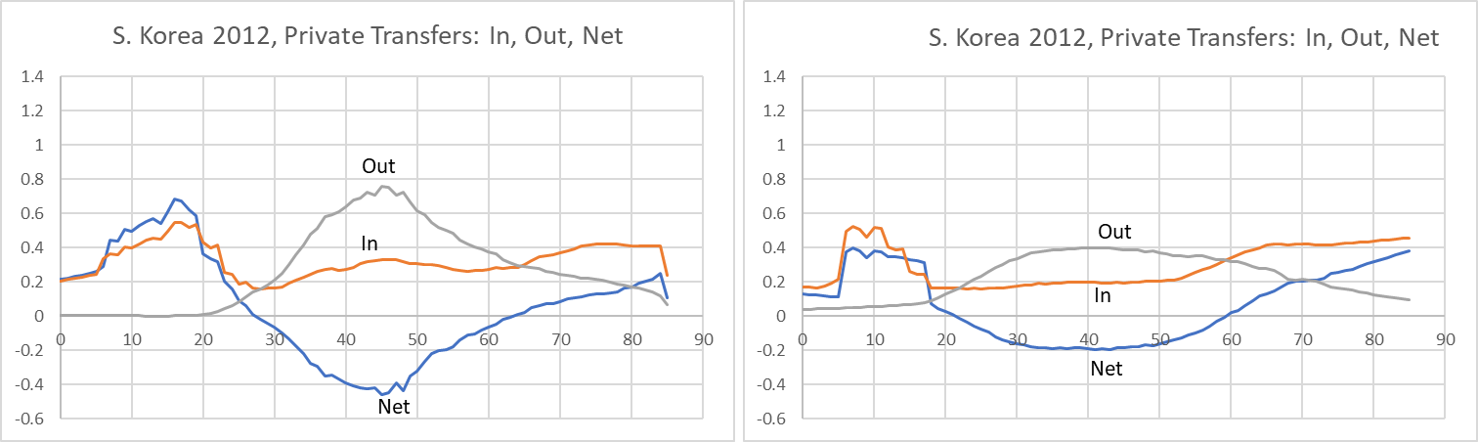
Public and Private Transfer Systems in Selected ESCAP Countries
Australia
Family
Public
Thailand
Family
Public

Slide 20
Public and Private Transfer Systems in Selected ESCAP Countries
Singapore
Family
Public

Slide 21
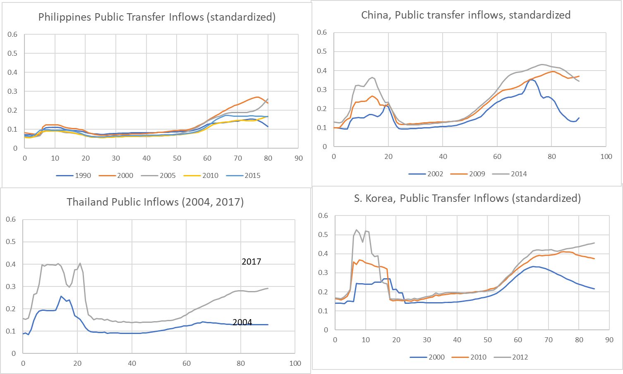
Longitudinal: Public transfer inflows for education and elderly rise
China 2002-2014
Thailand 2004-2017
S.Korea 2000-2012

Slide 22
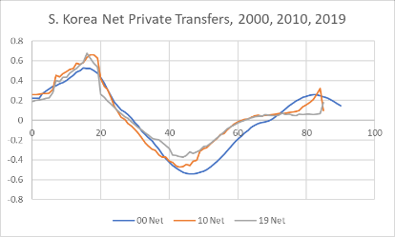
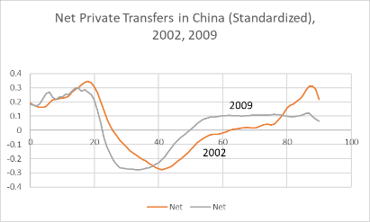
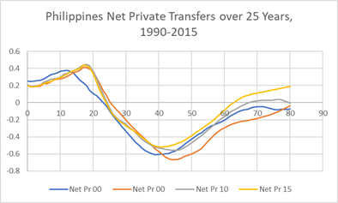
Longitudinal: Net private transfers over time
Rise to children
Rise or fall to elderly
Rapid econ gr shifts elder support to younger ages

Slide 23
7. Thoughts on policy
Slowing population growth will slow GDP growth correspondingly.
Individual economic wellbeing should continue upwards as productivity growth outweighs falling support ratios.
Big problem is pressures on public and familial transfer systems which will require reduced benefits and increased taxes/contributions.
  Maintaining transfers to elderly through increased taxes/family transfers is not sustainable due to deadweight loss and political conflict as populations age.
  Instead, elderly should retire later and save more arrive at old age with increased asset income. Greater inherited assets due to fewer siblings will help.
  Retirement age should rise mainly for higher income individuals with more costly benefits, longer lives, and better health, while protecting lower income people.
  Consider automatically stabilizing public pension systems as in Sweden and Germany.
In East Asian countries, private education spending per child is 2 to 3 times as great as public spending.
  This perpetuates inequalities intergenerationally.
  Raises costs to couples of childbearing.

Slide 24
END

