Slide 1


Harnessing Demographic Dividend in Nigeria: Evaluation of the Progress in the Implementation of the National Roadmap in Nigeria
Noah Olasehinde, Olanrewaju Olaniyan, Akanni Lawanson, Olabanji Awodumi, Oyeteju Odufuwa, Temitope Faronbi, and Andat Dasogot
13 March 2025
Presented during the 15th Global Meeting of the NTA Network @ Bangkok Thailand

Slide 2
Outline of Presentation
Introduction
DD Roadmaps in Nigeria
Methodology of the Evaluation
Results
Conclusion

Slide 3
How is the concept of demographic dividend shaping policy and practice?
“…demographic dividend lens offers a strategic basis for focusing and prioritizing investments in people in general and the youth in particular, in order to achieve sustainable development, inclusive economic growth, and to build "an integrated, prosperous and peaceful Africa, which is driven by its own citizens and representing a dynamic force in the international arena”
(African Union, 2016)
“In the next 50 years Africa’s biggest single asset but also its potential Achilles heel will be its youthful population. The upside risk of the youth population is their contribution to economic growth resulting in increased incomes and employment. The downside risk is the inability to provide gainful employment for them thus creating a potential source of instability.”
(Agenda 2063, First Ten-Year Implementation Plan 2014–2023, p. 127)

Slide 4
Introduction
Roadmaps for harnessing DD in Africa and Nigeria
A continental initiative, following AU Assembly Decision (Assembly/AU/Dec.601 (XXVI).
Contains key deliverables and milestones to be delivered over a given timeline.
Nigeria is a federation of 36 States and a Federal Capital Territory (FCT).
Creating and harnessing the demographic dividend (DD) in the country requires in-depth consideration of the peculiarity of each federating unit.
The heterogeneity necessitates that distinct roadmap be prepared for national and each subnational.
Developed in July 2017 with 5-year implementation cycle.

Slide 5
The working collaboration
NTA Nigeria
(Health Policy Training and Research Programme – HPTRP, Univ. of Ibadan)
United Nations Population Fund (UNFPA Nigeria)
Ministries of Economic Planning (National and Subnational)

Slide 6
Timelines of Various DD Roadmaps in Nigeria
Roadmap | When Developed?
African Union (AU) | January 2017
Nigeria (National) | July 2017
Lagos State | October 2018
Kaduna State | September 2019
FCT | October 2019
Ogun State | November 2020
Ondo State | December 2020
Sokoto State | May 2021
Akwa Ibom State | November 2023

Slide 7
African Union’s Agenda 2063: Four pillars in AU Roadmap on Demographic Dividend, 2017

Slide 8
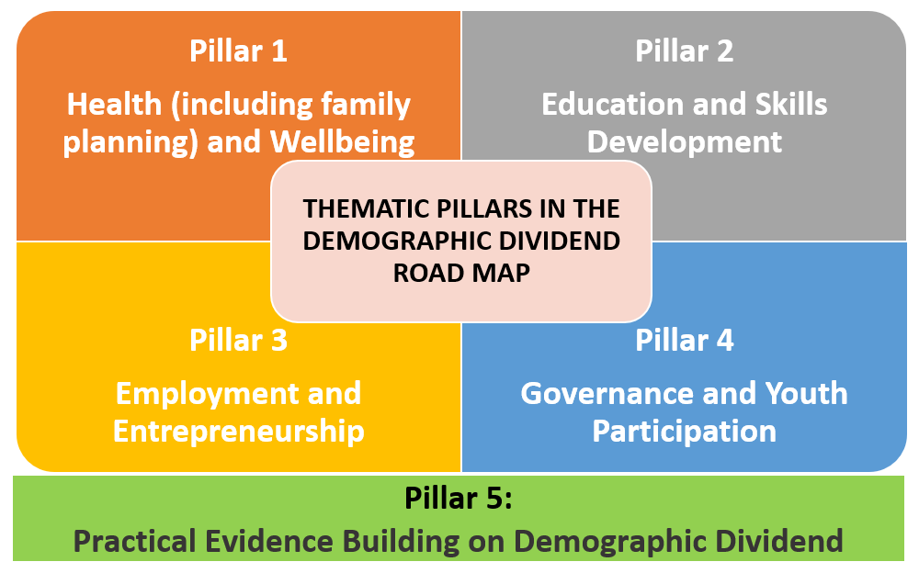
Thematic Pillars in the Nigerian DD Roadmap

Slide 9
Linkages among the DDMI (Pillars of the Nigeria DD Roadmap), AU Roadmap, UNFPA WCARO Programming Guide and SDGs
Nigeria Roadmap/ DDMI Dimensions | AU Roadmap | UNFPA WCARO Programming Guide | SDGs
Pillar/Dimension 1: Health and Wellbeing | Pillar 3: Health and Well-being | Axis 1: Demography and Human Development Axis 4: Health and Family Planning Axis 8: Socioeconomic Environment | Goal 2, 3,5, 6, 7, 12, 13
Pillar/Dimension 2: Education and Skill Development | Pillar 2: Education and Skill Development | Axis 1: Demography and Human Development Axis 3: Education Axis 8: Socioeconomic Environment | Goal 1, 4, 5, 8
Pillar/Dimension 3: Employment and Entrepreneurship | Pillar 1: Employment and Entrepreneurship | Axis 1: Demography and Human Development Axis 5: Youth Empowerment Axis 8: Socioeconomic Environment | Goal 1, 2, 5, 8, 9, 10, 12
Pillar/Dimension 4: Governance and Youth Participation | Pillar 4: Rights, Governance and Youth Empowerment | Axis 1: Demography and Human Development Axis 6: Gender Equity Axis 7: Rights and Governance | Goal 5, 9, 10, 11, 13, 16
Pillar/Dimension 5: Practical Evidence-Building | Pillar 2: Education and Skill Development | Axis 1: Demography and Human Development | Goal 11, 17

Slide 10
29 67
Thematic Pillars | Investment | Activities
Health and Wellbeing
6
17
Education and Skills Development
4
17
Employment and Entrepreneurship
8
23
Governance and Youth Participation
7
4
10
Practical Evidence-Building on DD
Five thematic pillars in the Roadmap for harnessing DD in Nigeria
Source: Roadmap for harnessing the Demographic Dividends in Nigeria

Slide 11
Methodology
The Demographic Dividend Monitoring Index (DDMI) is…
the Monitoring and Evaluation (M&E) framework computed from signature outcome indicators to directly monitor the thematic pillars of the national roadmap.
provides a performance matrix to identify areas of strengths and areas for more policy attention.
tracks the progress made towards creating and harnessing the DD at the baseline (2016) and Endline (2022).
reinforces the country’s efforts towards achieving the:
AU Agenda (2063)
Global Agenda (2030- SDGs).

Slide 12
Steps in the construction of DDMI
S/N | Dimension | Domain | Sub-Domain | Indicators
1 | Health and Wellbeing | 7 | 4 | 21
2 | Education and Skill Development | 3 | 7 | 20
3 | Employment and Entrepreneurship | 4 | 2 | 14
4 | Governance and Youth Participation | 5 | 3 | 26
5 | Practical Evidence-Building on DD | 5 | - | 9
 | Total | 24 | 16 | 90

Slide 13
Data and Sources
Data for the indicators utilized were sourced from both domestic and international databases for 2015/16 and 2021/22.
These are official databases that are reliable, publicly available and easily accessible (DHS, MICS, Digest of Education Statistics, WASH-NORM – NBS, CBN, Worldbank, etc)
Selected indicators and data are validated through the National Transfer Account Global Network.
All indicators are adjusted and normalized to ensure that they all have common units

Slide 14
Weights
Weights are assigned to Dimensions, Domains, Subdomains and Indicators based on:
relative importance in DD achievement
peculiarity to the entity context and
closeness to the Agenda 2030 and 2063
Dimension | 1 | 2 | 3 | 4 | 5 | Total
Weight | 28 | 22 | 35 | 10 | 5 | 100
Range: DDMI ranges from worst (0) to best (100)

Slide 15
Classification of the Performance of the various indicators with the DDMI
Index Score | Performance
81 - 100 | Optimal progress
61 - 80 | Good progress
41 - 60 | Average progress (intervention needs to be scaled up)
21 - 40 | Deficient (Intervention required)
0 - 20 | Critically Deficient (Serious Intervention required)

Slide 16
Health and Wellbeing
2016
2022
Deficient
Deficient

Slide 17
Education and Skill Development
2016
2022
Average
Average

Slide 18
Employment and Entrepreneurship
2016
2022
Deficient
Deficient

Slide 19
Governance and Youth Participation
2016
2022
Average
Average

Slide 20
Practical Evidence Building on DD
2016
2022
Critically Deficient
Critically Deficient

Slide 21
DEMOGRAPHIC DIVIDEND
2016
2022
37.4
38.7
Deficient
Deficient

Slide 22
Methodology of the Index
S/N | Dimension | 2016 | 2022 | Remark
1 | Health and wellbeing | 32.7 | 39.6 | ↑ 21%
2 | Education and Skill Development | 45.1 | 43.6 | ↓ 3%
3 | Employment and Entrepreneurship | 34.2 | 38.3 | ↑ 12%
4 | Governance and Youth Participation | 51.1 | 40.6 | ↓ 20%
5 | Practical Evidence-Building on DD | 8.1 | 10.6 | ↑ 30%
 | DD | 37.4 | 38.7 | ↑ 3%

Slide 23
CONCLUSION
There is progress in the overall performance of the National Roadmap though minimal.
HPTRP/UNFPA collaboration is yielding much fruits as Practical Evidence-Building on DD leads the pack
Some progress have been recorded Health and Wellbeing and Employment and Entrepreneurship.
Efforts are still far from enough in education and skill development and governance and youth participation.
Work in progress – FGD for triangulation

Slide 24
Thank you for your attention
Health Policy Training and Research Programme (HPTRP)
University of Ibadan, Nigeria

