Slide 1


Gendered Analysis of Economic Production and Consumption in Sri Lanka: Insights from the National Time Transfer Accounts (NTTA)
Unveiling the hidden contributions of women to Sri Lanka’s economy
Lakshman Dissanayake, PhD
Emeritus Professor of Demography
University of Colombo

Slide 2
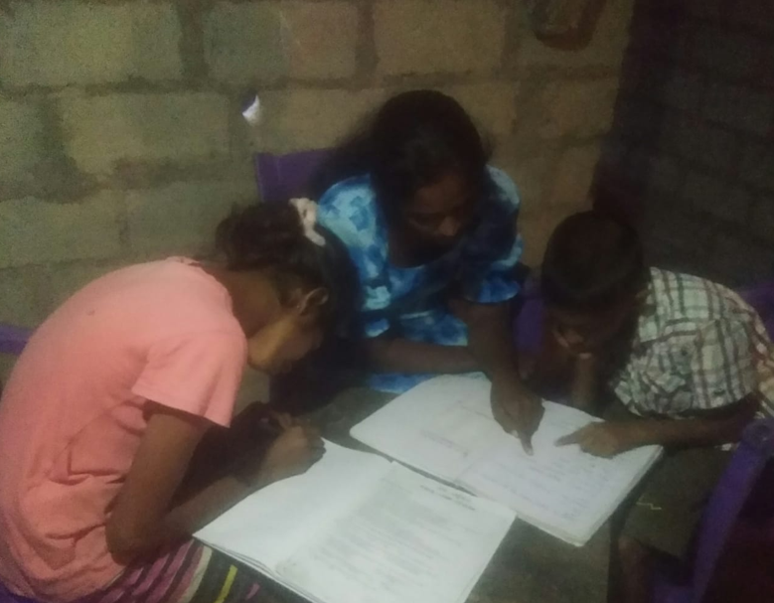
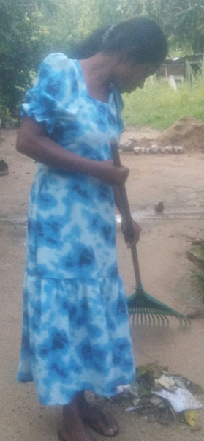
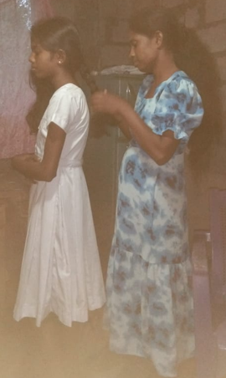
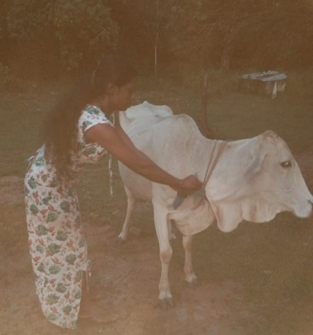
Introduction
Imagine a bustling household in Sri Lanka—before dawn breaks, women are already at work. They cook, clean, care for children, and support the elderly. This invisible labor sustains families, yet it remains uncounted in official economic measures.
Today, I will share insights from the National Time Transfer Accounts (NTTA) that uncover the hidden contributions of women to Sri Lanka’s economy and why these findings should reshape our understanding of national productivity and policy design.

Slide 3

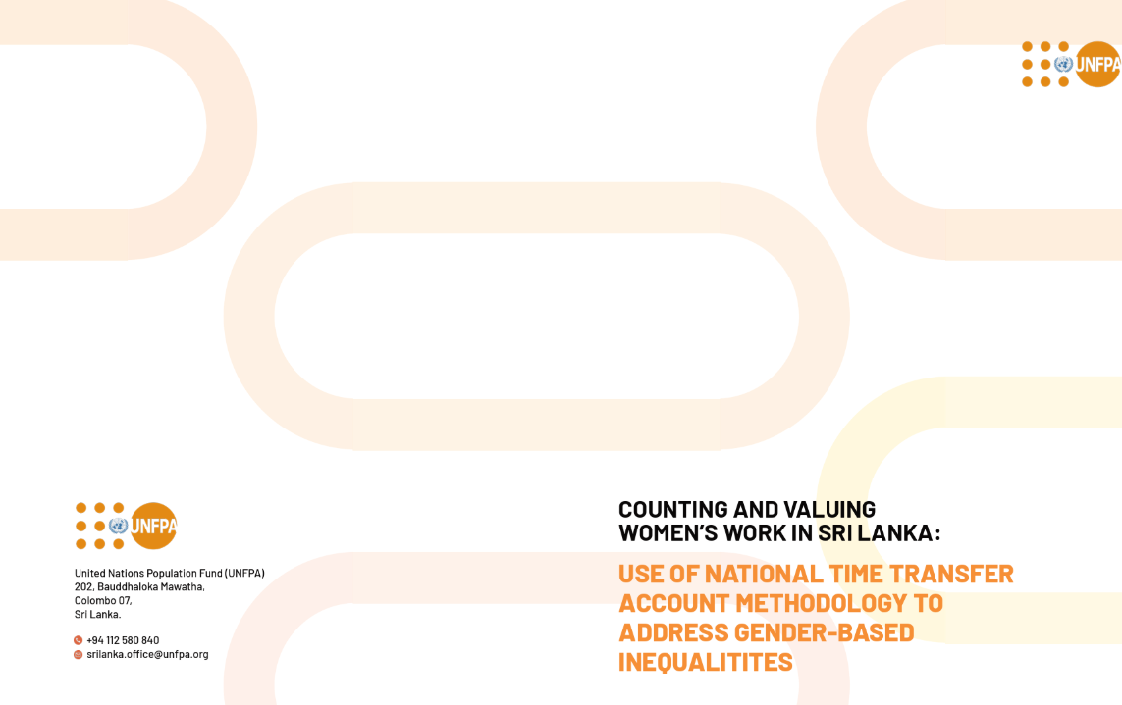
Context
  2021 National Transfer Accounts (NTA) study as a base.
  Adding a gendered perspective using innovative 'Counting Women’s Work Project' methodology.

Slide 4
Labour Force Participation:
📉 Persistent Decline & Widening Gender Gap
Female labor force participation remains low despite high education levels.
2013–2023 Decline:
Women: ↓11.6%
Men: ↓9.4%
Economy failing to absorb the working-age population.
Source: Department of Census and Statistics, various Labour Force Surveys

Slide 5
📊 The Gender Gap: High Education, Low Employment
Key Message:
Women in Sri Lanka attain higher education at greater rates than men (A/L & above: Female 10.2% vs. Male 5.8%).
Despite this, their employment remains significantly lower than men (Employed Women: ~2.7 million vs. Employed Men: ~5.3 million).
This gap highlights barriers to women's workforce participation, including structural constraints (Inflexible work schedules and employer preferences for men in key roles limit women's employment opportunities, worsened by a lack of flexible work policies), unpaid care work, and lack of access to decent employment opportunities.

Slide 6
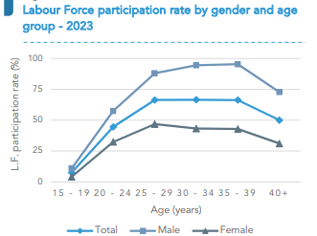

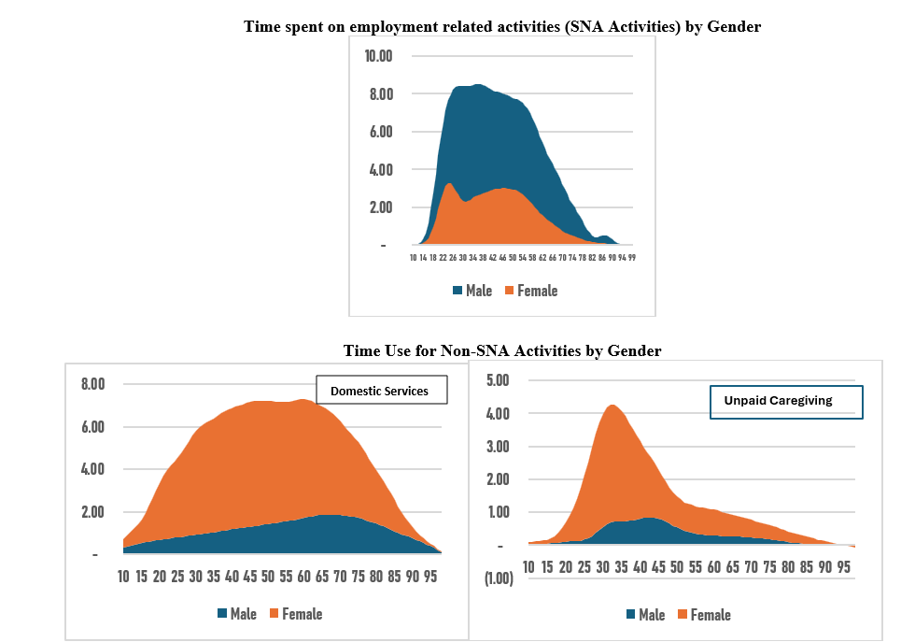
Gender Inequality in Time Use
Key Message: Women’s time is disproportionately spent on unpaid work, limiting their participation in formal labor markets.
Young women’s burden—Their early engagement in household tasks restricts educational and career opportunities.
Men’s time use: "While men devote more time to market work, women invest heavily in household production—at the cost of their economic independence."
A valid question: "What would our GDP look like if we valued every hour of unpaid care work?"
Source: Author’s calculation using Time Use Survey data, 2017

Slide 7


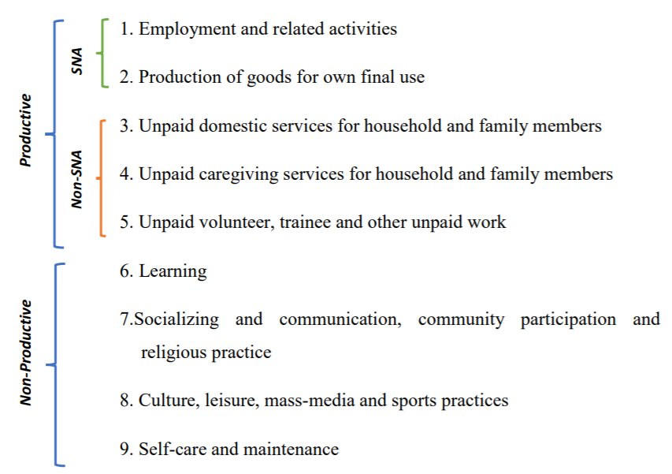



The Invisible Economy
Key Message: Unpaid care and household work make up a substantial share of the economy—yet it is absent from national statistics.
Share the 36% of GDP figure from 2017—emphasizing how massive this hidden contribution is.
"If unpaid care work were a formal industry, it would be one of the largest sectors in our economy."
"Women perform the lion’s share of this work, yet their contribution is often dismissed as ‘natural’ rather than economic."

Slide 8

Market Production
Source: Author’s calculation using Time Use Survey data, 2017 and Labour Force Survey data, 2017
Note: Profiles are standardized by dividing through by the average labour income for 30- to 49-year-old (‘peak labour income’); this average equal one income unit.
Men dominate market production, while women's contribution remains lower due to their heavy involvement in household production, which is excluded from SNA measurements.

Slide 9
🔹 Key Findings from Binary Logistic Regression
Factor | Effect on Participation
Education | Higher education ≠ higher participation; primary & secondary ↓ odds significantly.
Age | Younger women (15-24) less likely to participate due to education & inexperience.
Marital Status | Married & widowed women ↑ participation due to financial obligations.
Sector | Urban & rural women ↓ participation vs. estate sector due to job accessibility.
Ethnicity | Sinhalese & Tamil women ↑ participation compared to other ethnic groups.
🔹 Key Conclusion
Education is the most influential factor—
Lack of skills for formal employment;
Preference for domestic responsibilities over low-paying jobs
Addressing gender disparities in education & employment can improve female labor force participation.

Slide 10
Women’s Education vs. Workforce Participation – The Paradox
📚 Free & Accessible Education
Tuition-free schooling with free textbooks & uniforms
Tuition-free university education with government bursaries for low-income students
🚧 Barriers to Workforce Participation
Limited Decent Employment → Many women remain housewives
Preference for Teaching → Shorter work hours allow household responsibilities
Field of Study Mismatch → Majority in Social Sciences & Arts, fewer in STEM
🎯 Call to Action: Expand decent job opportunities & encourage women in STEM to bridge the gap!

Slide 11

Non-Market Production
Source: Author’s calculation using Time Use Survey data, 2017 and Labour Force Survey data, 2017
Note: Profiles are standardized by dividing through by the average labour income for 30- to 49-year-old (‘peak labour income’); this average equal one income unit.
Figure shows that women's household production (or Non-Market Production), including domestic and care work, is about four times higher than men's throughout the life cycle, presenting its monetary value for the first time in Sri Lanka.

Slide 12

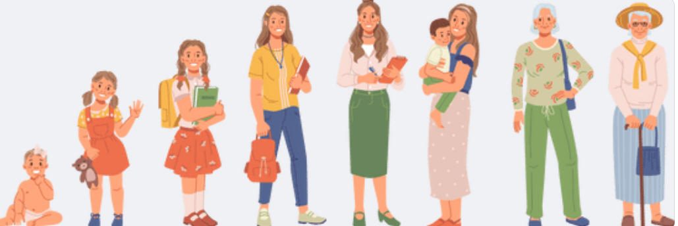
Revealing the Full Picture: Boosting Life Cycle Surplus with Home Production
Impact of Home Production:
  Adding unpaid care and domestic work significantly increases life cycle surplus, especially for women between ages 20 to 75.
  For women, lower labor market participation leads to a persistent deficit, as consumption exceeds earned income.
  Men's involvement in household production does not substantially affect their life cycle surplus.
Rethinking Aging Costs:
  When market production is considered alone, both children and older adults generate deficits, relying on transfers from family or society.
  Including home production reduces the perceived cost of older adults as they continue to provide unpaid care and domestic work.
  This broader perspective challenges traditional views on the financial impact of an aging population
Takeaway Message: Increasing women's labor force participation is crucial to balancing the life cycle surplus and ensuring sustainable economic contributions across all age groups
Source: Author’s calculation using Time Use Survey data, 2017 and Labour Force Survey data, 2017

Slide 13

Policy Blind Spots
Key Message: Current economic frameworks fail to capture the real value of household production, leading to misguided policies.
It ignores unpaid work and thus distorts labor force participation rates:
  "Women are not 'missing' from the workforce—they’re already working tirelessly, just without recognition."
This misrepresentation affects policies targeting female labor force participation:
  "Without reducing the unpaid work burden, we cannot expect women to increase their market work."

Slide 14

Policy Recommendations
Call to Action: Recognizing, Reducing & Redistributing Unpaid Work
🚀 Recognize unpaid care work in national economic indicators to ensure policies reflect reality.
🏡 Reduce the burden of unpaid work by investing in care infrastructure (childcare, eldercare).
👨‍👩‍👧 Promoting equal household work empowers women and boosts economic growth..
💼 Enable Women’s Workforce Participation by creating pathways for decent employment in the formal sector, ensuring fair wages, job security, and career growth.
🔎 Policy Transformation: Time-use surveys, social protection reforms, and gender-inclusive economic strategies are critical.
🛠️ The Future is Inclusive: A thriving economy requires harnessing the full potential of women’s contributions—both paid and unpaid.
"It’s time to shift from economic invisibility to economic empowerment!"

Slide 15


Empowering Women for Sustainable Growth 💼
Achieving SDG 8 (Decent Work and Economic Growth) requires recognizing and valuing unpaid care and household work. By redistributing responsibilities and enhancing women’s participation in the formal workforce, we unlock economic potential, drive inclusive growth, and build a more equitable future for all.

Slide 16

Thank You!

