Slide 1

National Time Transfers Accounts for Colombia
15th NTA Global Meeting
Angela Casas Valencia
March 13, 2025

Slide 2

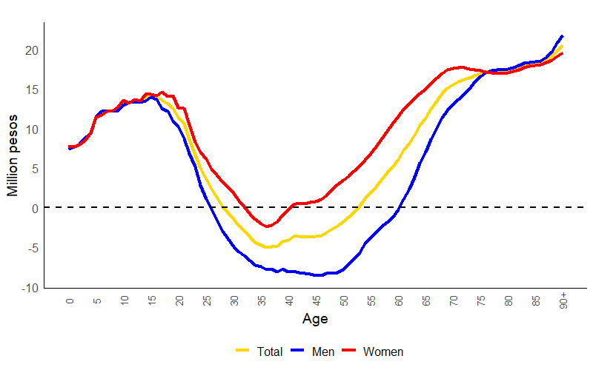


Lifecycle deficit by age and sex
Colombia
2021
For 2021, the economic life cycle for Colombia shows its highest deficit point (consumption greater than labor income) in the population aged 90, with 20.5 million pesos, while age 36 is the age with the highest surplus, at 5.1 million pesos.
In 2021, the transition to surplus occurs in the age range of 29 to 52 years.
While for men the surplus stage spans from age 26 to 60, for women it is between ages 33 and 40.
  The minimum deficit occurs at age 46 for men, at 8.6 million pesos.
  For women, the minimum deficit is at age 36, at 2.5 million pesos.
Source: DANE, Cuentas Nacionales de Transferencia

Slide 3
National Time Transfer Accounts
NTTA
The National Time Transfer Accounts (NTTA) extend the focus of the NTA to the measurement of the gender economy, including unpaid household and care activities.
The NTTA record the production, consumption, and transfers of services generated by unpaid work, differentiated by age and sex.
Source: DANE, Cuentas Nacionales de Transferencia de Tiempo 2021

Slide 4
National Time Transfer Accounts
Variables
NTTA Variables
Unpaid household service work
Production
Consumption
Transfers
Inflows
Outflows
Time spent on unpaid household service work activities
Imputed value of time consumed on unpaid household service work by household and non-household members
Flows of transferred time between household members or between individuals.

Slide 5
National Time Transfer Accounts
Household production activity groups
NTTA Activities
Household activities
1. Cleaning
2. Laundry
3. Cooking
4. Household maintenance and repair
5. Lawn and garden care
6. Household management
7. Pet care
8- Purchasing goods and services
9. Travel
Care
10. Childcare
11. Care for adults and older persons
12. Volunteering
Care activities for both children and adults can be for household members or for members of other households

Slide 6
National Time Transfers Accounts
Data sources
National Time-use Survey
It is nationally representative.
It covers the same period as comparable NTA estimates (2021).
It has a sample of 45.000 households.

Slide 7

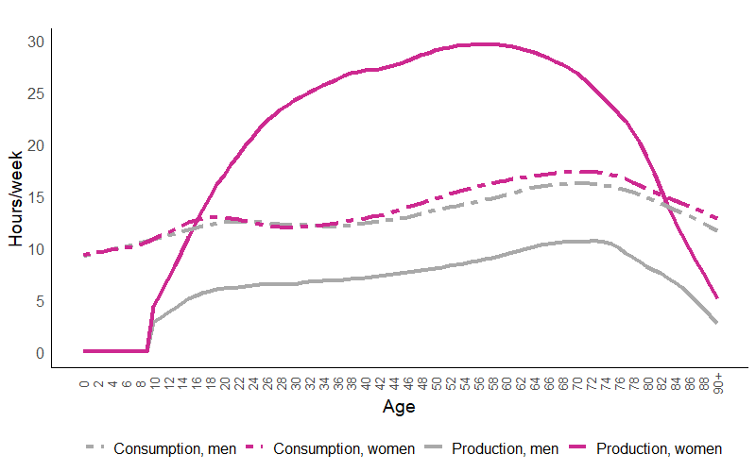
Production and consumption of unpaid household activities
Colombia
2021
Time spent on household activities is similar between men and women, with women averaging 13.8 hours per week and men 13.2 hours per week.
Women reach their highest level of dedication to household activities at age 57, with 29.6 hours per week, while men reach their peak later, at age 72, with 10.7 hours.
Between ages 27 and 59, women spend an average of 19.7 more hours on household activities than men.
Source: DANE, Cuentas Nacionales de Transferencia de Tiempo

Slide 8

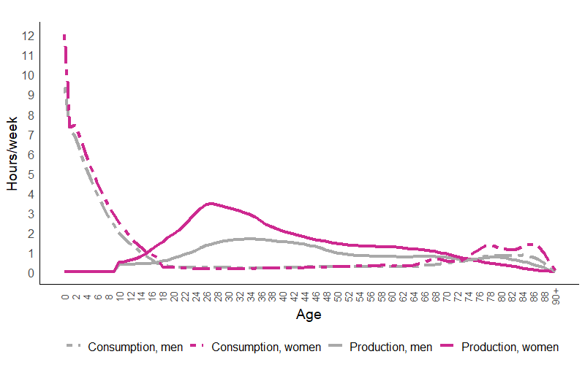



Girls under one year old receive 12 hours of care per week, while boys of the same age receive 9.4 hours.
The amount of care received decreases with age, dropping to 0.4 hours per week between ages 15 and 26, and to 0.8 hours for women and 0.5 hours for men over the age of 60.
Women produce 0.5 hours more unpaid care on average than men, reaching their peak at age 27 with 3.5 hours per week. Between ages 15 and 59, women dedicate an average of 2.1 hours per week to care, which decreases to 0.6 hours for those over 60.
Men reach their highest level of care production at age 34 with 1.7 hours per week and dedicate an average of 1.3 hours between ages 27 and 59.
Production and consumption of care, by age and sex
Colombia
2021
Source: DANE, Cuentas Nacionales de Transferencia de Tiempo

Slide 9

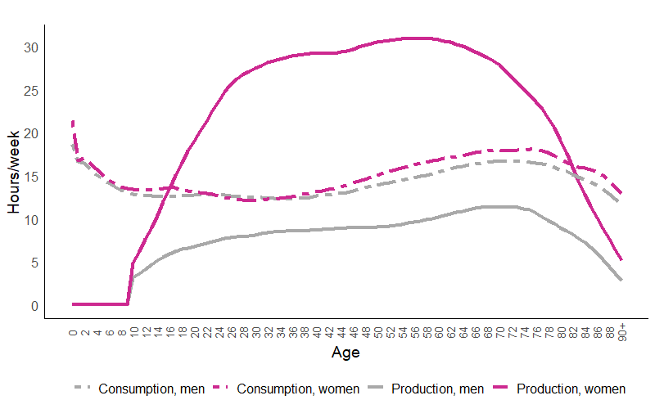


Production and consumption of NTTA activities (unpaid household and care activities) by age and sex
Colombia
2021
Women spend an average of 21 hours per week on household and care activities, while men spend 7.5 hours.
Women consume 0.9 more hours of NTTA activities compared to men.
Girls under 15 years old consume an average of 15 hours, while boys consume 14.3 hours. In the 60 and older age group, women consume an average of 16.8 hours, and men 15.5 hours.
Between ages 15 and 26, women consume 0.4 more hours of care activities than men; this difference increases to 0.6 hours between ages 27 and 59.
Source: DANE, Cuentas Nacionales de Transferencia de Tiempo

Slide 10

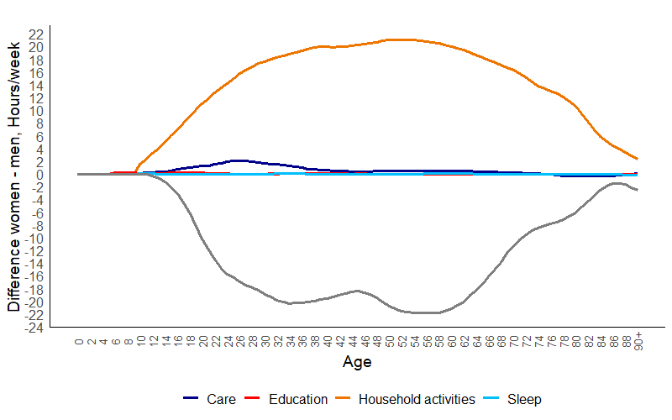

Difference between women and men in time spent per NTTA activity (hours per week) by age
Colombia
2021
Women spend more time than men on household activities, with a difference of 13 hours. This gap reaches its peak at age 52, where women spend 21 more hours per week.
The difference in dedication to paid work is the opposite of household activities. Men spend more time than women on labor market activities, with the largest gap of around 22 more hours per week at age 56. On average, men spend 11.8 more hours than women on paid work in the labor market.
Source: DANE, Cuentas Nacionales de Transferencia de Tiempo

Slide 11
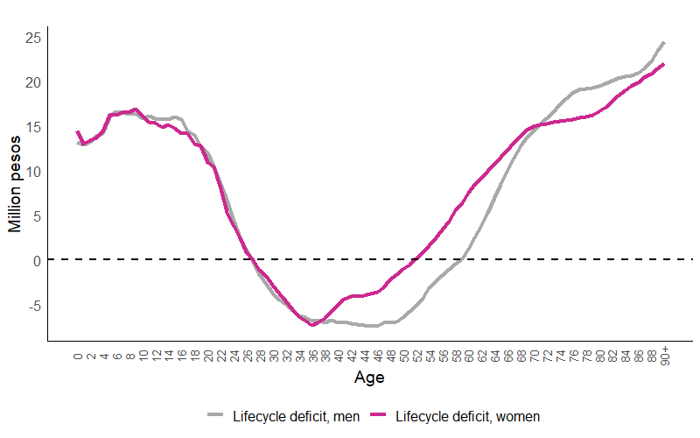
Lifecycle deficit NTA + NTTA by age and sex
Colombia
2021
For women, the surplus stage in the labor market is between 33 and 40 years old. When considering unpaid household and care activities, this stage extends from 27 to 51 years old.
For men, the surplus stage in the labour market takes place between the ages of 26 and 60. When integrating unpaid home and care activities, this window is between 27 and 58 years old.
Source: DANE, Cuentas Nacionales de Transferencia de Tiempo

Slide 12


National Time Transfers Accounts
Colombia
Q&A
apcasasv@dane.gov.co

Slide 13
National Time Transfers Accounts for Colombia
15th NTA Global Meeting
March 2025

