Slide 1



The Age Orientation of European Welfare States
Bernhard Binder-Hammer, Alexia Fürnkranz-Prskawetz
The 15th Global Meeting of the NTA Network, March 13, 2025
The research received funding from the Jubiläumsfonds of the Austrian National Bank under project no. 18465 and from the European Union’s research and innovation programme under Grant agreement no 101095175 (ww.ub.edu/sustainwell-eu-project)

Slide 2
Motivation
How strongly does the governemnt redistribute between age or income groups?
Analysing redistribution between age and income groups: Hammer, B., Christl, M. & De Poli, S. (2023). Public redistribution in Europe: Between generations or income groups? The Journal of the Economics of Ageing. https://doi.org/10.1016/j.jeoa.2022.100426
=> based only on survey data
National Inclusion Accounts: Integrating the analysis of public transfers by age and income quintiles into the NTA framework
=> adjustment to aggregates

Slide 3
Goal
Developing indicators and graphs to measure, illustrate and analyse public redistribution between age and income groups in Europe

Slide 4
NTA database for in Europe
EUROSTAT provides harmonized aggregate data for all European countries:
European System of Accounts
EU-SILC (income and living conditions)
EUROMOD (tax-benefit simulation model)
Household Budget Survey (Consumption)
Household Finance and Consumption Survey (assets)
NTA based on Eurostat data:
AGENTA project (https://dataexplorer.wittgensteincentre.org/nta/)
SUSTAINWELL project
=> NTA for all EU countries from 2008 to 2022

Slide 5
NTA database for in Europe
Limitations of ESA and European microdata for analysis by income quintiles
Limited number of obervations = limiting breakdown
=> aggregation of age groups, 25-39; 40-64; 65+
Asset income of low quality => age profiles ok, bias if analysed by income quintiles
Not all particularities of countries fit into highly standardised data; Unclear distinction between public and private transfers for occupational pensions in DK, NL, SE

Slide 6
Variables
Available variables for analysis by income quartile/quintile (good quality in survey + aggregate):
Labour income (income form employment and self-employment)
Taxes on labour income
Social benefits in cash
Only in survey:
Equivalised household income

Slide 7
1. Public benefits by quartile of equivalised household income

Slide 8
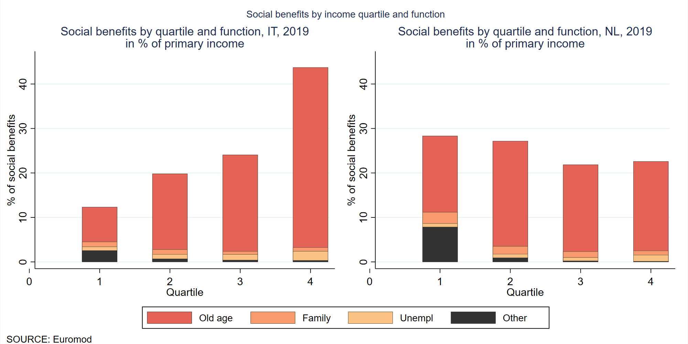
Young working age: income quartiles

Slide 9
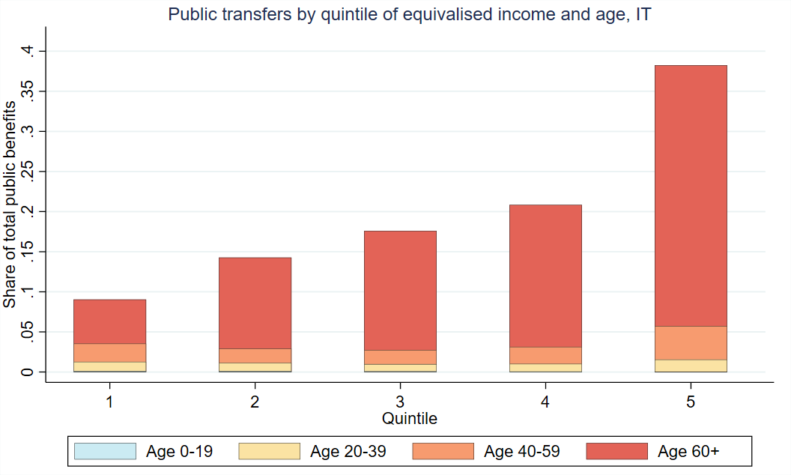
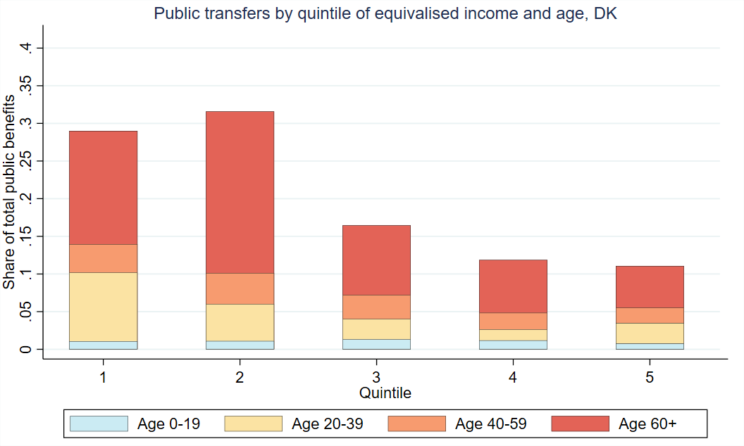
Public cash transfers by income quintile
Italy
Denmark

Slide 10
Income, taxes and social benefits
by age and quartile of individual income

Slide 11
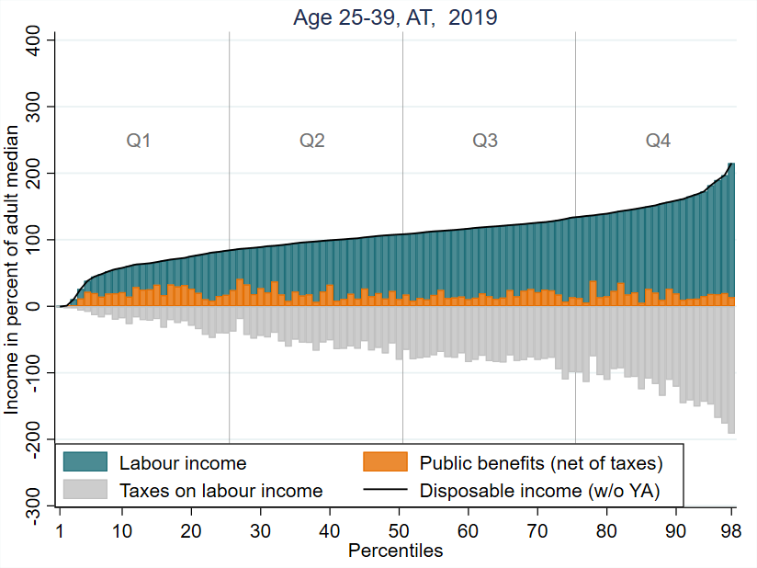
Percentile plots

Slide 12
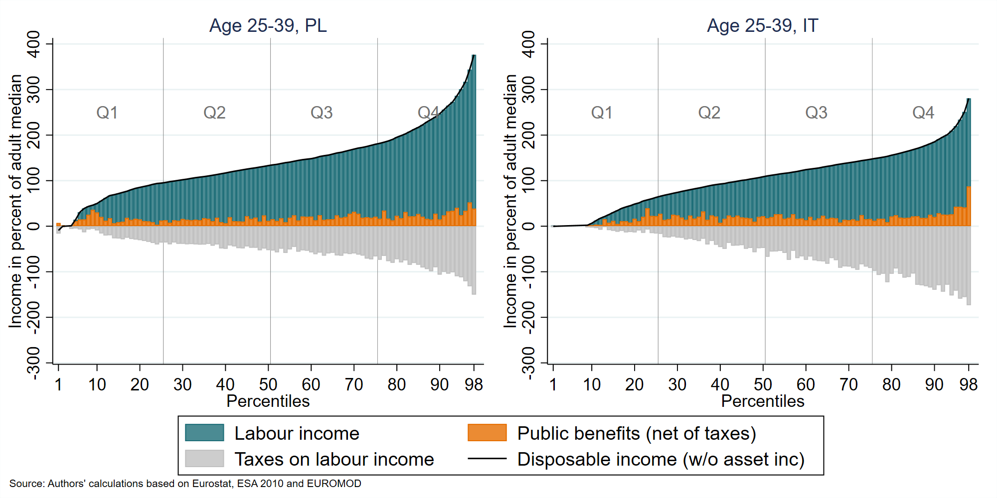
Distribution of income and its components: age group 25 - 39

Slide 13
Distribution of income and its components: age group 25 - 39

Slide 14
Income quartiles
Age-specific income quartiles (age 25-39) in percent of total median |  | median in % | in % of total
 | 1st | 2nd (median) | 3rd
Austria (AT) | 79 | 106 | 132
Italy (IT) | 55 | 98 | 140
Poland (PL) | 88 | 123 | 170
Sweden (SE) | 73 | 110 | 141
In Eastern Europe income of the 25-39-year-old is higher relative to older age groups
High share of young adults with no/little income in Italy (and Spain and Greece)

Slide 15
Average income, taxes and social benefits
by age and income quartile

Slide 16
Income components at Q1

Slide 17
Income components at Q1 in % of adult median
 | Disposable Income | Net employment income | Net social benefits
Country | income | income | benefits
AT | 51 | 32 | 18
IT | 21 | 13 | 7
PL | 50 | 38 | 12
SE | 48 | 24 | 23
Low income of the poorest quarter is a combined effect of little employment income and low social benefits

Slide 18
Retirees (age 65+)

Slide 19
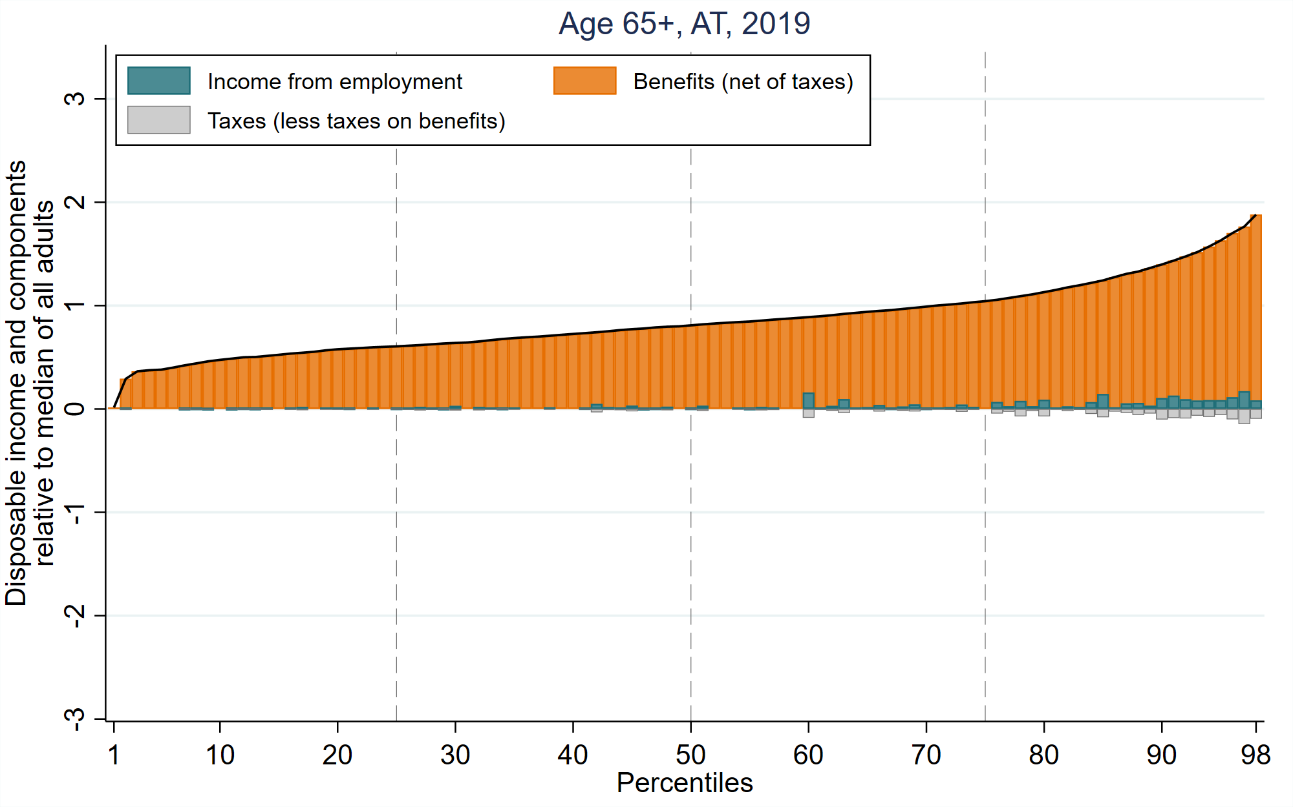
Old age: income by quartile

Slide 20
Old age: income components
 | Age-specific income quartiles
 | in percent of adult median
Country | 1st | 2nd (median) | 3rd
AT | 58 | 78 | 105
IT | 57 | 88 | 129
PL | 53 | 76 | 97
Larger distribution to income rich pensioners in Central and Southern European countries

Slide 21
Summary
Biggest difference between welfare states is how much they redstribute to income-rich pensioners Disagregating NTA by income opens a new world:
Integration of demography into inequality research
Better understanding of public redistirbution
Identifcation of reform needs and potential

