Slide 1
Changing Patterns of Female Employment in Poland – paid vs unpaid work
Agnieszka Chłoń-Domińczak and Paweł Strzelecki

Slide 2
Population ageing and female employment
Population ageing in Poland leads to the gradual shrinking of the working-age population
Maintaining potential on the labour market requires mobilisation of the underrepresented groups, including women in the childbearing age
Employment rate among females aged 25-49 in Poland increased between 2013 and 2023 from 72.0% to 82.8%, faster compared to the EU,
  for females with secondary education it increased from 66.2% to 75%
  for females with higher education it increased from 85% to 92%
The time use survey initial results show decline of the gennder gap in work and family obligations

Slide 3
Research problem
Using Age-Period-Cohort model we investigate the effects on the
  employment rate of women aged 25-49 with higher and below higher
  Share of inactive women aged 25-49 due to care responsibilities with higher and below higher education
  between 2003 and 2023 using Labour Force Survey data
We aim to identify the main drivers affecting the observed changes in economic activity of women in childbearing age

Slide 4
Change in the time spent on selected groups of activities for people aged 15 or more between 2013 and 2023 (in minutes)
Between 2013 and 2023
women more than men increased time spent on employment activities,
men more than women increased time spent on household and family care

Slide 5
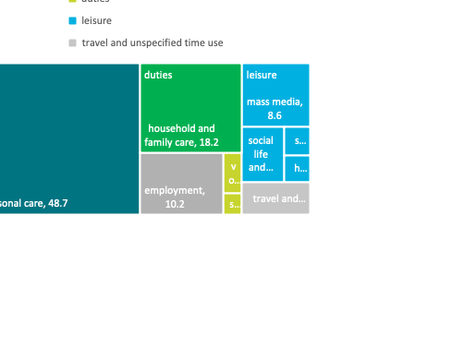
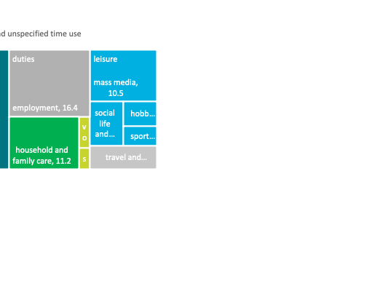
Structure of the day of women and men aged 15 or more in Poland in 2023 (%)
  The gender differences remain:
    Household and family care: 18.2% vs 11.2% of a day
    Employment: 10.2% vs 16.4% of a day

Slide 6
Barriers in the childcare are smaller

Slide 7
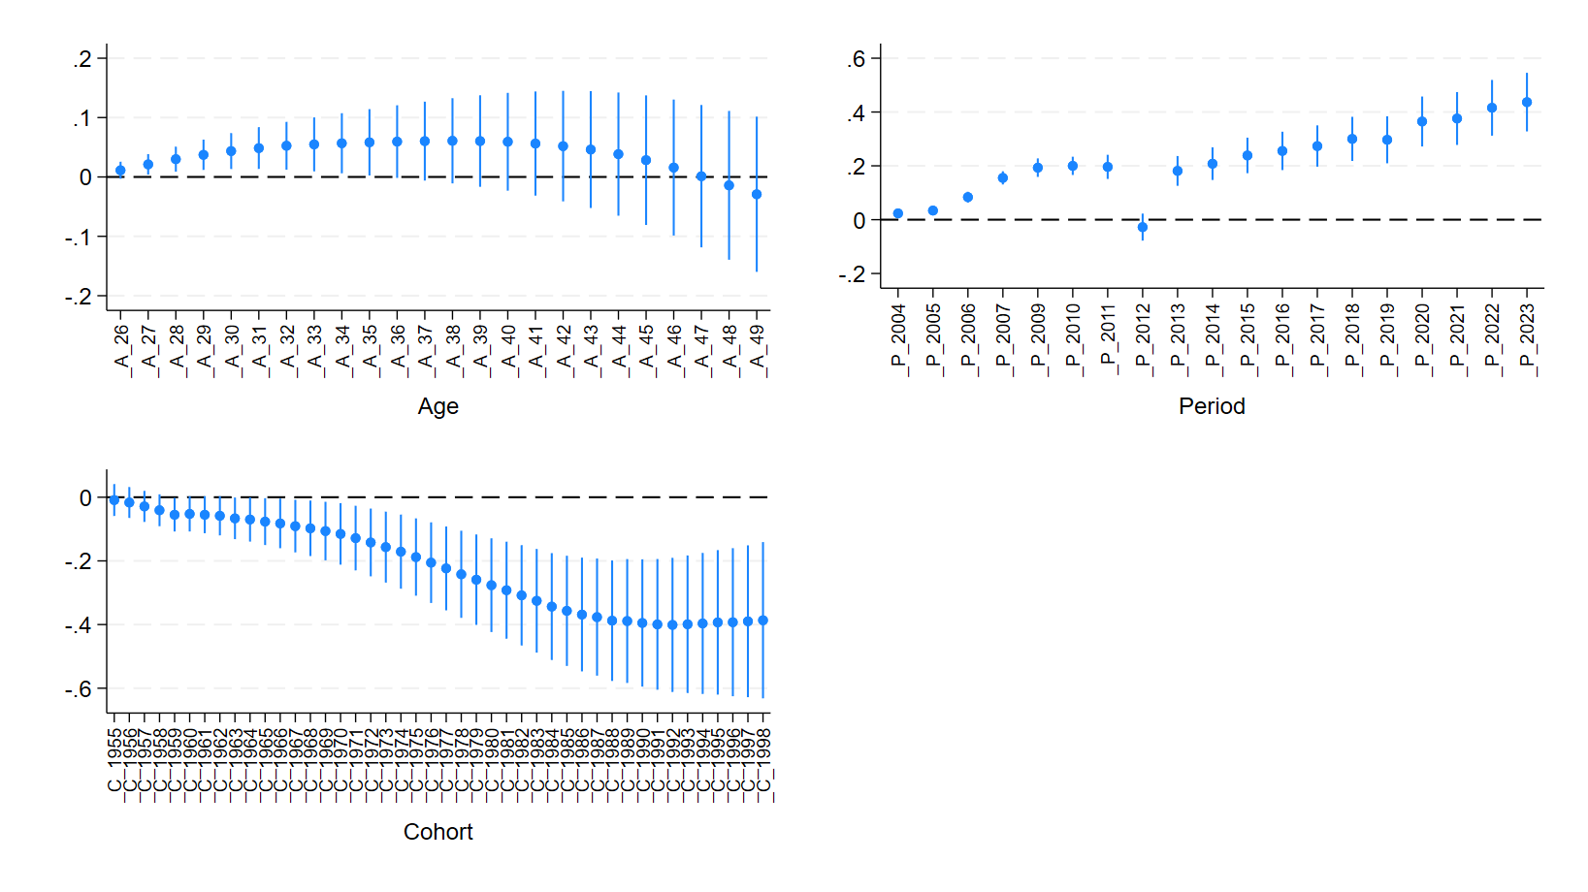
APC decomposition
Employment rate women below higher education

Slide 8
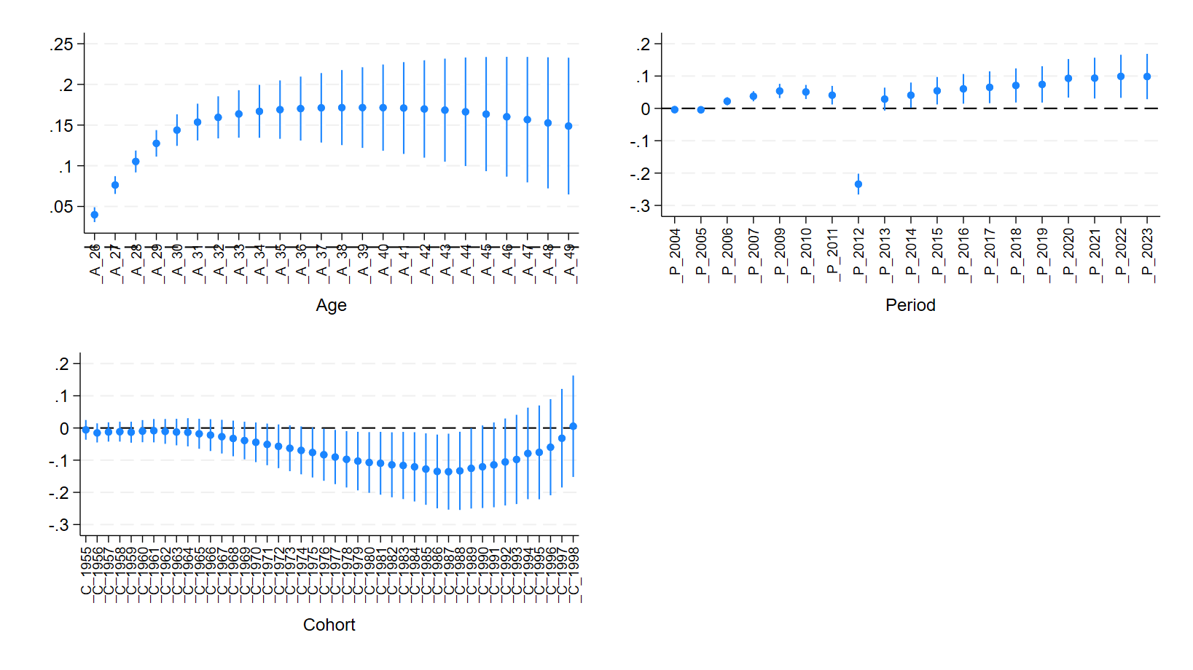
APC decomposition
Employment rate women with higher education

Slide 9
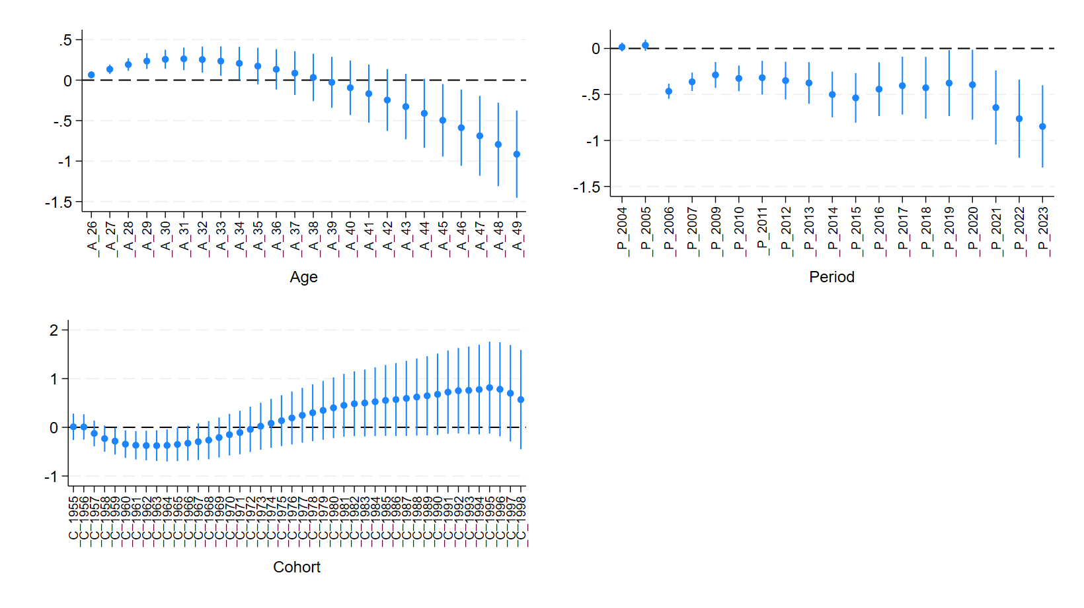
APC decomposition
Share of inactive women due to family care below higher education

Slide 10
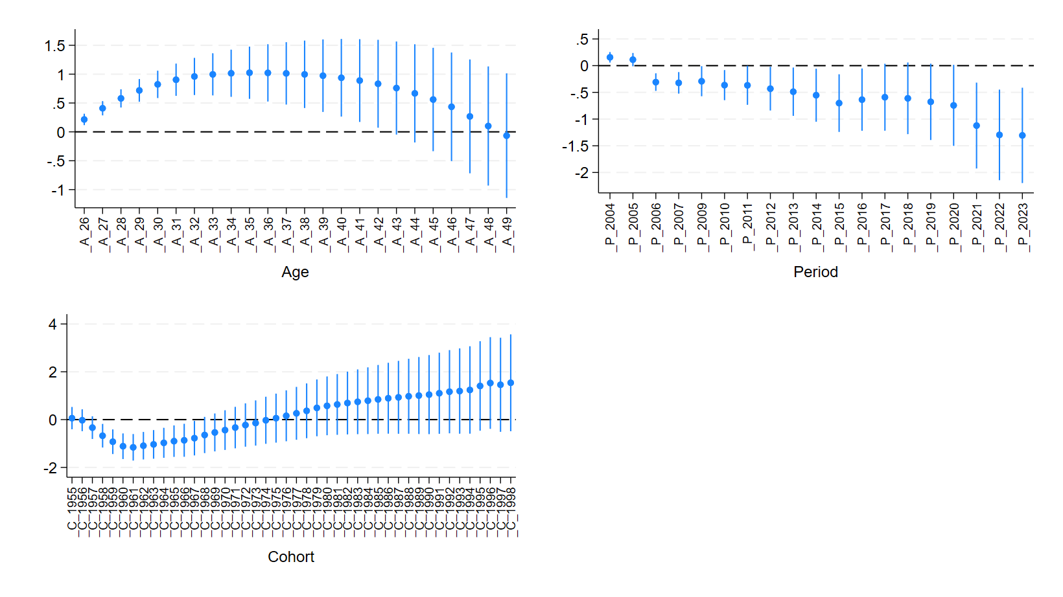
APC decomposition
Share of inactive women due to family care with higher education

Slide 11
Findings
Education does matter for economic activity of women
Employment rate of women aged 25-49 increased, particularly among women aged 25-34
  The increase was higher among women with higher education attainment
Share of women who are inactive due to their caring obligations declined, also among younger women
Age-Period-Cohort decomposition
  increase of employment rate was due to the age and period effects
  Decline in inactivity due to care is mainly related to the period effects
  Age effects in inactivity follow the changes in the childbearing age

Slide 12
Findings – potential explanations
Population ageing and working age population shrinking create pressure to increase employment rates
More favourable conditions to combine work and family obligations
The effect of the universal child benefit introduced in 2016 is diminishing, especially with higher inflation (2020-2023)

