Slide 1
Statistical matching of different microdata sets
The 15th Global Meeting of the NTA Network – Bangkok, Thailand
Matic Verbič, Matjaž Koman, Tanja Istenič

Slide 2
Motivation

Slide 3
NTA requires accurate allocation of income and consumption across household members for their analysis of different transfers and profiles,
In the past, estimation of intra-household transfers were estimated by imputing age and gender-specific average values of private consumption from EU-SILC (European Union Statistics on Income and Living Conditions). However, by matching EU-SILC and the (HBS) Household Budget Survey, which primarily collects information on consumption, a better estimate can be achieved
Strengths of the supplementary data: EU-SILC provides detailed income and demographic data, but no expenditure information. This is compensated for by the Household Budget Survey (HBS), which is the exact opposite: it contains extensive consumption data but very little income information,
The main question is how different are the end results compared to the imputation of averages for our case?

Slide 4
Theoretical Background

Slide 5
The need for an integrated analysis of household economic welfare at the micro level has been acknowledged in various forums, including the report of the Commission on the Measurement of Economic Performance and Social Progress (Stiglitz et al. (2009)) and the Vienna Memorandum issued by the Conference of the Directors-General of National Statistical Institutes (DGINS) in 2016, among others,
There has been many attempts in the recent years with different aims to statistically merge SILC and HBS. Among others: (Rude & Robayo-April, 2024) which combined mentioned dataset to evaluate Energy Expenditures for Bolgaria, (Tran & Osier, 2023) which measured multidimensional poverty on selected European countries, (Balestra & Oehler, 2023) measured distribution of income, consumption and wealth.
We also have Eurostat experimental statistics which includes their views on how to matched mentioned two datasets.
Microdata provides granular insights into income distribution, consumption, and household behavior. It enables age-specific economic estimates essential for NTA and policymaking, allowing for a more precise understanding of intergenerational transfers and economic welfare

Slide 6
Empirical Part

Slide 7
Necessary steps:
Choosing data sets -> In our case SILC & HBS
Harmonization of reference periods and units
Harmonization of variables and its classification -> majority of variables had to be harmonized between datasets
Adjustment for measurement errors
Adjustment for missing data –> option to either predict values based on other variables or delete missing obs.
Measuring coherence of distributions –> different distance measure can be used, in our case – Hellinger distance
Choosing the matching variables -> based on the previous step and specific threshold
Propensity score model –> achieved by various data packages (in Stata for example teffects, psmatch2, etc.)
Final data manipulation

Slide 8
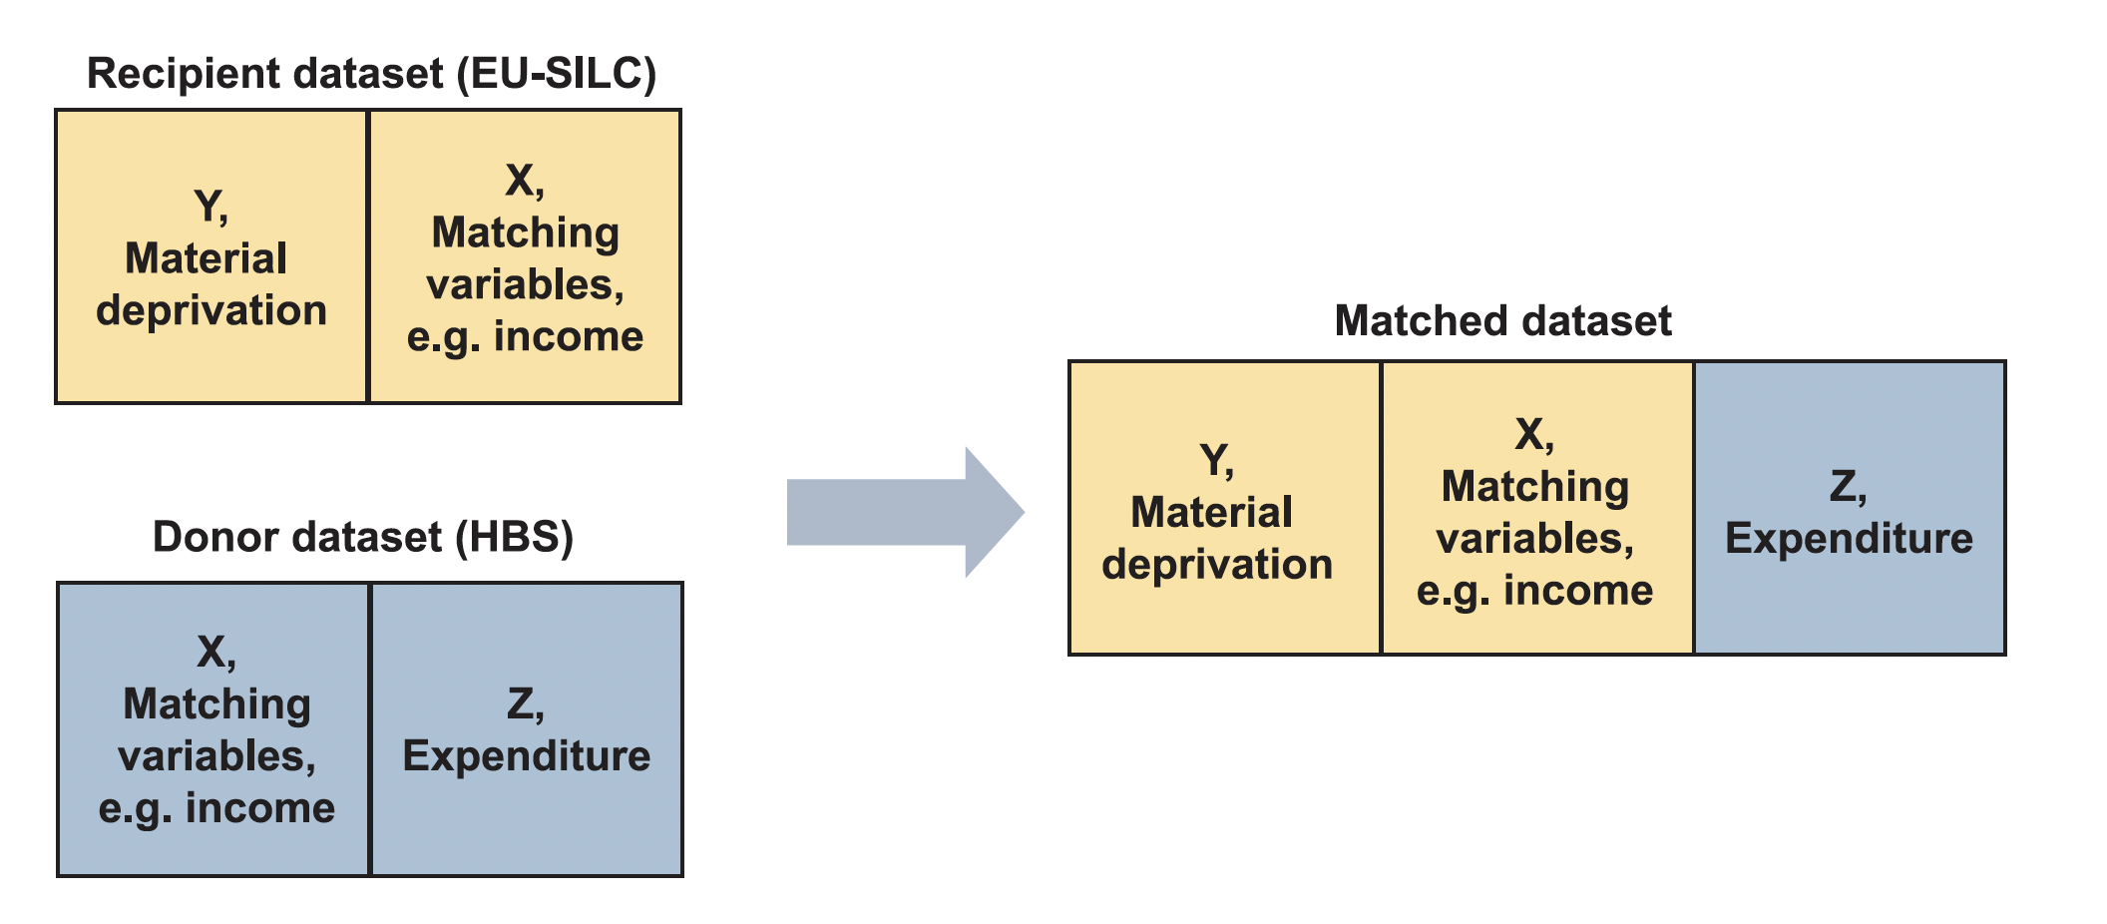
Concept of statistical matching
Statistical matching is a term used to describe the merging of two data sets. In this context, the datasets are households from the same population. The typical approach is to define one dataset as the recipient (EU-SILC) and the other as the donor (HBS). The recipient dataset contains a variable called Y, which represents the material deprivation that is not present in the donor dataset. Conversely, the donor dataset contains a variable called Z, which represents expenditure and is only present in the donor dataset. The aim is to use the information contained in the set of variables common to both datasets, X, to establish a link between the donor and recipient datasets. Consequently, expenditure is linked to EU-SILC, which provides information on income, material deprivation and work intensity (Donateillo et al, 2018).
Source: (Serafino & Tonkin, 2017)

Slide 9
Possibilities of matching methods:
Method | What it does | Pros | Cons
Non-Parametric Methods e.g. Hot Deck Imputation | Matches households in recipient with similar households in donor using a distance function. | Provides a structured approach, allowing for systematic relationships between variables. | Model dependence – accuracy relies on correctly specifying the regression equation. Regression towards the mean – imputed values may be biased toward the average, reducing variability in the data.
Parametric Methods e.g. Multivariate Regression | Uses regression models to predict missing expenditure values based on observed income and household characteristics. | Provides a structured approach, allowing for systematic relationships between variables. | Model dependence – accuracy relies on correctly specifying the regression equation. Regression towards the mean – imputed values may be biased toward the average, reducing variability in the data.
Mixed Method e.g. Predictive Mean Matching | Uses a parametric model to estimate intermediate values of expenditure. | Balances model-based estimation with real data variability, improving robustness | More complex and computationally intensive due to multiple imputed datasets and averaging results.

Slide 10
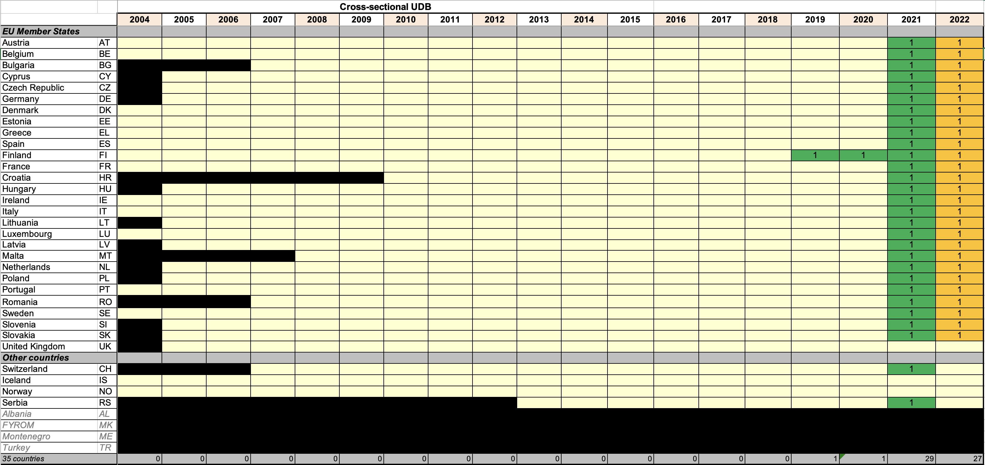
Data availability – EU SILC (European Union Statistics on Income and Living Conditions) - receiver

Slide 11
Data availability – HBS(Household Budget Survey) - donor
2010 | 2015 | 2020
BE | BE | AT
BG | BG | BE
CY | CY | BG
CZ | CZ | CY
DE | DE | CZ
DK | DK | DE
EE | EE | DK
EL | EL | EE
ES | ES | EL
FI | FI | ES
FR | FR | FI
HR | HR | FR
HU | HU | HR
IE | IE | HU
IT | IT | IE
LT | LT | IT
LU | LU | LT
LV | LV | LU
MT | MT | LV
PL | NL | MT
PT | PL | NL
RO | PT | NO
SE | RO | PL
SI | SE | PT
SK | SI | RO
UK | SK | SI
 |  | SK
The Household Budget Survey is a survey of a representative random sample of all private households for each country. The main purpose of the HBS is to determine in detail the pattern of household expenditure in order to update the weighting basis of the Consumer Price Index.
Main coverage:
Households
Housing tenure
Housing facilities
Domestic appliances
Source: Eurostat (2025)

Slide 12
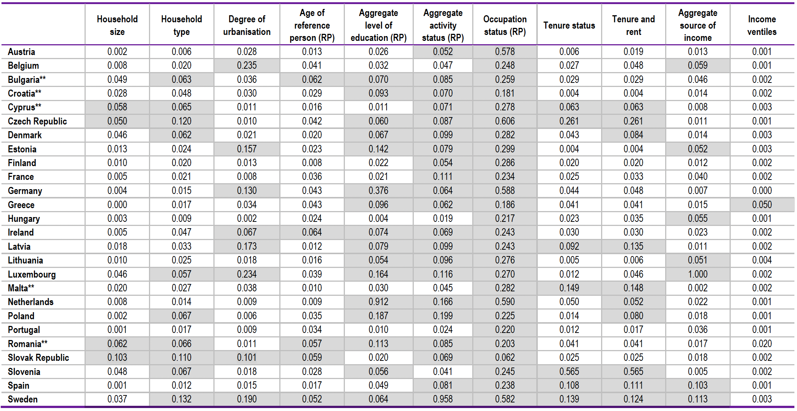
Measuring coherence of distributions – Hellinger distance
*Hellinger distances above the threshold of 0.05 (used as a rule of thumb) are shaded. Source: Eurostat calculations based on EU-SILC and HBS microdata.
Source: Balestra & Oehler (2023)

Slide 13
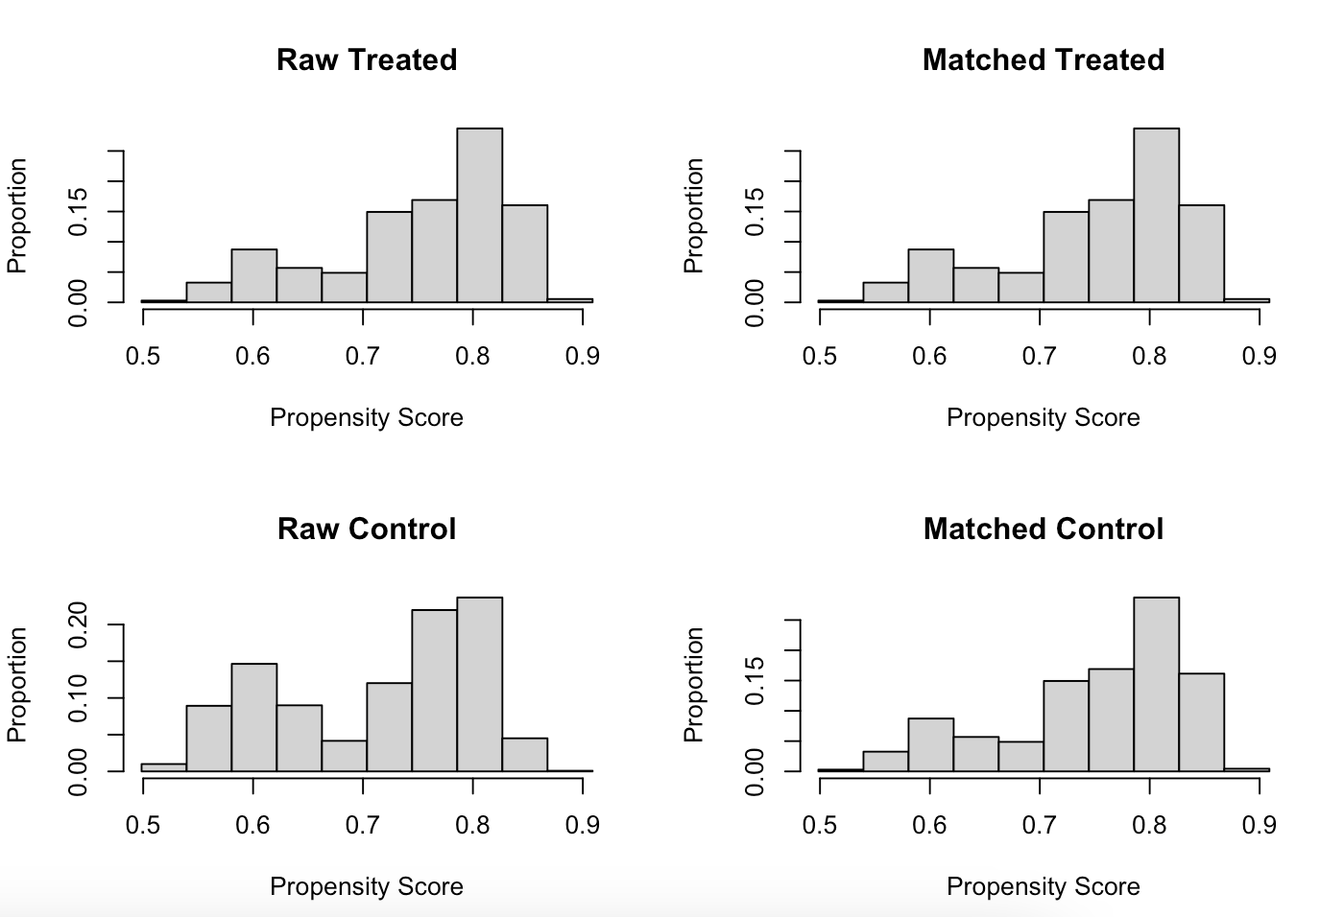
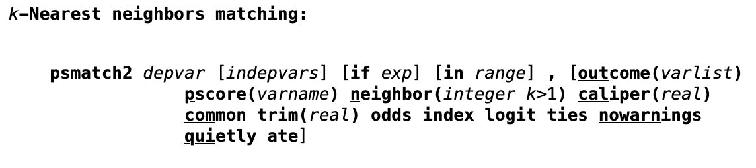
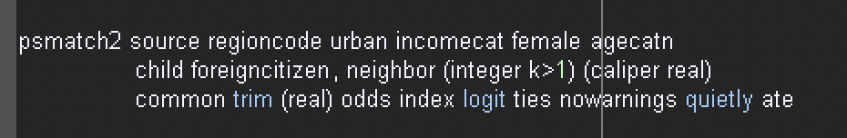
Propensity Score model
For calculation of propensity score (to match nearest neighbor matching household) between the household from datasets different functions can be used in Stata (teffects, psmatch2) or in R (machIt) among others
Source: Stata (2025)
Source: Own code
Source: Own computations

