Slide 1
Changes in intergenerational transfers in Japan during the Abenomics period:
An examination using the Japanese NTA data from 2014 and 2019
March 11, 2025
The 15th Global Meeting of the NTA Network,
Bangkok, Thailand
SUZUKI Takashi, NISHIMURA Yoshinori, FUKUDA Setsuya,
IPSS (National Institute of Population and Social Security Research, JAPAN)

Slide 2
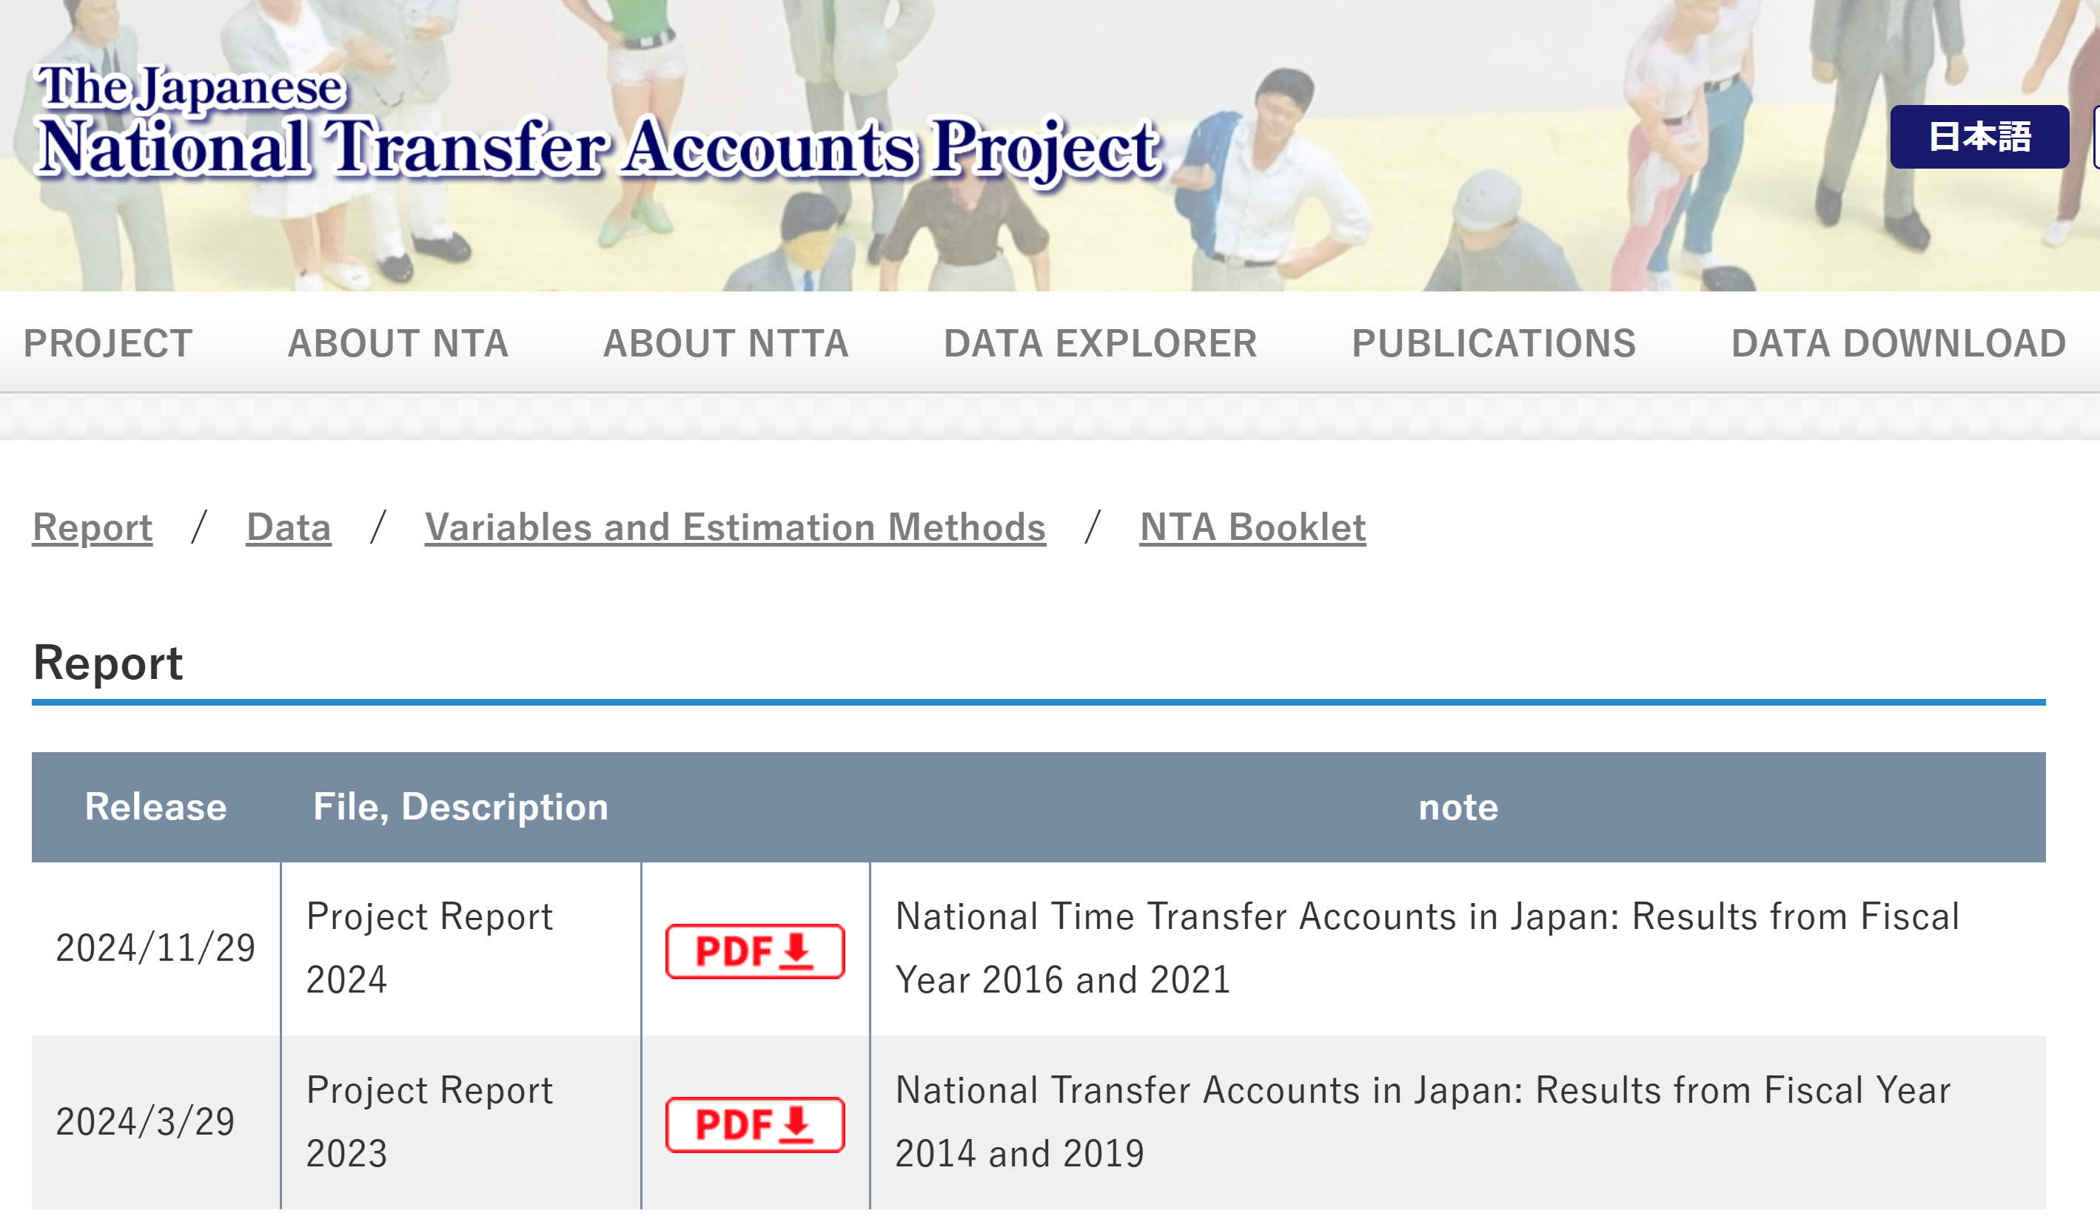
Introduction
In 2023, National Institute of Population and Social Security Research (IPSS) released the National Transfer Accounts (NTA) data for 2014 and 2019.
This period corresponds to the Second ABE Shinzo Cabinets (2012-2019), one of the longest-serving in Japan's history.
The Abe Cabinets implemented "Abenomics," a comprehensive economic and fiscal policy package.
This study aims to understand changes in Labor Income and Consumption in Japan during the Abenomics period, using the NTA lens.
https://www.ipss.go.jp/projects/NTA/index.html

Slide 3
Previous Studies
"The first arrow of Abenomics is aggressive monetary policy aimed at lifting the economy from the deflation that had persisted in the preceding 15 years.“(ITO, 2021)
"The second arrow of Abenomics is flexible fiscal policy. Many interpreted “flexible” to be synonymous with “stimulative."(ITO, 2021)
"These observations are consistent with a widely shared view that the first and second arrows have mostly succeeded in managing aggregate demand, while the third arrow has been stalled or not even fired so that there was no increase in the potential growth rate."(ITO, 2021)
Support for employment by providing childcare support, etc., with the aim of realizing a society in which people (female, younger, elderly) are able to continue to work. (mhlw, 2016)
Japanese firms generally have a mandatory retirement age. The Ministry of Health, Labor and Welfare (MHLW) has implemented policies to extend employment for the elderly since 2014. (mhlw, 2025)

Slide 4
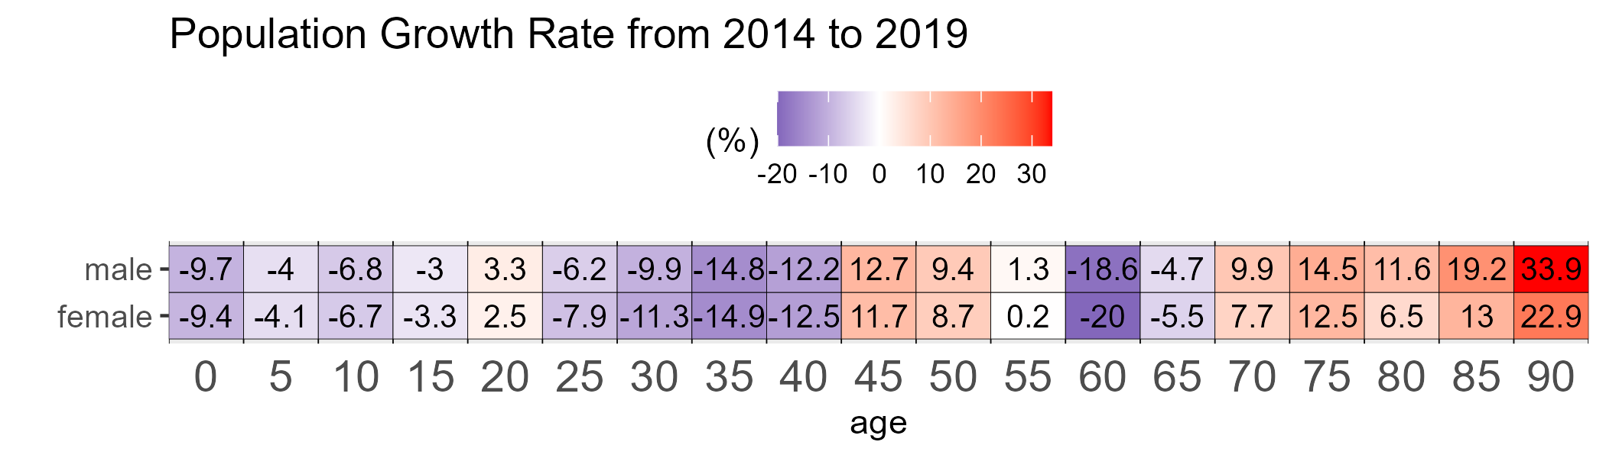
Japan aged between 2014 and 2019.
The population decreased by 1 million.
The proportion of people aged 65+ increased by 2.4 points.
In general, the elderly population increased, the working-age population declined.
 | 2014 | 2019
Total Population | 127.1 million | 126.1 million
 | Ages | 2014 | 2019
Age Structure | 0-14 | 12.8% | 12.1%
 | 15-64 | 61.3% | 59.5%
 | 65+ | 26.0% | 28.4%
Due to the baby boomer (Dankai Junior gen), the population aged 45 to 54 increased.

Slide 5
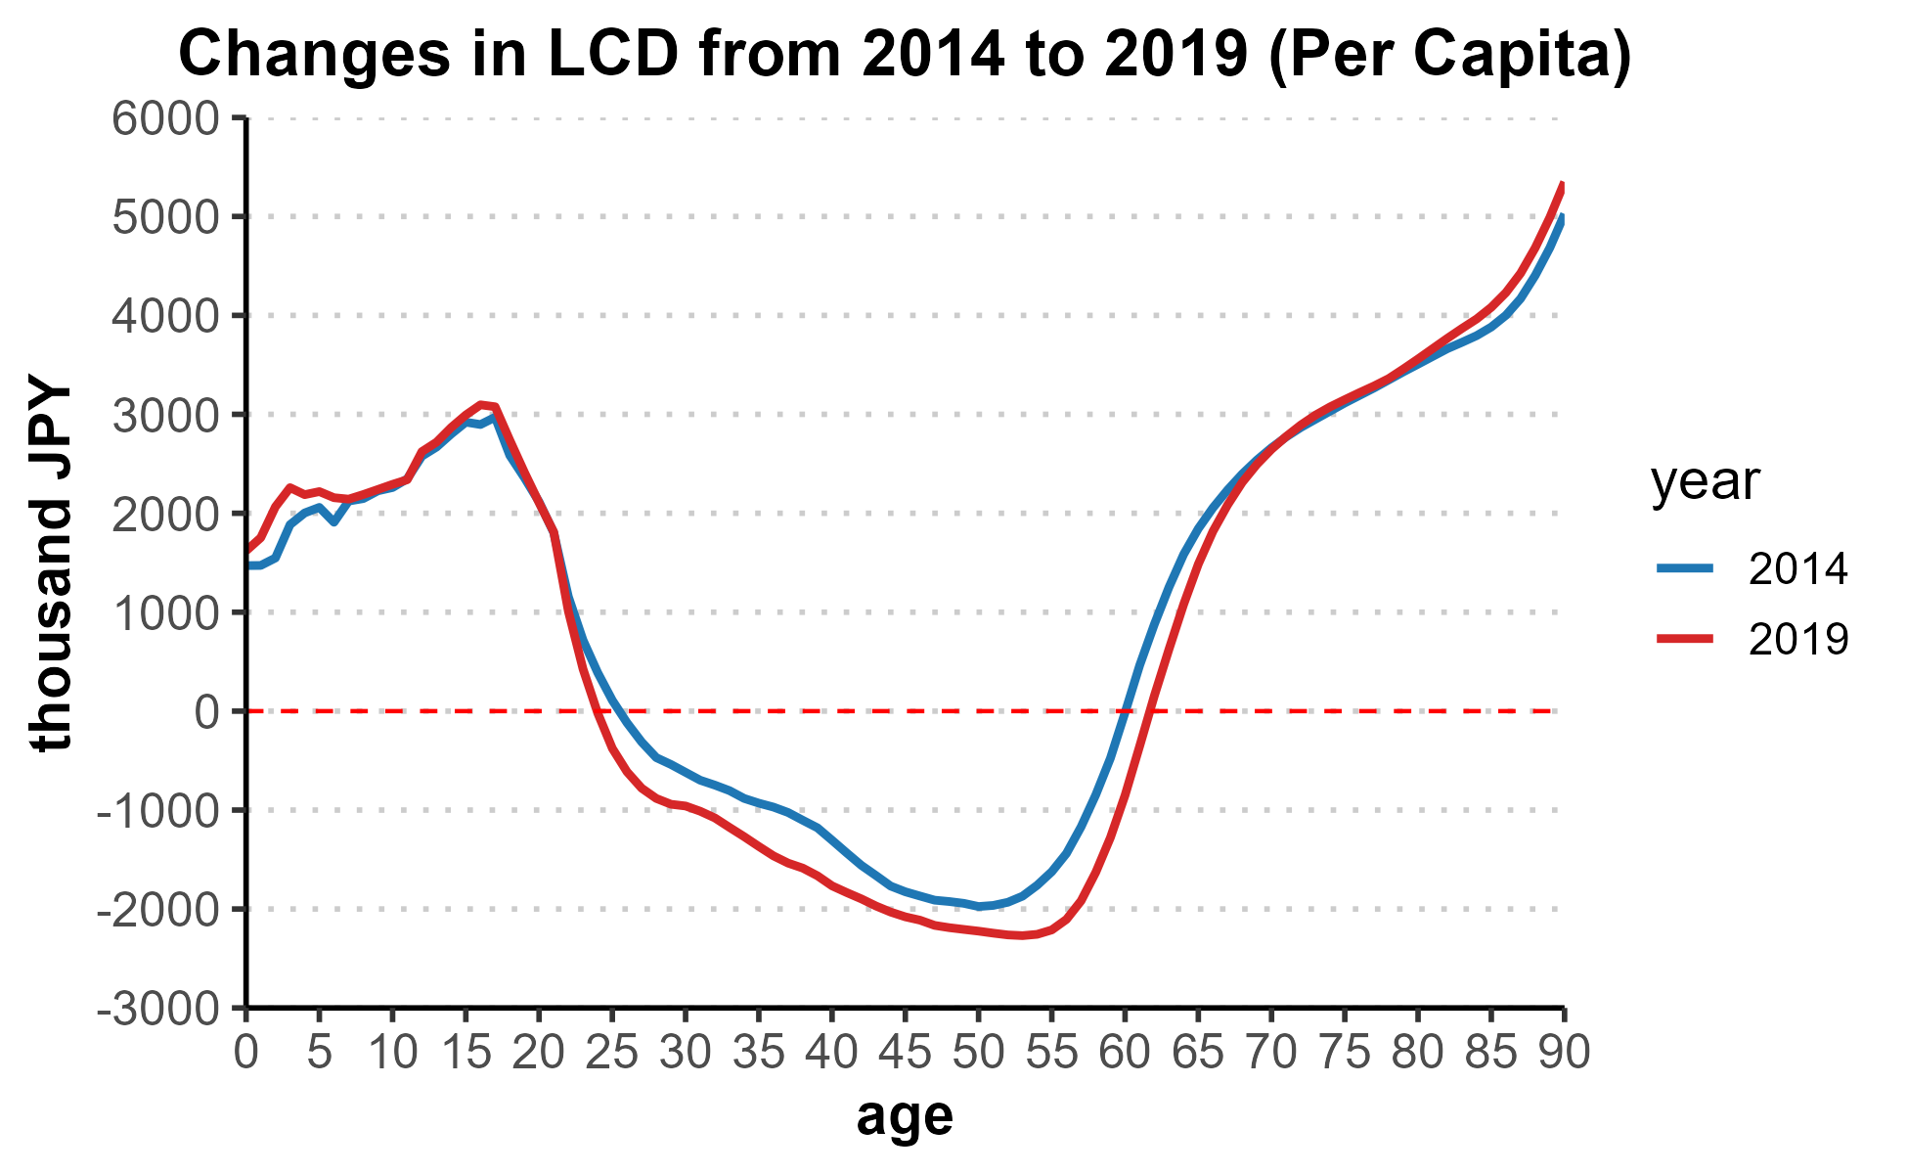
The period of life cycle surplus extended by 3 years
Despite the aging population structure between 2014 to 2019, the period of life cycle surplus extended by 3 years.
Age26
Age60
Age24
Age61

Slide 6
The life cycle deficit (LCD) improved by 18 trillion JPY.
Despite the aging population structure between 2014 to 2019, The life cycle deficit (LCD) improved by 18 trillion JPY.
Life Cycle Account (aggregate value)
(Unit: Billion JPY)
 | 2014 | 2019 | 2019-2014
LCD (C-YL) | 97,315 | 79,130 | -18,185
Consumption | 364,777 | 374,539 | 9,762
Labor Income | 258,435 | 287,995 | 29,560

Slide 7
LCD has improved despite population aging.
Comparison between 2014 and 2019 shows the following:
The population declined, and the population structure aged.
Despite these changes
The period of life cycle surplus extended by 3 years.
The life cycle deficit improved by 18 trillion JPY.
➡We will examine which age groups contributed to the improvement in LCD using the NTA lens.

Slide 8
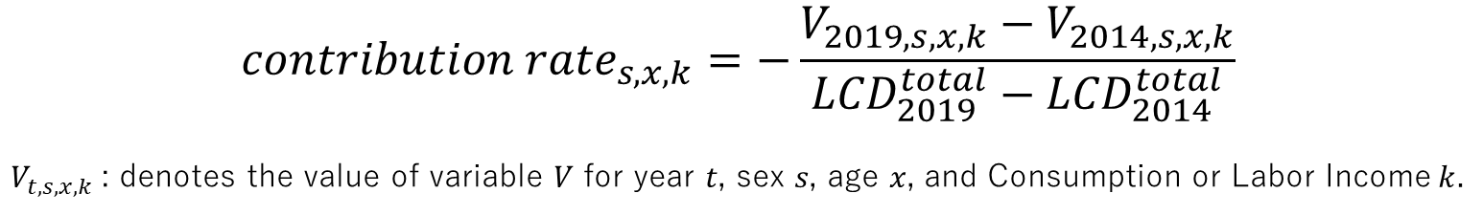
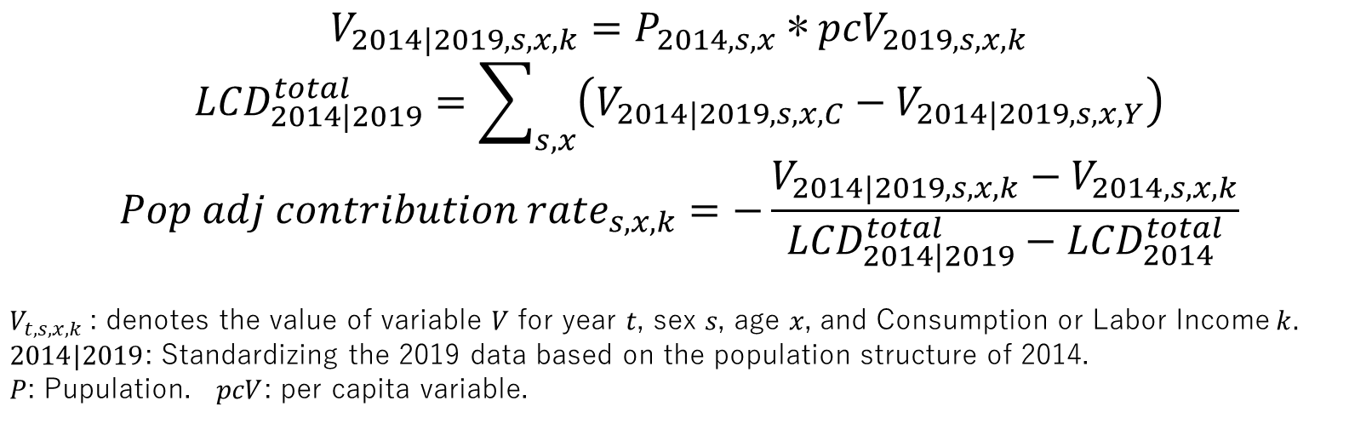
What is the key driver for the improvement in LCD?
・To find out what improves LCD [sex, age, consumption, or labor income], we calculate the contribution rate.
・Next, we adjust for demographic changes, similar to looking at per capita values.
$${contribution rate}_{s,x,k}=−\frac{V_{2019,s,x,k}−V_{2014,s,x,k}}{{LCD}_{2019}^{total}−{LCD}_{2014}^{total}}$$
$V_{t,s,x,k}$: denotes the value of variable 𝑉 for year 𝑡, sex 𝑠, age 𝑥, and Consumption or Labor Income$k$.
$$V_{2014|2019,s,x,k}=P_{2014,s,x} \text{∗} {pcV}_{2019,s,x,k}$$
$${LCD}_{2014|2019}^{total}=\sum_{s,x}{\left(V_{2014|2019,s,x,C}−V_{2014|2019,s,x,Y}\right)}$$
$${Pop adj contribution rate}_{s,x,k}=−\frac{V_{2014|2019,s,x,k}−V_{2014,s,x,k}}{{LCD}_{2014|2019}^{total}−{LCD}_{2014}^{total}}$$
$V_{t,s,x,k}$: denotes the value of variable 𝑉 for year 𝑡, sex 𝑠, age 𝑥, and Consumption or Labor Income$k$.
$2014|2019$: Standardizing the 2019 data based on the population structure of 2014.
$P$: Pupulation. $pcV$: per capita variable.

Slide 9
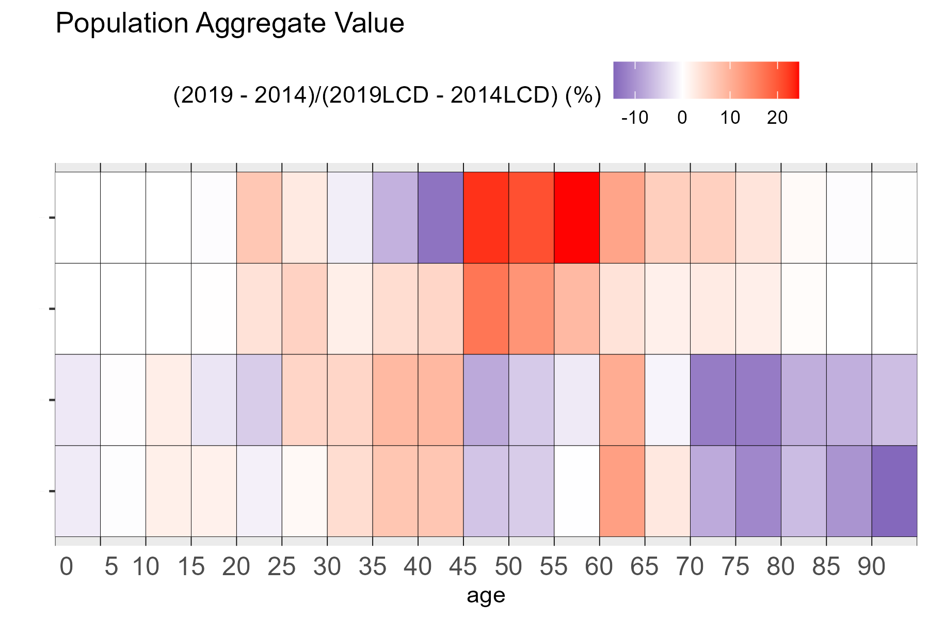
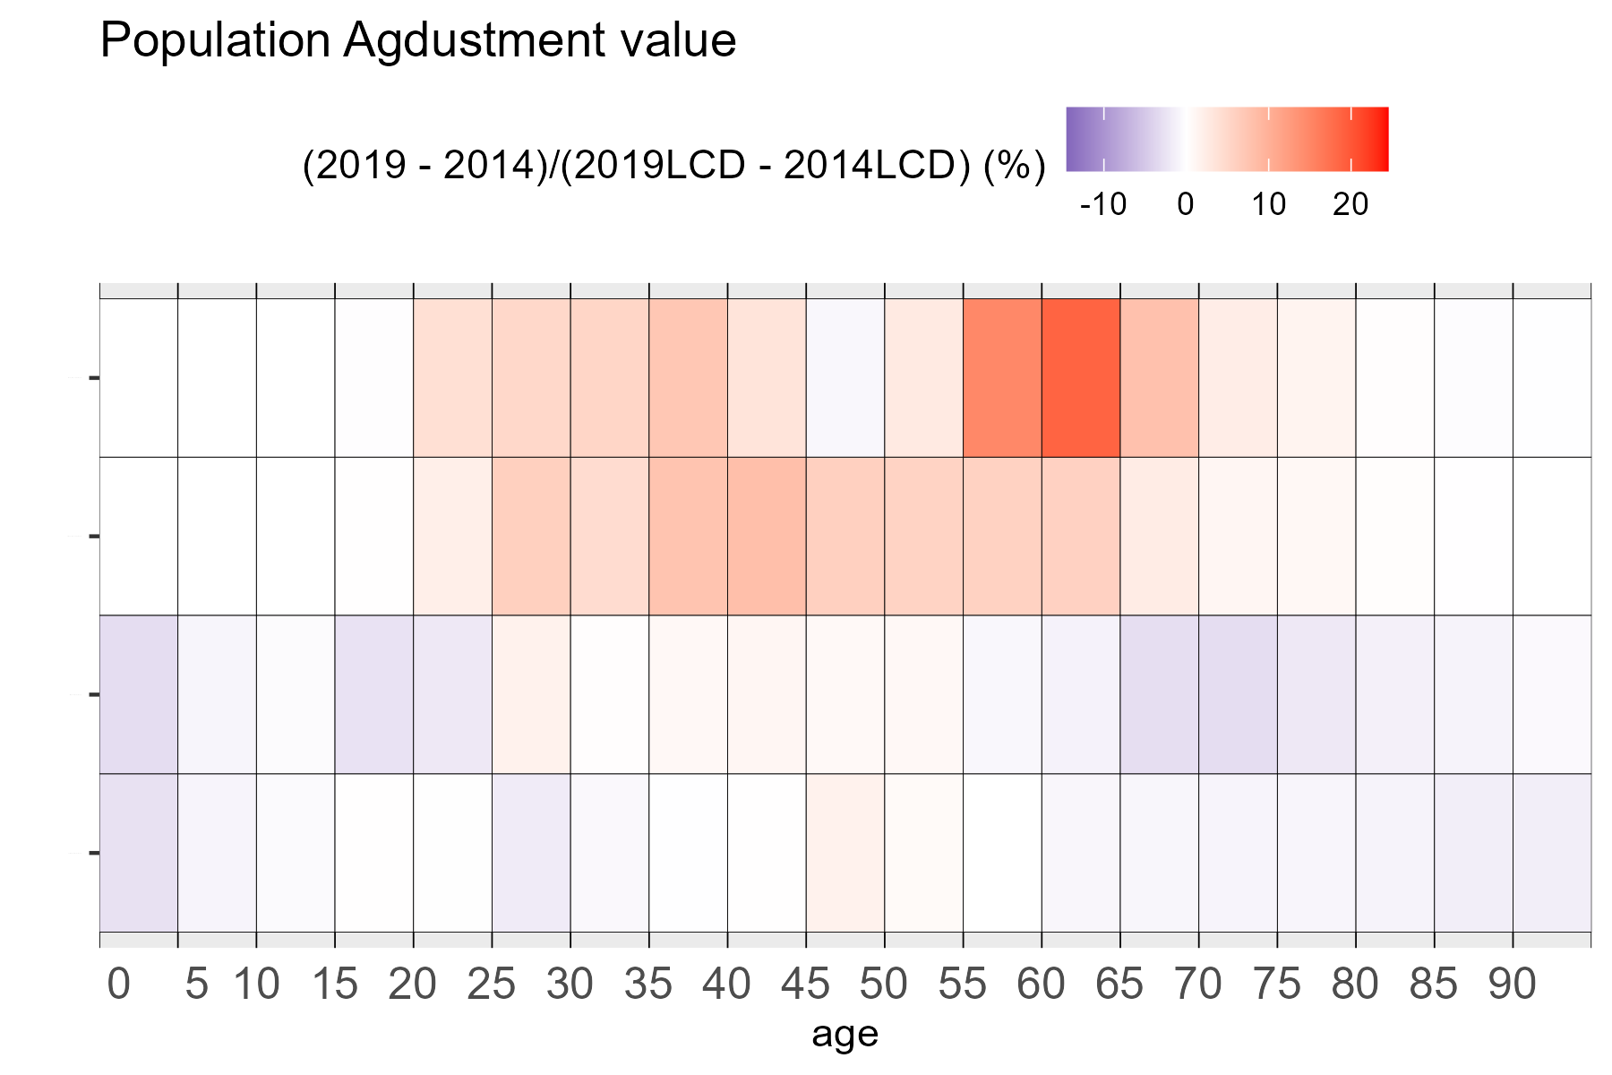
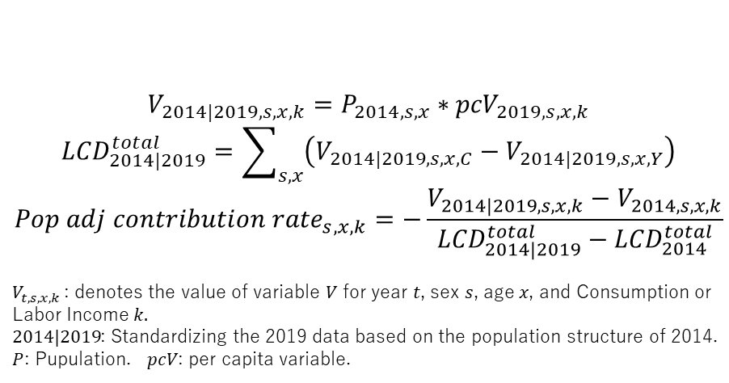
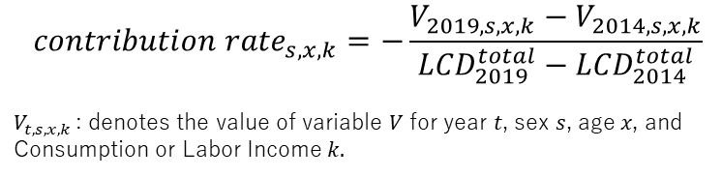
What is the key driver for the improvement in LCD?
𝑐𝑜𝑛𝑡𝑟𝑖𝑏𝑢𝑡𝑖𝑜𝑛 𝑟𝑎𝑡𝑒
𝑃𝑜𝑝 𝑎𝑑𝑗 𝑐𝑜𝑛𝑡𝑟𝑖𝑏𝑢𝑡𝑖𝑜𝑛 𝑟𝑎𝑡𝑒
Female
Labor
Income
Male
Female
Consumption
Male
Female
$${contribution rate}_{s,x,k}=−\frac{V_{2019,s,x,k}−V_{2014,s,x,k}}{{LCD}_{2019}^{total}−{LCD}_{2014}^{total}}$$
$V_{t,s,x,k}$: denotes the value of variable 𝑉 for year 𝑡, sex 𝑠, age 𝑥, and Consumption or Labor Income$k$.
$$V_{2014|2019,s,x,k}=P_{2014,s,x} \text{∗} {pcV}_{2019,s,x,k}$$
$${LCD}_{2014|2019}^{total}=\sum_{s,x}{\left(V_{2014|2019,s,x,C}−V_{2014|2019,s,x,Y}\right)}$$
$${Pop adj contribution rate}_{s,x,k}=−\frac{V_{2014|2019,s,x,k}−V_{2014,s,x,k}}{{LCD}_{2014|2019}^{total}−{LCD}_{2014}^{total}}$$
$V_{t,s,x,k}$: denotes the value of variable 𝑉 for year 𝑡, sex 𝑠, age 𝑥, and Consumption or Labor Income$k$.
$2014|2019$: Standardizing the 2019 data based on the population structure of 2014.
$P$: Pupulation. $pcV$: per capita variable.

Slide 10
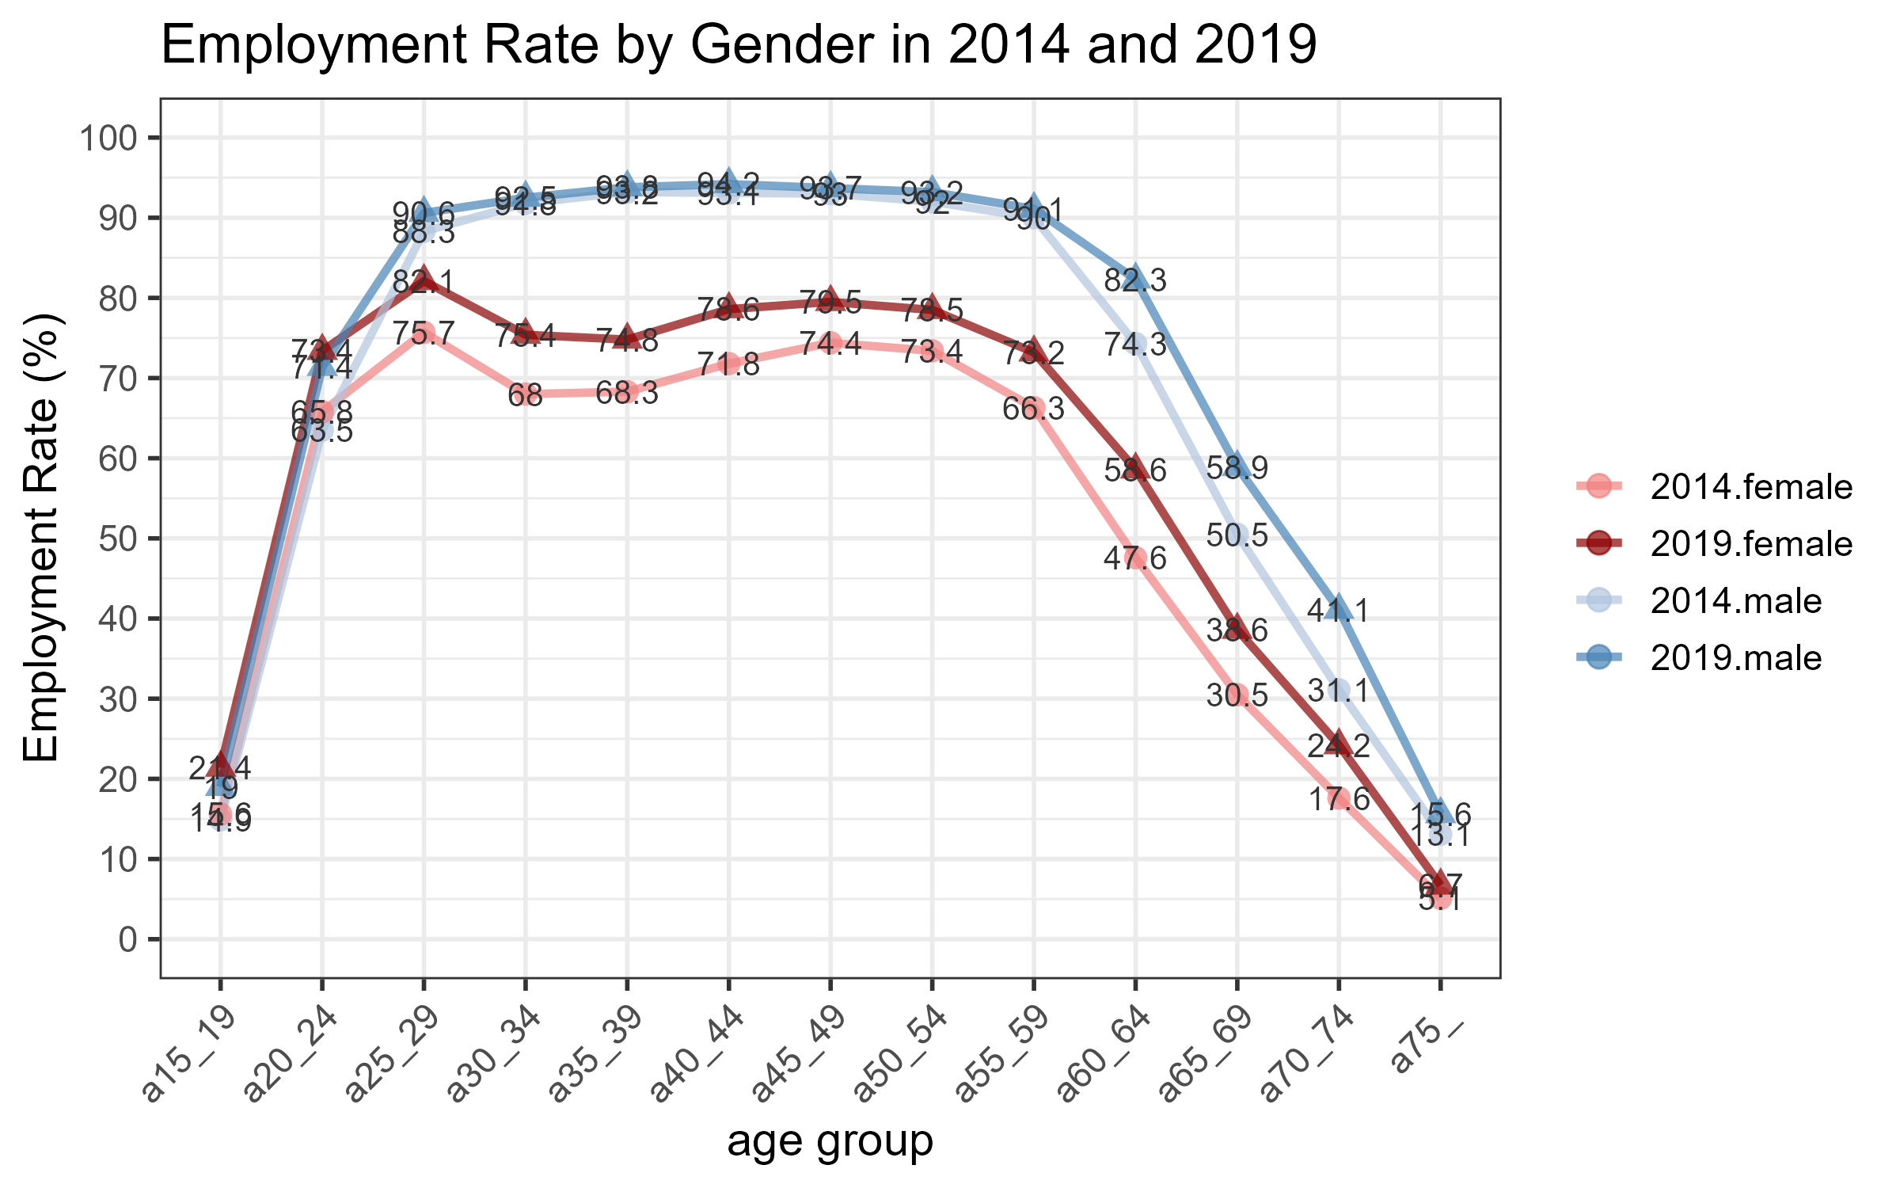
The Employment Rate grew from 2014 to 2019
Increase Male in aged 60+, and Female
It is a factor in Labor income growth
Males aged 55-59 (Whose labor Income Increased) saw no change in Employment Rate.
As a side effect of the retirement age extension policy, per capita labor income may have increased.

Slide 11
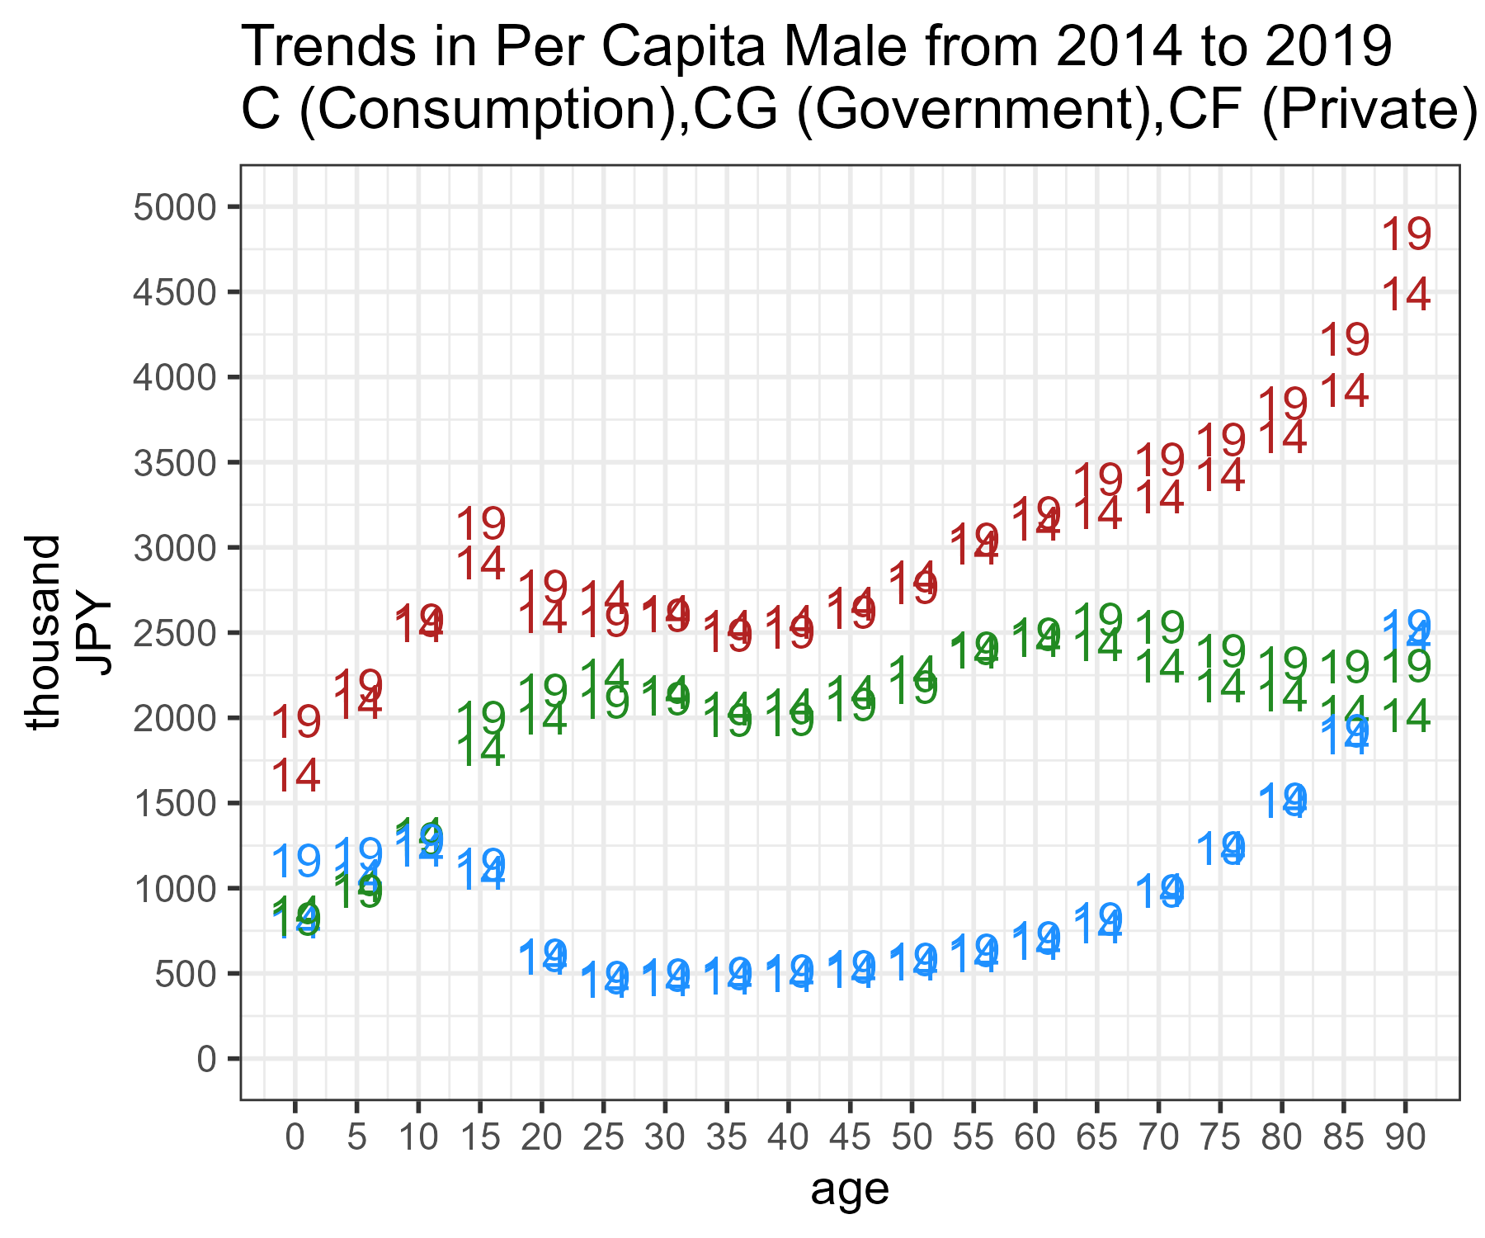
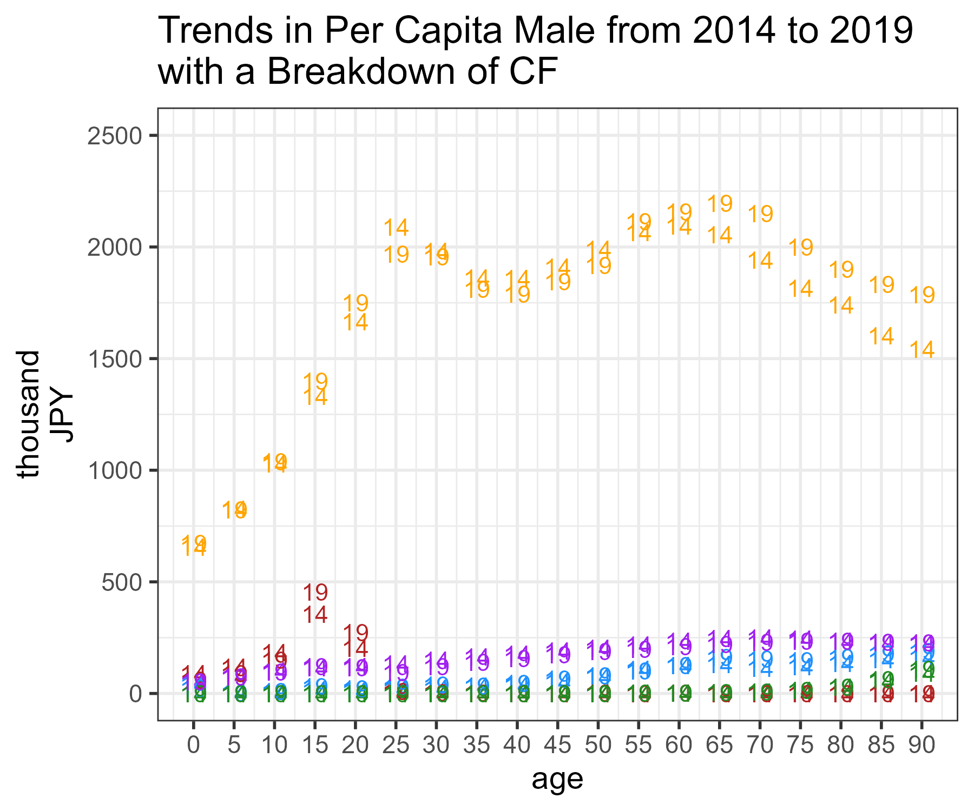
Elderly C Growth: Driven by CF (Not CG), Led by CFX
CFX
C
CF
Breakdown
of CF
CFE
CFR CFH CFL
CG
The growth in elderly consumption is due to CF (not CG)
The growth in elderly CF is due to CFX (other private consumption)

Slide 12
Summary and Conclusion
During the Abenomics period (2014-2019), LCD improved despite an aging population.
  Labor Income for Male aged 55+ increased possibly due to the retirement age extension policy (a key driver of LCD improvement).
  Labor Income for Female increased possibly due to the policies supporting female employment. (a key driver of LCD improvement).
  Aging demographics has increased the aggregate value of elderly consumption.
    Even with Pop adj (similar to per capita), elderly consumption is increasing. The main factor is CFX, not CG.
From the NTA lens, Japan worked well during the Abenomics period. However…
  The 65+ population is now around 30% and will keep growing. It is unclear how long consumption can be maintained.
  Japan’s elderly employment rate is high, so further growth is challenging but not impossible.
  Female employment can improve, but time for unpaid care work is needed (use NTTA!).

