Slide 1


Emerging Life-Cycle Deficits in India from 2011 to 2036: a simulation exercise using National Transfer Accounts (NTA) methodology
Shivendra Singh, UNFPA
Arup Kumar Das, Population Council Consulting
Sanjay Kumar, UNFPA (Presenter)

Slide 2


Objectives of the study
To assess how changes in age structure impact economic dependency across different age groups.
To simulate future trends in labour income and consumption based on demographic changes, with varying assumptions of economic growth.
To assess the implications of shifting LCD patterns on social security, healthcare, and higher education expenditures.

Slide 3

Methodology and Assumption
Data & Methodology
Assumption
Data
Income and consumption patterns for 2023 and 2036 were estimated using growth rate computed from India Human Development Survey (IHDS) 2004 and 2011.
Macro level indicators were adopted from national account statistics (NAS) (2011-12 and 2022-23, MoSPI, India) and population data from WPP, UNDESA, 2024
Method
Since macro aggregates for 2036 are unavailable, GDP growth was estimated for the period 2011 to 2023 at an annual rate of 6%.
Total Labor income and consumption for 2023 and 2036 were computed by using age specific pattern from IHDS data, 2011-12 and applied to the NAS.
The annual growth rate for income and consumption was assumed to reduce to half of its original value (between 2004 to 2011) during the periods leading to 2023 and 2036.
India's GDP growth rate was assumed to remain constant at 6% annually from 2023 to 2036.
The distribution of income and expenditures as a share of GDP in 2023 was assumed to remain the same for 2036, ensuring consistency in projections.
Macro aggregates for 2036 were derived from the 2022-23 National Accounts data, assuming a similar proportion of expenditure on health, education, and other sectors from GDP.

Slide 4


Findings

Slide 5
1.4 Billion and Counting… But for How Long?

Slide 6
India’s Evolving Population Structure
India is undergoing a profound demographic transition. The once dominant young population (0-19 years) is steadily shrinking, making way for a rapidly growing elderly population (60+ years).
By 2036, this proportion of elderly will reach a level of 15% from current level of 10% and significantly increase the dependency ratio
Source: Census, 2011 ; World population prospects, UNDESA 2024

Slide 7

Demographic Turning Point: India’s Elderly Surge
Elderly population would be almost double in 25 years
Source: World population prospects, UNDESA 2024

Slide 8

Growing Private Expenditure in Social Sector
Private expenditure on health has increased from78% in 2011-12 to 82% and share of private expenditure on education increase from 52% to 56% during the same time.
Consumption by sector | 2011-12 (Rs. Crore) |  |  | 2022-23 (Rs. Crore)
Consumption by sector | Public | Private | Total | Public | Private | Total
Health | 52,073 [22.3%] | 1,81,334 [77.7%] | 2,33,407 [100%] | 97,351 [18.3%] | 4,35,390 [81.7%] | 5,32,741 [100%]
Education | 1,71,545 [48.5%] | 1,82,378 [51.5%] | 3,53,923 [100%] | 3,11,505 [43.8%] | 4,00,296 [56.2%] | 7,11,801 [100%]
Others* | 4,95,610 [9.8%] | 45,72,284 [90.2%] | 50,67,894 [100%] | 14,83,992 [14.9%] | 84,85,005 [85.1%] | 99,68,997 [100%]
*General public services, defense, public order and safety, economic affairs, environmental protection, housing and community amenities, recreation, culture, and religion)
Source: National Accounts Statistics

Slide 9

Changing age pattern of income and consumption over the years
The peak in income distribution shifting rightward, indicating higher income among the working-age (50-55 years).
A sharp increase in per capita consumption expenditure among population of 17–22 years in 2036, would be require for spending on education and skill development.
In 2036, consumption among older age groups (60+) will also rise substantially, reflecting higher demand for healthcare and other expenditures.

Slide 10
Changing age pattern of income and consumption over the years

Slide 11
Changing age pattern of Life cycle deficit
Working age population will experience double burden of economic dependency due to increase in per capita LCD for youth and elderly by 2036.

Slide 12
Social security and heath-care schemes for elderly in India
Schemes | Year | Benefits | Benefits
Social security and pension schemes
Antodaya Anna Yojana | 2000 | Provides food grains at a highly subsidized rate | Provides food grains at a highly subsidized rate
Annapurna Scheme | 2000 | Get 10 kg foodgrains per person per month, free of cost. | Get 10 kg foodgrains per person per month, free of cost.
Indira Gandhi National Old Age Pension Scheme (IGNOAPS) | 2007 | Government assistance of `200 per month | Government assistance of `200 per month
Indira Gandhi National Widow Pension Scheme | 2009 | Monthly pension of ₹200 per beneficiary to BPL widows | Monthly pension of ₹200 per beneficiary to BPL widows
Atal Pension Yojana | 2015 | For unorganized sector workers save money as they earn and provides guaranteed return post retirement. Fixed pension ranging from `1,000 to `5,000, | For unorganized sector workers save money as they earn and provides guaranteed return post retirement. Fixed pension ranging from `1,000 to `5,000,
Health care
Ayushman Bharat PM-JAY for Senior Citizens (70+) | 2023 |  | Annual medical insurance coverage of ₹500,000 per family

Slide 13

Elderly
Inadequate pension amount to meet rising living costs, and limited coverage, excluding many elderly in need
Low enrollment due to lack of awareness and financial literacy, and concerns over long-term sustainability and returns.
The pension amount is often too low to meet basic living expenses, making it insufficient for widows without other sources of income.
Ayushman Bharat - Pradhan Mantri Jan Arogya Yojana (PMJAY)-Only provide inpatient care. No provision of out-patient
Youth
The rising cost of higher education creates a major affordability gap despite existing government support and funding. Which is mainly borne by family.
Many skill-development and education schemes focus on vocational training but do not necessarily help students transition into quality higher education aligned with market needs.
Challenges

Slide 14
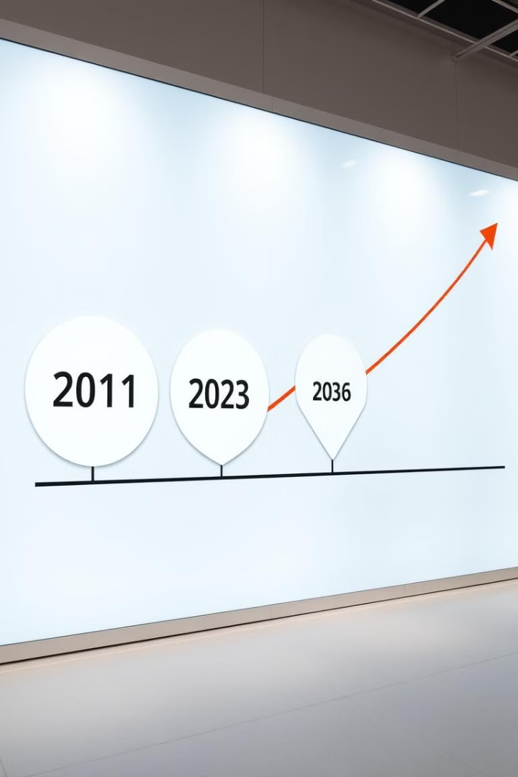
Key observation
In India, the shift from a young to a working-age population (2011-2023) is shaping consumption patterns. Also during the last decade, social sector expenditures are increasingly dependent on private funding.
1
Projected LCD profile for 2036 indicates further increases in old-age deficits, highlighting the challenges for pension systems and healthcare financing..
2
In the projected LCD per capita, a noticeable spike is observed in the 17-25 age group, driven by increased spending on higher education. Which indicating the growing demand for higher per capita expenditures in the sector
3

Slide 15
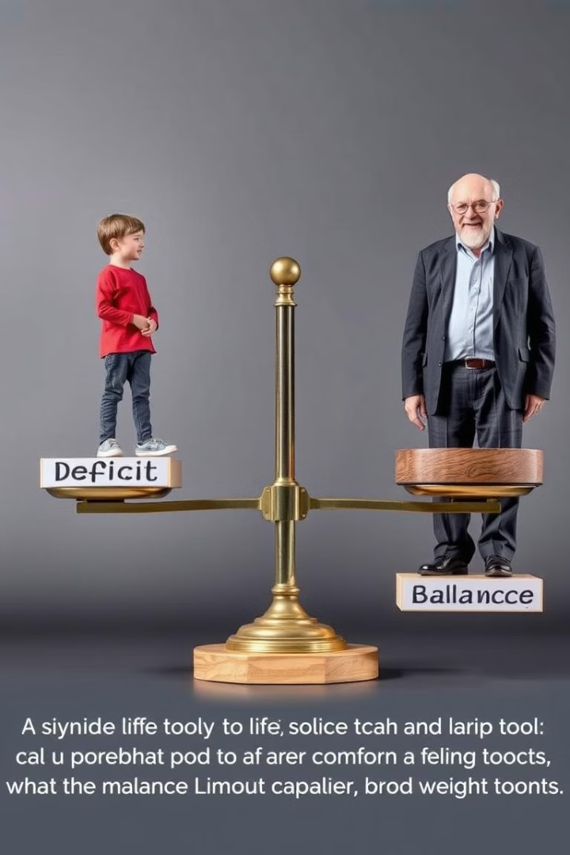




Policy Implications and Recommendations
Strengthening pension systems and expand coverage and increase pension benefits under schemes.
Investing in healthcare infrastructure to provide quality care for an aging population is crucial for maintaining well-being and minimizing healthcare costs mainly out-patient.
Improving access to quality education and vocational training that can equip young people with skills needed for success in the workforce, mitigating youth deficits.
Creating employment opportunities for young people through industrialization and entrepreneurship initiatives to stimulate economic growth and for more sustainable future ready elders.

Slide 16
THANKS

