Slide 1
Population Aging, Old-Age Support System, and Inequality: Role of Familial Transfers
Hyun Kyung Kim
Sang-Hyop Lee
March 11, 2025
Policy and the Generational Economy:
The 15th Global Meeting of the NTA Network
Bangkok, Thailand

Slide 2
Motivation
Population aging → increase inequality (between variation)
Inequality tends to increase with age (Deaton & Paxson, 1994, 1997; Ohtake & Saito, 1998)
Transfers (Old-age support system in NTA)
Public transfers reduce inequality (Anderson et al., 2017; Doumbia & Kinda, 2019; Sidek, 2021; Aaberge et al. 2019)
Studies on the role of private or familial transfers in reducing inequality are much rarer (Mason and Lee, 2004)
Familial transfers for older people are important for Asian countries, and for older old.

Slide 3
Questions
Does population aging increase inequality?
If so, is it due to between age variation or within variation?
What is the role of familial transfers reducing inequality?
How does old-age support system varies by income and living arrangement?
Does population aging affect the living arrangement? (another paper)

Slide 4
Theory
It is still uncertain whether familial transfers necessarily reduce inequality
Altruistic motive: intergenerational transfers to allocate resources equally among all members (Behrman et al., 1982; Ravallion and Dearden, 1988; McGarry and Schoeni, 1995; Berry, 2008; Aida and Sawada, 2016).
If altruism is weak or an exchange motive dominates, then income differences within the family may even increase (Lillard and Willis, 1997; Altonji et al., 2000; Son, 2018).

Slide 5
Theory
In practice, the transfers can depend a lot on living arrangements, leading to so-called indirect reciprocity (Arrondel and Masson, 2006) → reduce inequalities.
Inequality among older people is also closely related to their household income and asset levels(Kazianga, 2006).
Asia vs. West (Lillard and Willis, 1997; Frankenberg et al., 2002).

Slide 6
Data (National Inclusion Accounts)
7 years of micro level NTA data (2010-2016)
South Korean HIES
South Korean NTA
Combine the two data using age information by household members in the HIES and the information in the NTA to construct NIA

Slide 7
Methodology
Construct 4 NIAs by living arrangement (E/N) and income level (L/H) to see their support system and disparity for each group
Estimate the counterfactual densities of elderly inequality (like DiNardo et al., 1996)
What would the inequality level be in 2016 if population age structure, living arrangements, and household income levels stays in 2000 or 2010?
Address the endogeneity of living arrangement to check the direction and magnitude of bias.

Slide 8
Familial transfers are more important old age support system for Asia
Asset/Saving
Developing Asia, Africa, Singapore
US
Thailand
Korea, PRC
Japan
Europe, LAC
Family
Public

Slide 9
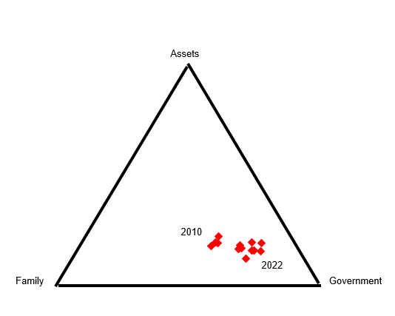
Familial support is deteriorating for S. Korea from 2010 to 2022

Slide 10
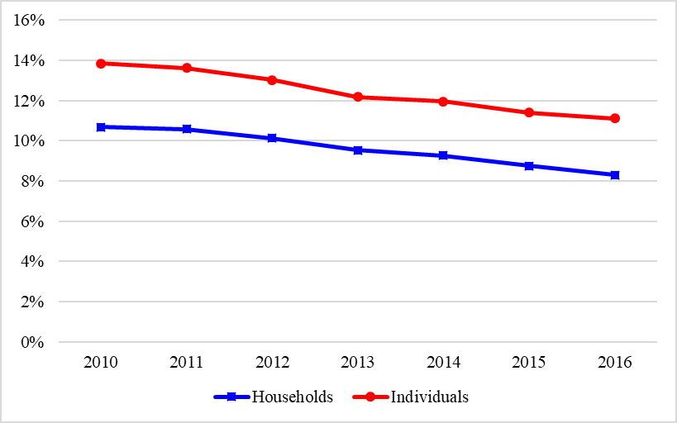
Proportion of the extended households

Slide 11
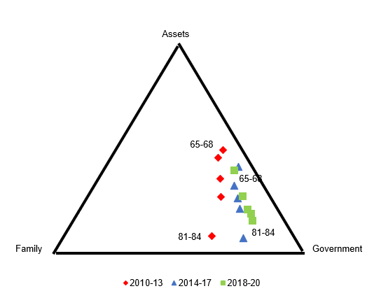
Age vs. Time effect (S. Korea) (2010-13 vs. 2014-17 vs. 2018-21)
The major tradeoff was TG and TF but it is TG and A now

Slide 12
Result 1. Support System in S. Korea
 | Nuclear | Extended
High | A | Tf
Low | Tg | Tg
Assets / Saving
HN
HE
LN & LE
Familial Transfers
Public Transfers

Slide 13
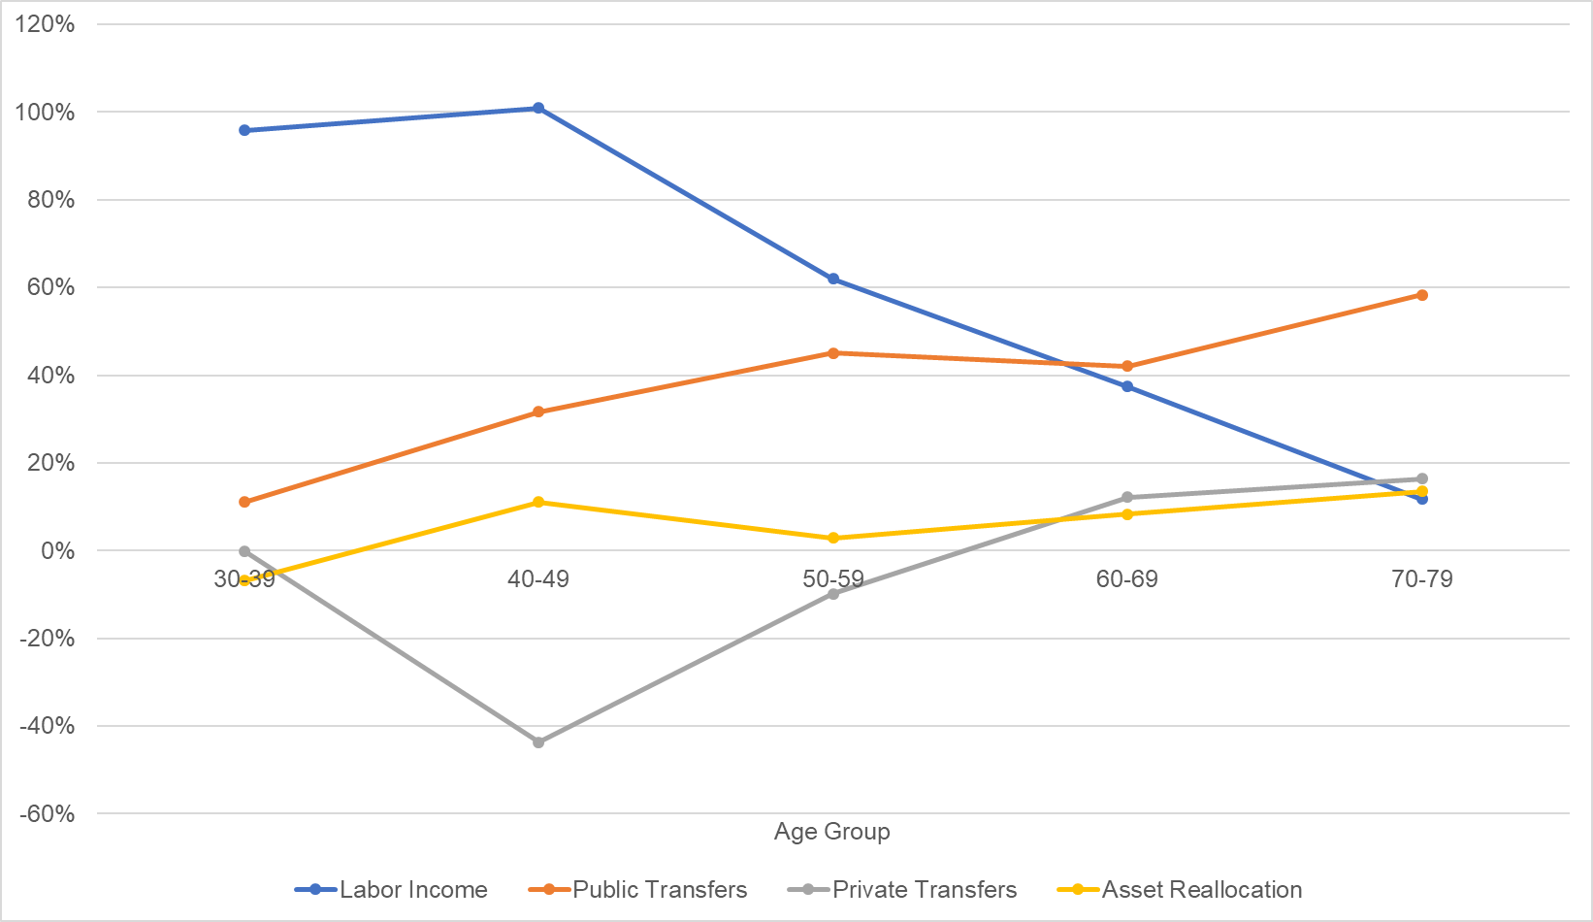
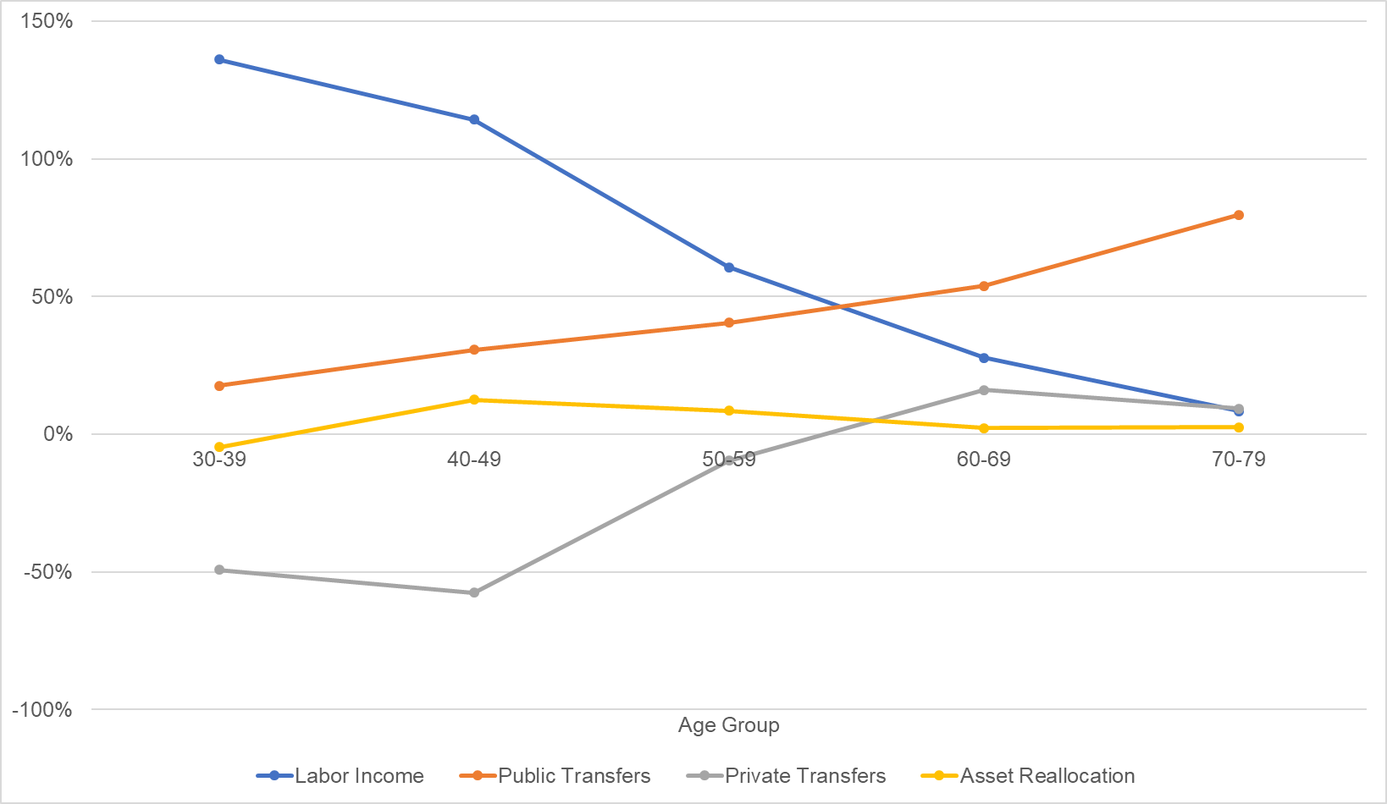
Support System by Age: Low Income HH
Public transfers for both nuclear (LHS) and extended HH (RHS)
Labor Income
Labor Income
Public Transfers
PublicTransfers

Slide 14
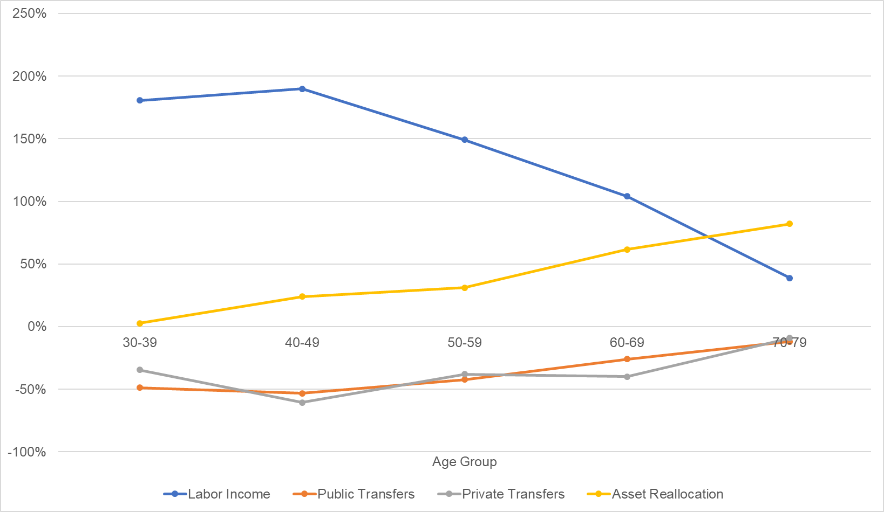
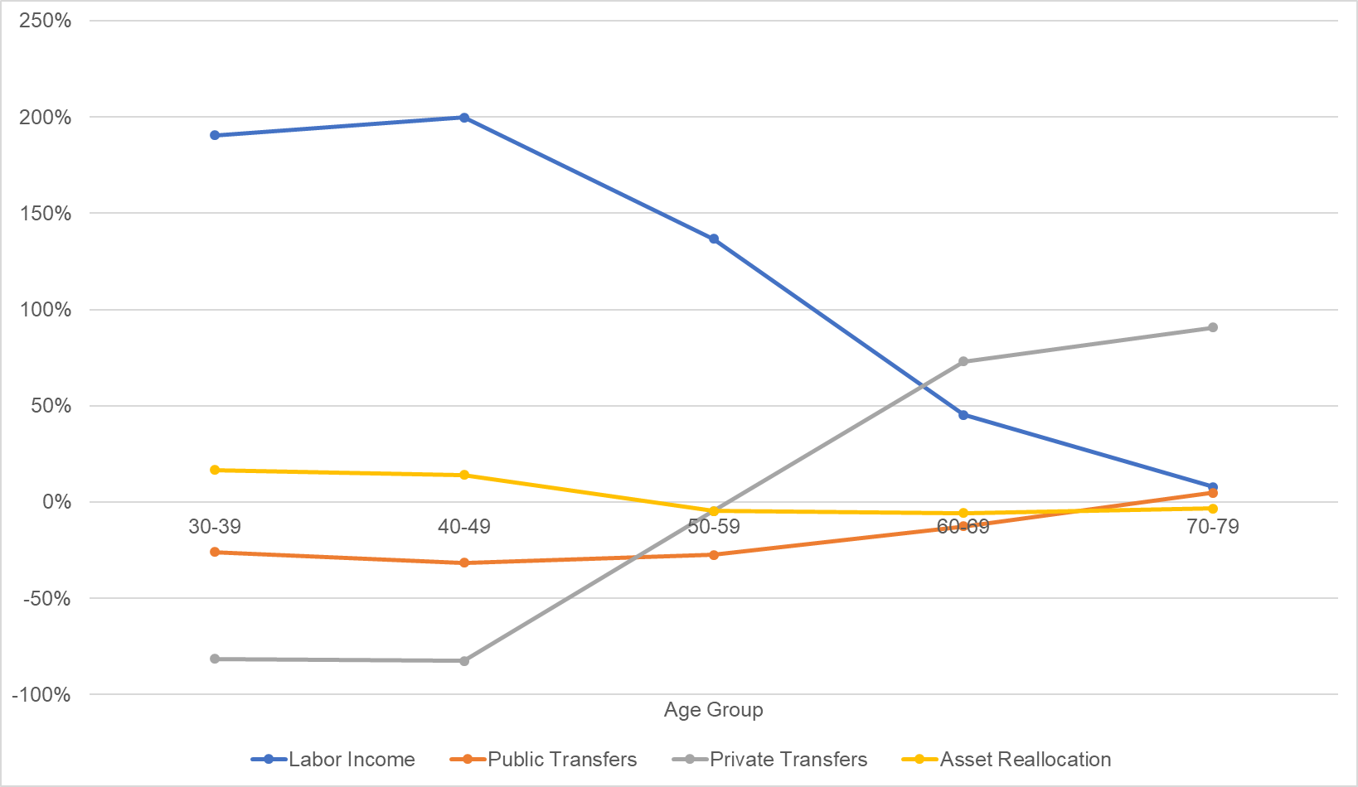
Support System by Age: High Income HH
Assets for nuclear (LHS), familial transfers for extended (RHS)
Labor Income
Labor Income
Asset-based Reallocation
Familial Transfers

Slide 15
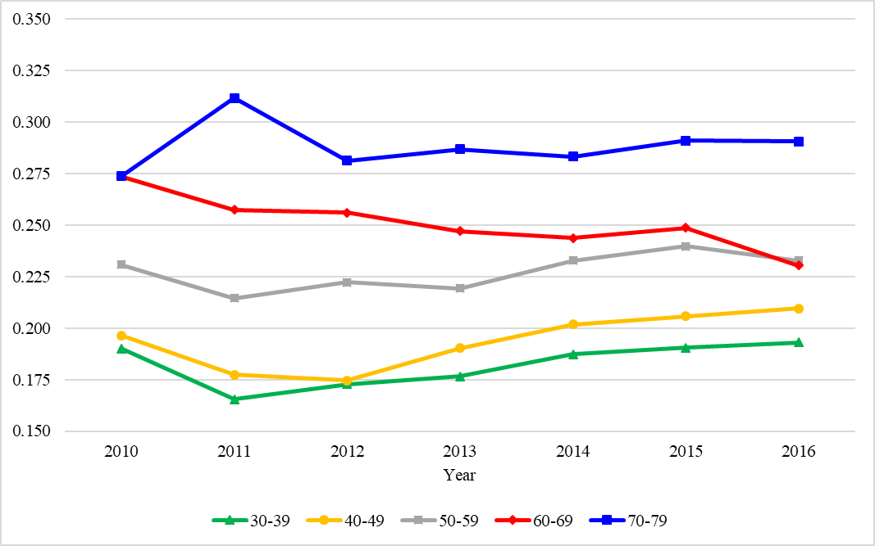
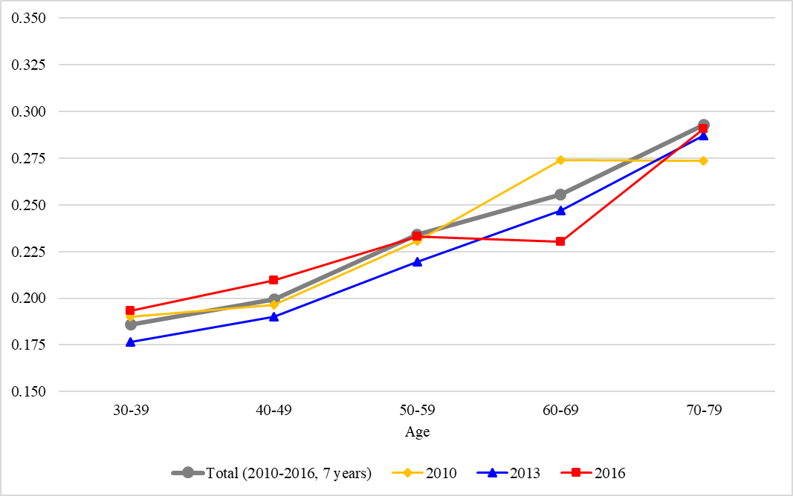
Result 2: Inequality
High for older people and varies by age group.
Within age variation among elderly is not increasing, while that for ages 30-59 is increasing.
Log Variance by Year
Log Variance by Age Group

Slide 16
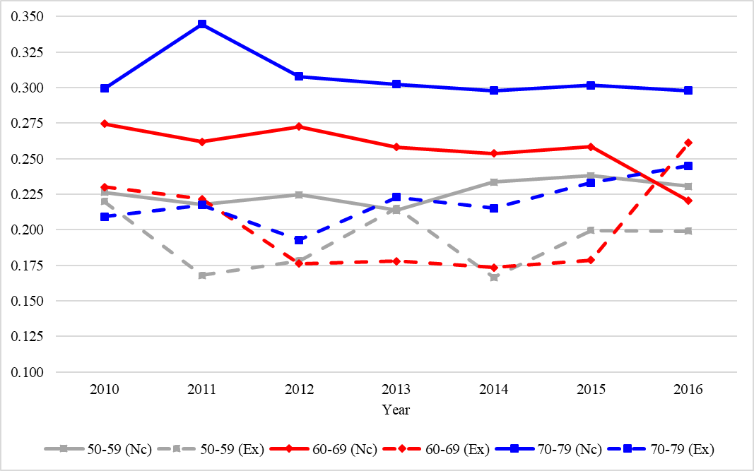
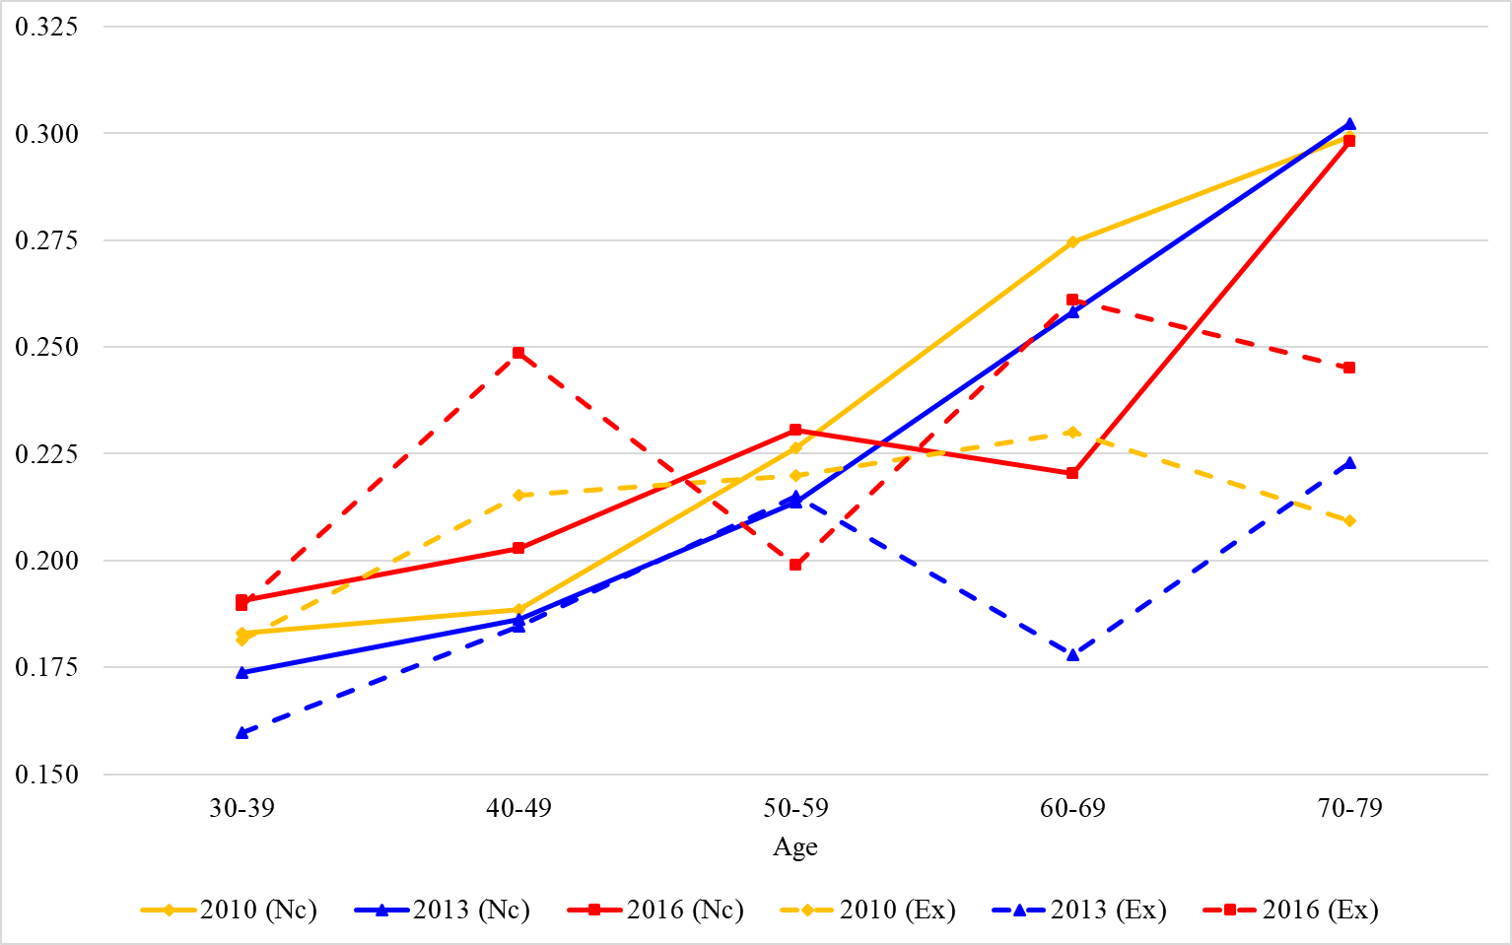
By living arrangement, age, and time
Consumption inequality among older people in extended households (dotted lines) is much lower than that of older people in nuclear households (solid lines).

Slide 17
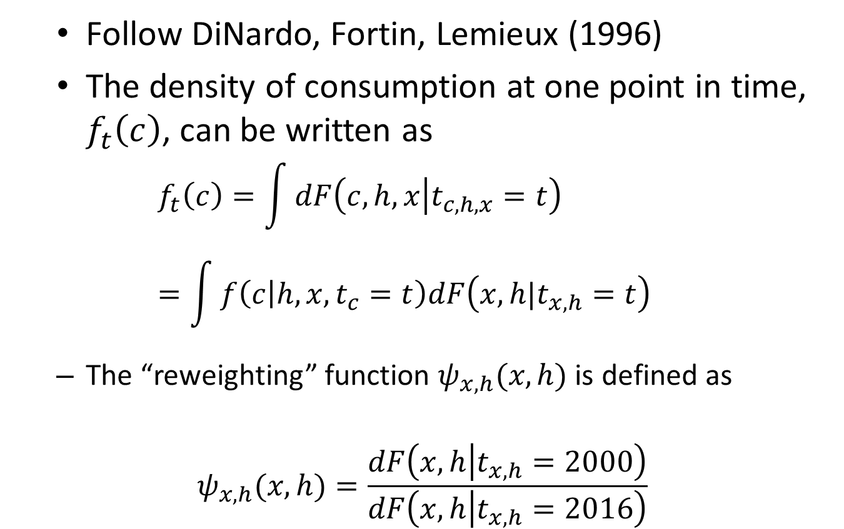
Counter factual analysis
Follow DiNardo, Fortin, Lemieux (1996)
The density of consumption at one point in time, $f_{t}\left(c\right)$, can be written as
$$f_{t}\left(c\right)=\int{dF\left(c,h,x | t_{c,h,x}=t\right)}=\int{f\left(c | h,x,t_{c}=t\right)dF\left(x,h|t_{x,h}=t\right)}$$
The “reweighting” function $ψ_{x,h}(x,h)$ is defined as
$$ψ_{x,h}(x,h)=\frac{dF\left(x,h | t_{x,h}=2000\right)}{dF\left(x,h | t_{x,h}=2016\right)}$$

Slide 18
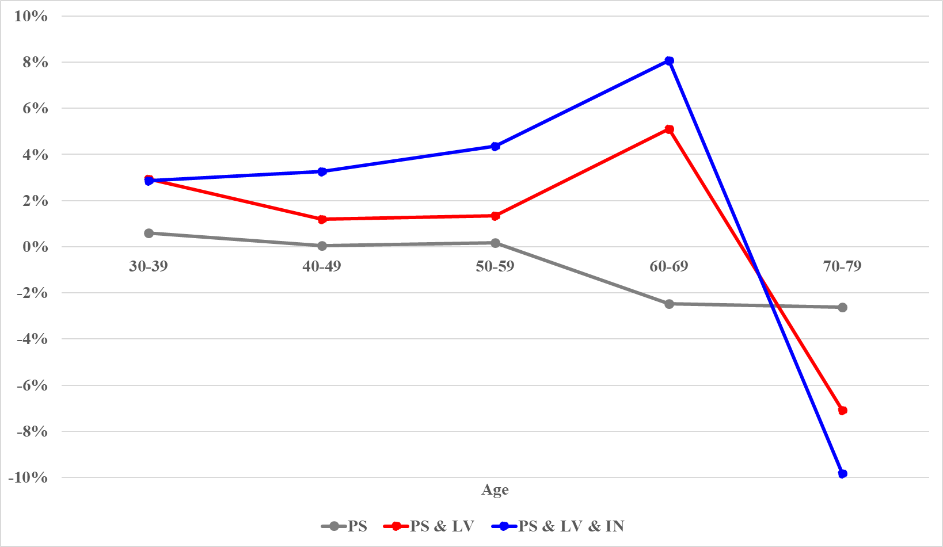
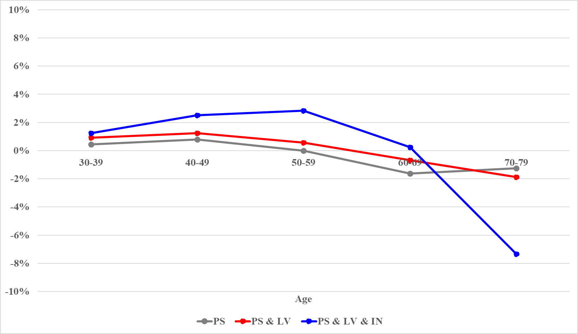
Result 3: Counterfactual analysis
2000-2016 2010-2016

Slide 19
Endogeneity of living arrangement
Mason and Lee (2004): as the number of seniors increases relative to the number of non-senior adults, the following should happen.
the number of seniors living in extended households must decline
the old-age dependency ratio within extended households must rise more rapidly than the old-age dependency ratio for the general population
the proportion of non-senior adults living in extended households must rise.

Slide 20
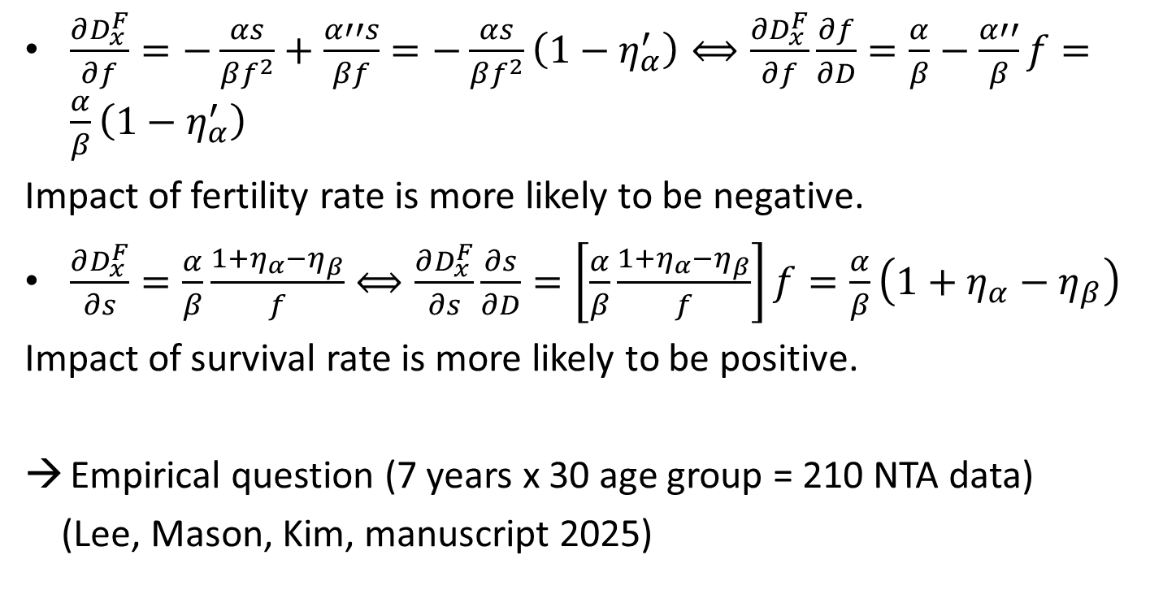
Effect on multi-generational family (ambiguous)
$\frac{∂D_{x}^{F}}{∂f}=−\frac{αs}{βf^{2}}+\frac{α′′s}{βf}=−\frac{αs}{βf^{2}}\left(1−η_{α}^{′}\right)⟺\frac{∂D_{x}^{F}}{∂f}\frac{∂f}{∂D}=\frac{α}{β}−\frac{α′′}{β}f=\frac{α}{β}\left(1−η_{α}^{′}\right)$
Impact of fertility rate is more likely to be negative.
$\frac{∂D_{x}^{F}}{∂s}=\frac{α}{β}\frac{1+η_{α}−η_{β}}{f}⟺\frac{∂D_{x}^{F}}{∂s}\frac{∂s}{∂D}=\left[\frac{α}{β}\frac{1+η_{α}−η_{β}}{f}\right]f=\frac{α}{β}\left(1+η_{α}−η_{β}\right)$
Impact of survival rate is more likely to be positive.
Empirical question (7 years x 30 age group = 210 NTA data)
(Lee, Mason, Kim, manuscript 2025)

Slide 21
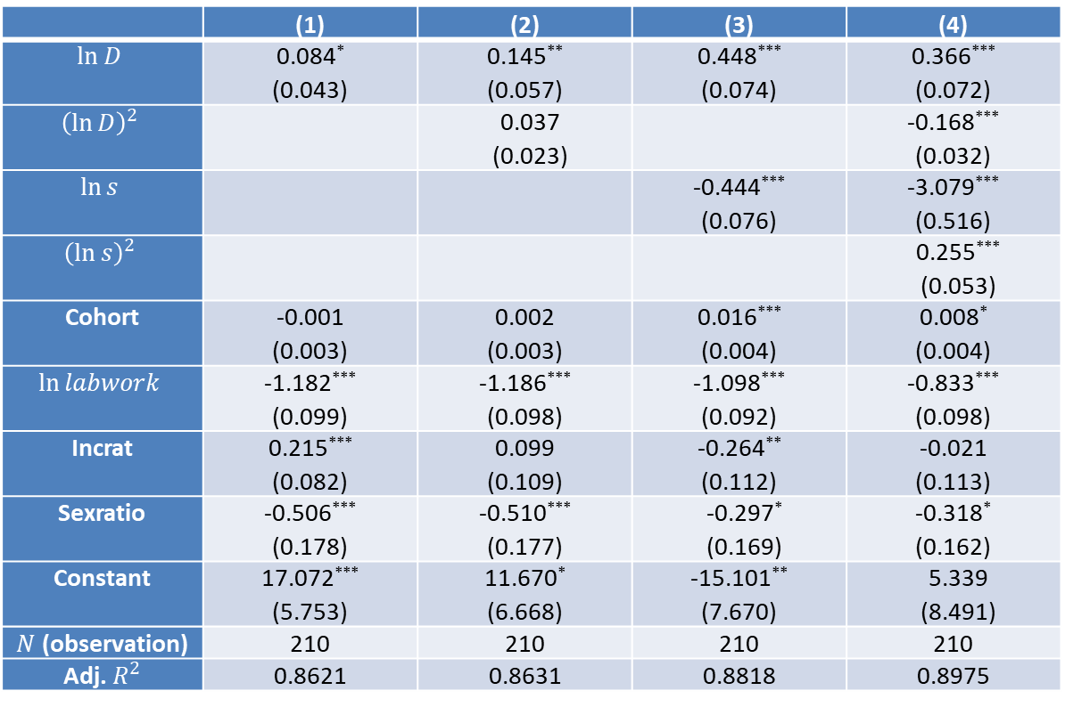
Results for proportion living in extended households
 | (1) | (2) | (3) | (4)
$$\ln{D}$$ | 0.084* (0.043) | 0.145** (0.057) | 0.448*** (0.074) | 0.366*** (0.072)
$${\left(\ln{D}\right)}^{2}$$ |  | 0.037 (0.023) |  | -0.168*** (0.032)
$$\ln{s}$$ |  |  | -0.444*** (0.076) | -3.079*** (0.516)
$${\left(\ln{s}\right)}^{2}$$ |  |  |  | 0.255*** (0.053)
Cohort | -0.001 (0.003) | 0.002 (0.003) | 0.016*** (0.004) | 0.008* (0.004)
$$\ln{labwork}$$ | -1.182*** (0.099) | -1.186*** (0.098) | -1.098*** (0.092) | -0.833*** (0.098)
Incrat | 0.215*** (0.082) | 0.099 (0.109) | -0.264** (0.112) | -0.021 (0.113)
Sexratio | -0.506*** (0.178) | -0.510*** (0.177) | -0.297* (0.169) | -0.318* (0.162)
Constant | 17.072*** (5.753) | 11.670* (6.668) | -15.101** (7.670) | 5.339 (8.491)
$N$ (observation) | 210 | 210 | 210 | 210
Adj. $R^{2}$ | 0.8621 | 0.8631 | 0.8818 | 0.8975
Notes:
A large surplus in the male pensioner population leads to a decline in the proportion of pensioners in extended households

Slide 22
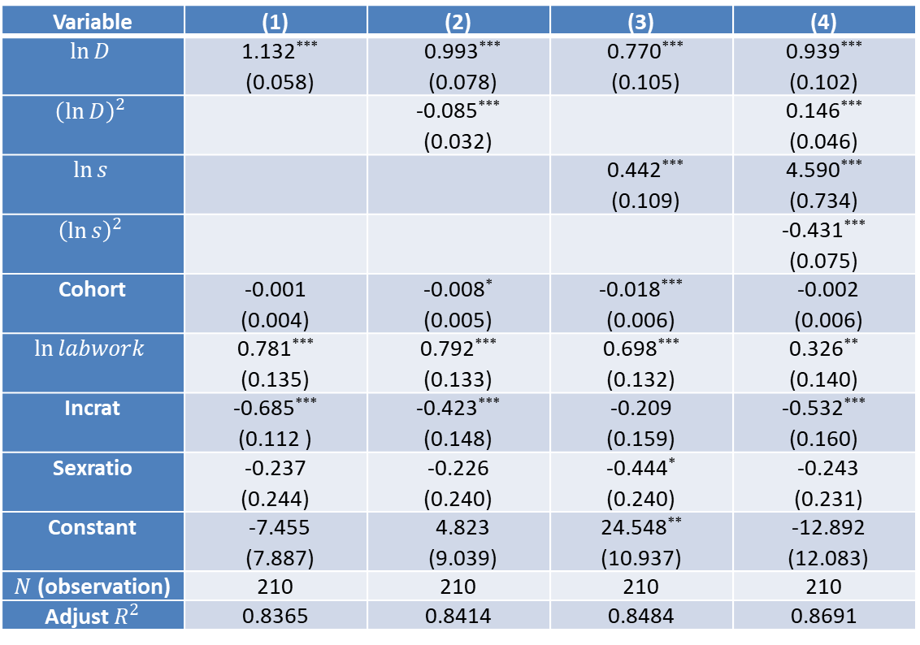
Results for dependency ratio in extended households
Variable | (1) | (2) | (3) | (4)
$$\ln{D}$$ | 1.132*** (0.058) | 0.993*** (0.078) | 0.770*** (0.105) | 0.939*** (0.102)
$${\left(\ln{D}\right)}^{2}$$ |  | -0.085*** (0.032) |  | 0.146*** (0.046)
$$\ln{s}$$ |  |  | 0.442*** (0.109) | 4.590*** (0.734)
$${\left(\ln{s}\right)}^{2}$$ |  |  |  | -0.431*** (0.075)
Cohort | -0.001 (0.004) | -0.008* (0.005) | -0.018*** (0.006) | -0.002 (0.006)
$$\ln{labwork}$$ | 0.781*** (0.135) | 0.792*** (0.133) | 0.698*** (0.132) | 0.326** (0.140)
Incrat | -0.685*** (0.112 ) | -0.423*** (0.148) | -0.209 (0.159) | -0.532*** (0.160)
Sexratio | -0.237 (0.244) | -0.226 (0.240) | -0.444* (0.240) | -0.243 (0.231)
Constant | -7.455 (7.887) | 4.823 (9.039) | 24.548** (10.937) | -12.892 (12.083)
$N$ (observation) | 210 | 210 | 210 | 210
Adjust $R^{2}$ | 0.8365 | 0.8414 | 0.8484 | 0.8691

Slide 23
Conclusion
If other things equal, between age variation due to aging may increase overall inequality
But within group variation among elderly decreases while within group variation for prime age adults increases rapidly
Familial transfers have been important factor in reducing inequality in S. Korea.
Counterfactual analysis suggests that declining extended households can be more important than aging for overall inequality
Results also suggest that declining extended households in S. Korea are not mainly due to population aging, but other factors such as demand for privacy (even in a non-Asian context: de Macedo et al., 2022).

