Slide 1


Training Workshop:
Intro to NTA and Macro Controls
Gretchen Donehower, UC Berkeley
March 11, 2025

Slide 2
Plan
Overview of NTA
  Motivation, objectives of the project
  Organization of the network
Calculation Basics
  What age profiles are
  What flows are included, how they are organized
Macro controls
  Flow from GDP by expenditure and income approaches to NTA lifecycle deficit and reallocations
  High-level macro control calculation examples

Slide 3
What are National Transfer Accounts?
National Transfer Accounts
National Accounts
(NA)
Household Surveys
Census, Population Projections
Administrative Data
Other Surveys and Indicators
Introductory Videos
    UNFPA Eastern Europe & Central Asia
    UNFPA Asia Pacific
NTA integrates population into economic analysis (puts the PEOPLE in the ECONOMY!)
Using existing data, NTA produces economic flows by age
Resources at ntaccounts.org

Slide 4
Three Features of our Societies Motivate the NTA Project
Changes in population age structure
  Large national, regional, and global changes
  Asia in particular notable for rapid fertility declines
Economic lifecycle
  Extended periods of “dependency”
  Many other aspects of economic behavior are age dependent
Complex and varied intergenerational economic systems
  Families, firms, markets, the state, and civil society all play a role
  Important implications for poverty, economic growth, and generational equity

Slide 5
Goals of the NTA Project
Develop a system of economic accounts that quantifies age and intergenerational flows in a comprehensive fashion
Estimate the accounts with historical depth for economies with different cultures, levels of development, economic systems and policies
Analyze and explain
  variation in the economic lifecycle and the intergenerational economic systems
  macroeconomic effects of demographic transition and population aging
Improve policy related to economic growth, pensions, health care, education, fertility, etc.

Slide 6
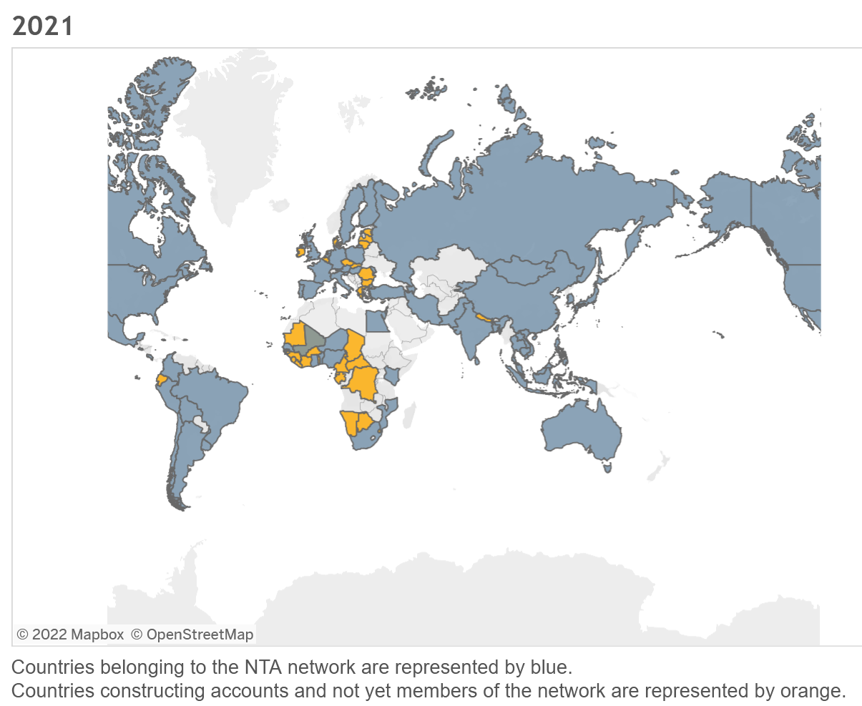
The NTA Network
Over 80 country teams, with estimates from 101 countries
Teams combine academics, government and think tank researchers and others
Once formed, teams get the “franchise” for NTA in that country
Affiliation network only, most funding through regional projects or individual researcher’s grants.
Data and results sharing, collaboration, networking through www.ntaccounts.org
Notes:
Currently 98 countries, with over 85% of the world’s population. (big one missing is Pakistan although they have a team now)
Begun conceptually in the 1990s, by professors Ron Lee of UC Berkeley and Andrew Mason of the University of HI and the East West Center.
The first estimates began around 2003-2006, with numbers of countries climbing quickly as publications from the project began to come out.

Slide 7
I. Population Age Structure
Population age structure is a feature of the demographic transition
  Before: very young populations due to high fertility
  Early: decline in infant and child mortality
  Mid: decline in fertility
  Mid: Large working-age share as large cohorts of children reached adulthood
  Late: Old populations as old-age survival increases and fertility reaches low levels.
  Example: NEPAL

Slide 8
Nepal’s population, today and tomorrow
Data from UN World Population Prospects, 2022

Slide 9
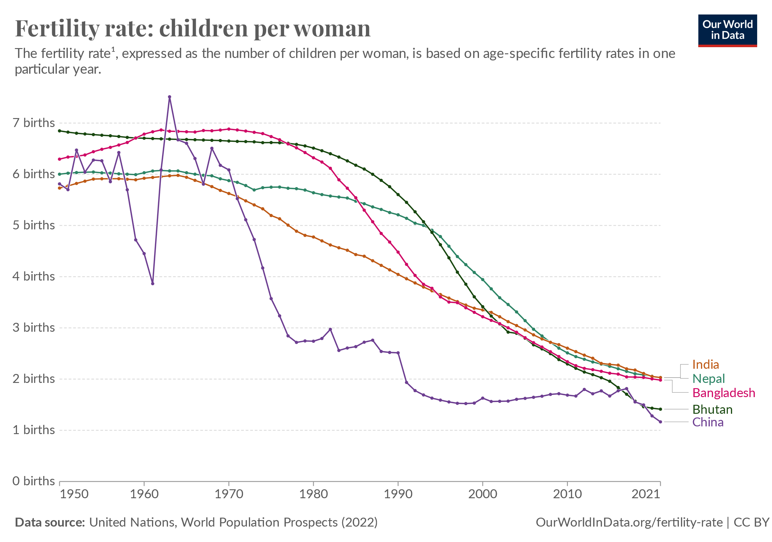

Slide 10
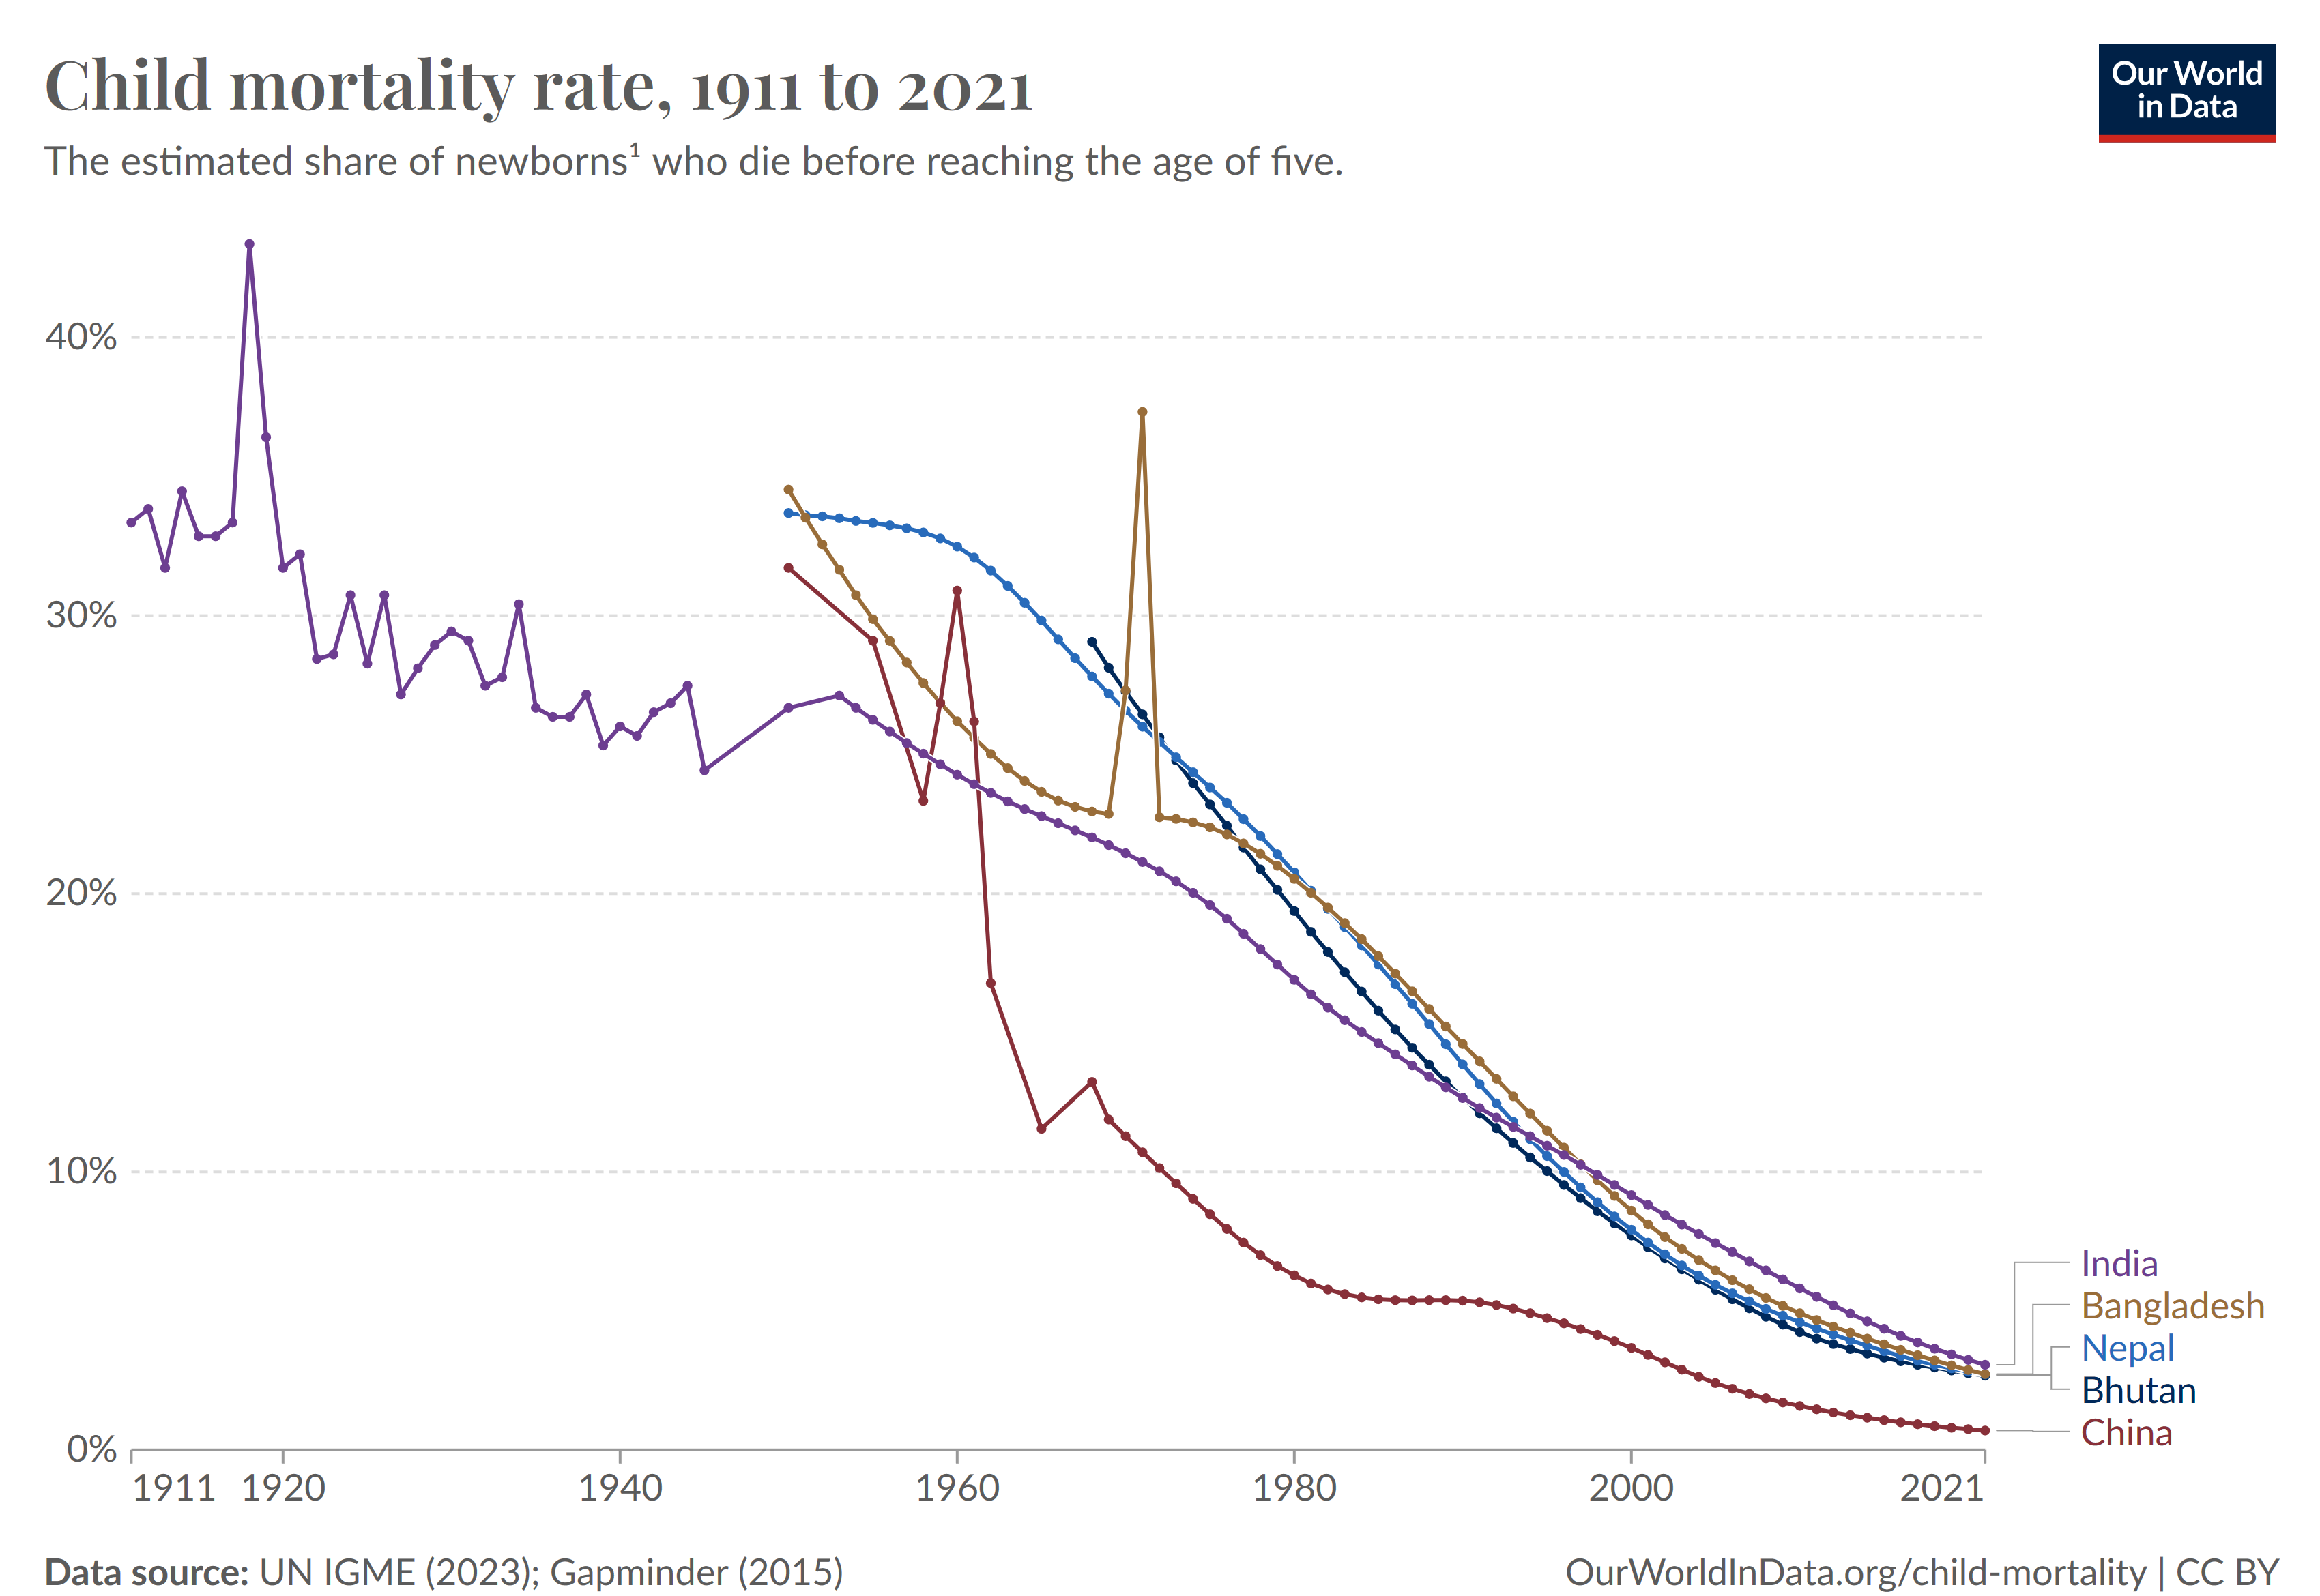

Slide 11
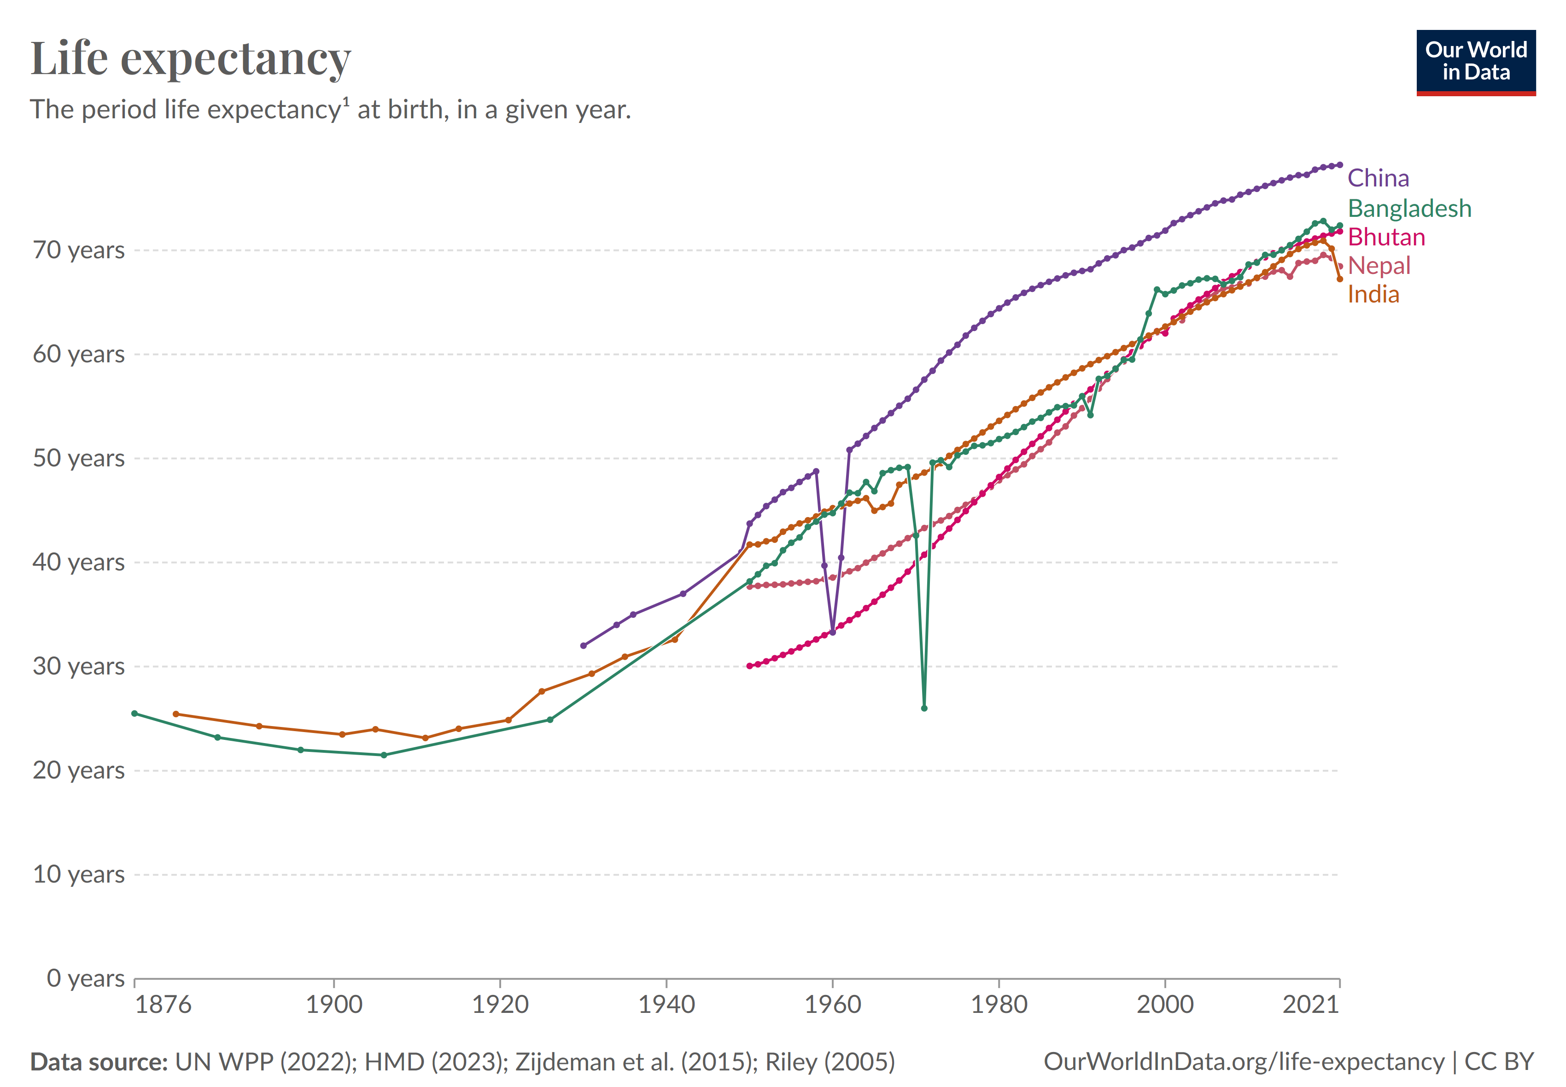

Slide 12
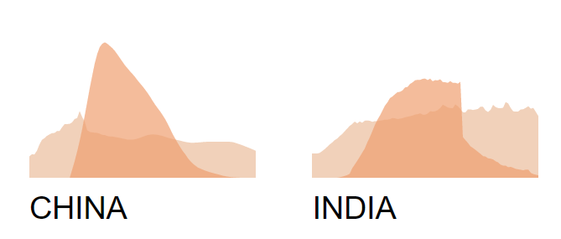

II. The Economic Lifecycle
Per Capita Consumption and Labor Income
Data available at NTA Interactive Data Explorer (https://ntaccounts.org/web/nta/show/Interactive%20Data%20Explorer)

Slide 13
Age in Our Economies
NTA disaggregates national accounts totals by age.
On average, ages 0-23 and 62+ need resources to be able to consume, from ages 24-61.
Young people get resources in the form of transfers.
Older persons get resources from transfers but also from asset income from own saving.

Slide 14
3 Population Age Distribution Examples

Slide 15
Aggregate Lifecycle
Based on per capita profile for developing countries weighted by UN estimates of 2005 age structure.
Two features are of interest
  Overall dependency: Total difference between labor income and consumption.
  Direction of IG flows: Do flows to children or the elderly dominate?

Slide 16
Lifecycle Deficit: Kenya
Intergenerational flows are heavily downward.
Kenya’s LC surplus is much smaller than its deficit; extra consumption could be funded from asset income (or net transfers from the rest of the world). Impact on saving.
Alternatively people could work more or consume less than in the standard profile. Difficult to balance without spending less on children. Impact on human capital.

Slide 17
Lifecycle Deficit: Germany
Intergenerational flows in both directions are important.
Germany’s surplus is slightly smaller than its deficit; extra consumption must be funded from asset income (or net transfers from the rest of the world).
Alternatively people could work more or consume less than in the standard profile.
Note that results will differ when per capita lifecycle for Germany is used.

Slide 18
Future Lifecycle Deficit:
Germany 2050
Intergenerational flows to elderly have increased relative to flows to the young.
Germany’s overall deficit has grown to 10% of labor income. Almost as large as Kenya’s 2005 deficit.
How this will influence the German economy and other aging societies will depend on the systems used to reallocate resources across generations.

Slide 19
NTA beyond consumption and labor income: complex and varied intergenerational support systems
Sources
Uses
Labor Earnings
Consumption
Asset Income
Savings
Government Transfers (Receiving Benefits)
Government Transfers
(Paying Taxes)
Family Transfers
(Receiving)
Family Transfers
(Giving)
Notes:
So we saw how labor earning and consumption looked, now we see three different types of ways to “solve” the LCD “problem.
Market- sector (assets)
Government sector (public transfers)
Family sector (private transfers)

Slide 20
The Flow Account Identity (sources and uses rearranged)
Inflows
  Labor Income
  Asset Income
  Transfer Received
Outflows
  Consumption
  Saving
  Transfers Paid

Slide 21
Flow Account and Sectors
Flows are classified by sector based on the mediating institution.
  Public sector: flows to and from individuals through general government.
  Private sector: flows to and from individuals through financial and non-financial firms, households or families, and non-profit institutions serving families (NPISHs)
  Rest of the world (ROW): flows between the domestic economy and other economies (governments, firms, individuals, etc.)
NTA measures all flows from the perspective of individuals not from the perspective of the sector. A public inflow is an inflow to individuals through the public sector. It is not an inflow to the public sector.
Example: From the perspective of the government taxes are an inflow. From the perspective of individuals paying the taxes and NTA, they are public transfer outflows.

Slide 22
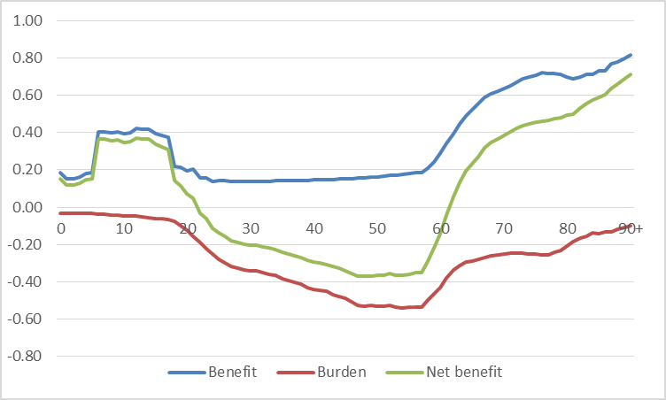
Understanding age in fiscal accounts
Per capita public transfer benefits (inflow) and burdens/taxes (outflow) by age
Can evaluate how population age structure change will make it harder or easier for government to afford its current per capita spending

Slide 23
Policy uses for NTA estimates
Enhance sustainability of intergenerational support systems
  Overall support system represented by consumption and labor income
  Fiscal support systems (balance of taxes and benefits)
  Asset accumulation systems
Understand and monitor potential demographic dividends
Further applications by estimating NTA by sub-groups
  Geography
  Gender
  Urban/rural
  Other

Slide 24
Other benefits of NTA approach
Lifecycle perspective is important for all kinds of policies, is future-focused, is person-focused
NTA can help integrate different government data producers, policy experts, and others
Supports a culture of evidence-based policymaking

Slide 25
Data and basic methods
National Transfer Accounts
National Accounts
(NA)
Household Surveys
Census, Population Projections
Administrative Data
Other Surveys and Indicators
Data: population, national accounts, household surveys, administrative data
Population estimates
  Single year of age to 90+
  Evaluated for quality
  Can use UN World Population Prospects if national estimates not available
  Significant non-household population?

Slide 26
Data and basic methods
National accounts data (in SNA format)
  List of main SNA tables given in the manual, need tables by sector
  Will probably also need:
      Government expenditure records
      Entries for your country in the International Monetary Fund’s Government Finance Statistics (GFS) publications

Slide 27
Data and basic methods
Household surveys
  Income and expenditure surveys give direct measures or indicators of relative age patterns
  May need to supplement with specialized surveys (older people, institutionalized population)
Administrative data
  Start with a “public sector inventory” (exercise we will go through tomorrow)
  Government reports on public program participation by age
  May have data on monetary flows, or may only have participation indicators

Slide 28
Data and basic methods
Necessary features of household surveys and administrative records:
  Nationally representative
  Designated household head/householder
  Sufficient sample size
  Household roster by age, sex, work/school status
  Includes necessary indicators:
    Income by source (including work, government benefits, gifts, interest and dividend income, etc.)
    Expenditure by type (amounts paid for consumption, taxes, gifts, etc.)

Slide 29
How to calculate an age profile
Calculate the macro control from national accounts
Identify a measure or proxy indicator for the flow
    1. From household survey
      Use individual-level data if available
      Otherwise allocate household amount to individuals in the household
    2. From administrative records
    3. On a priori grounds (i.e. assumed or calculated from other age profiles)
Calculate single-year age group averages
    May have to adjust for any missing populations (i.e. persons not represented in survey or administrative records)
Smooth
    Evaluate to ensure that no real variation has been eliminated
Adjust to controls
    Evaluate adjustment factor to test the validity of the age shape

Slide 30
Data and basic methods
Smoothing:
    Reduces noise from sampling
    We use a cross-validation smoother (Friedman’s Super Smoother) that can incorporate weights
    Smooth lowest-level components only
    Beware of eliminating “real” features of the age pattern
      Peaks/valleys, elbows, zeros
    False negative values should be replaced with zeros
    Details and examples in manual appendix
      *** but since manual was printed, a better solution has appeared: “supsmooth” is now in Stata in the base package, a cross-validation smoother that can incorporate weights

Slide 31
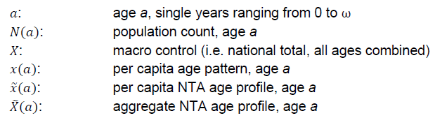


Macro control adjustment
Scale Factor Calculation:
Apply Scale Factor:

Slide 32
Organization of Accounts
Transfers have inflows and outflows.
Also collect a full set of tax profiles.

Slide 33
And now… SNA and NTA Macro controls!
Two different strategies
Calculate macro controls one by one as you estimate the age profiles
Calculate highest-level macro controls first to make sure they balance, then sub-divide high-level amounts into lower-level amounts as you estimate the age profiles
We will follow the second!

Slide 34
Start with the highest level amounts
NTA balancing equation is a rearrangement of the double accounting system for current income:
SNA NATIONAL ACCOUNTS SYSTEM
NTA MACRO CONTROLS

Slide 35
Start with the highest level amounts
NTA balancing equation is a rearrangement of the double accounting system for current income:
SNA NATIONAL ACCOUNTS SYSTEM
Go from a gross, domestic basis to a net national basis, allocate gross mixed income to labor or asset income, and go from basic prices to market prices, while separating public (government) from private (families, corporations, non-profits) flows.
NTA MACRO CONTROLS

Slide 36
How to get lower-level macro controls?
NTA MACRO CONTROLS
Once you have the macro controls above, how do you get the separate parts?
General rule: look for data sources to provide proportional shares of lower-level accounts, and apply those proportions to the higher-level macro controls that you know will balance
  Saving: separate into public and private based on sector-level accounts
  Consumption: look for “final consumption expenditures” separated into household and non-profits serving households sectors versus general government; further sub-divide within those categories

Slide 37
Lab exercise
Constructing aggregate NTA flows from National Accounts
Spreadsheet-based examples with data from UN database
  There are often LOTS of items left out of SNA tables, so sometimes we need to guess
Tables and calculation from example country
Start working through Nepal case with publicly available national accounts data, see where we have gaps

