Slide 1


Application of the NTTA and Micro-simulation Approach to Assessing Gender Dividend in Bangladesh
M Shahidul Islam, PhD and Bazlul H Khondker, PhD
Chief, Demographic Data and Intelligence Unit, UNFPA – Bangladesh
and Chairman, South Asian Network on Economic Modeling
Presented at the 15th NTA Global Workshop, March 10-13, 2025
Bangkok, Thailand

Slide 2

Content
Gender Dividend in Bangladesh: Application of NTTA and Beyond
NTTA
Micro-simulation
Policy Recommendation

Slide 3
Disparity and Gender Dividend in Bangladesh
Gender Divide
Gender divide in Labour Force Participation in 2022 (80:43)
Wage divide (male wage 23 % higher in 2022)
Inactive workers or labour outside labour force (LOLF) [in 2022 74% women vs 26% of 47 million]
Unpaid work divide (0.8 vs 5.9 hours in 2019)
Education divide [Average years of Schooling 2016 (15-64 years population): M 8.5| F 6.8
Parity in above areas will likely generate gender dividend
Requires assessment of size and drivers of GD to design strategies
Two approaches adopted here
NTTA for Bangladesh based on Time Use Survey 2012 and 2019
Micro-simulation models developed using LFS- 2013, 2017 and 2022
Notes:
Before estimating gender dividends, let me focus on Gender DIVIDE in Bnagaldesh
Women participate much less in the formal labour force and perform significantly more unpaid work.
A large proportion of women remain economically inactive despite being of working age.
The wage gap is substantial, with men earning 23% more than women for similar work.
Education disparities persist, with women receiving 1.7 fewer years of schooling on average.

Slide 4
SNA, NTA and NTTA (CWW)
GDP sectors 32 | UN SNA 2008
 | SNA Work Time
 | GDP growth & structure
Age cohort (0-100) | UN NTA MANUAL 2013
 | NTA Work Time
 | GDP age distribution
Age Cohort (0-100) | Gender (M-W) | COUNTING WOMEN WORK 2016
 |  | UNPAID WORK TIME (NTTA Time)
 |  | Share of Household production & care
GDP by Sector
(FY 23: USD 416 billion)
GDP by People
(FY 23: USD 416 billion)
Value of household work by Gender
(USD 200 billion)
Notes:
Standard UN methodology for calculating GDP (UN SNA)- Uses SNA Work Time to measure paid labour contributions.
NTA Expands GDP measurement by considering age-based economic contributions (UN NTA Manual 2013).
Highlights how different age groups contribute to and consume economic resources.
NTTA Measures unpaid household and care work (Counting Women’s Work 2016).
Uses Time to track hours spent in non-market activities.
Assigns economic value to unpaid work, especially that of women.
Unpaid household work is valued at USD 200 billion, represents nearly half of the formal GDP.

Slide 5
Counting Women Work and Gender Dividend in Bangladesh
Results from NTTA and Micro-simulation model

Slide 6
Bangladesh NTTA and CWW (2012)
Daily Hours spent of by type of work and sex
Percent distribution of employed by type of work and sex
Hourly distribution of time per NTTA Activity (Time Use, Average Person) in Bangladesh-2012
Hourly distribution of time per NTTA Activity, by gender in Bangladesh-2012
Notes:
For Employed Individuals:
Men spend more time on paid work (6.9 hours) than women (5.2 hours).
Women spend significantly more time on household work (3.6 hours) than men (1.4 hours).
Women have slightly more leisure time than men.
Both genders spend significant time on "other work" (14.6 hours for men, 14.4 hours for women)- informal employment and extended family responsibilities, making "other work" a significant time category.
✅ Women spend significantly more time on unpaid household work than men, regardless of employment status- carry a "double burden" of both paid and unpaid work.

Slide 7
Bangladesh NTTA and CWW (2012)
Average weekly time spent by age and sex in Bangladesh, 2012 (hours per week)
Value of time Household Production, by gender
Notes:
✅ Men dominate paid work, while women perform most unpaid household work. ✅ Women’s unpaid work is substantial and peaks in middle age. ✅ The economic value of women’s unpaid work is significant but not recognized in GDP calculations.

Slide 8
Bangladesh NTTA and CWW (2012)
Monetary Value of Unpaid work as a percentage of GDP 2012
Profile | Production - Care | Production - Care | Consumption - Care | Production - Housework | Production - Housework | Consumption - Housework
Sex | Female | Male | BOTH SEXES | Female | Male | BOTH SEXES
Aggregate single sex (Million BDT) | 632,333 | 125,042 |  | 3,924,194 | 1,075,866
Aggregate both sexes (Million BDT) |  |  | 757,375 |  |  | 5,000,060
% of GDP (2012) | 6.3% | 1.3% | 7.6% | 39.3% | 10.8% | 50%
Value of Women unpaid work = BDT 3,999 Billion or 46 % of GDP
Value of Men unpaid work = BDT 1,002 Billion or 12.1 % of GDP
Value of unpaid work will be higher by women as they devoted more time in unpaid work than men in 2019
Notes:
✅ Unpaid work makes up a massive share of GDP (50% for housework and about 8% for care work). ✅ Women carry the majority of the unpaid work burden, with little contribution from men. ✅ The economic value of unpaid work is enormous but remains invisible in GDP calculations.

Slide 9
Microsimulation Specification
Gender Dividend (GD) | Description | Key Drivers
GD 1 | Under this measurement, potential additional female workers have been calculated assuming that the FLFP rate is equal to the MLFP. | Parity in labour force participation
GD 2 | Assess the extent of GD if there is parity between inactivity rate of male workers and women workers. | Parity in inactivity rate (outside labour force)
GD 3 | Measure the extent of GD under wage parity between the male workers and women workers. | Parity in wage rate
GD 4 | Value of household unpaid works by gender | Closing Gender gap in household work
GD 5 | Value of household unpaid works by gender with wage parity | Closing Gender gap in household work and equal wage
GD 6 | Measure the extent of GD under parity in educational attainment | Parity in educational attainment
GD 7 | Measure the extent of GD under parity in educational attainment and wage equality | Parity in educational attainment and wage rate
Notes:
✅ Gender equality in labour force participation (GD 1) would significantly increase the number of female workers. ✅ Reducing women’s economic inactivity (GD 2) would lead to a more balanced workforce. ✅ Achieving equal pay (GD 3) would improve women’s economic contributions and earnings. ✅ Unpaid household work (GD 4 & GD 5) has substantial economic value, especially if valued equally as paid work. ✅ Educational parity (GD 6 & GD 7) would enhance economic productivity and income equality.

Slide 10
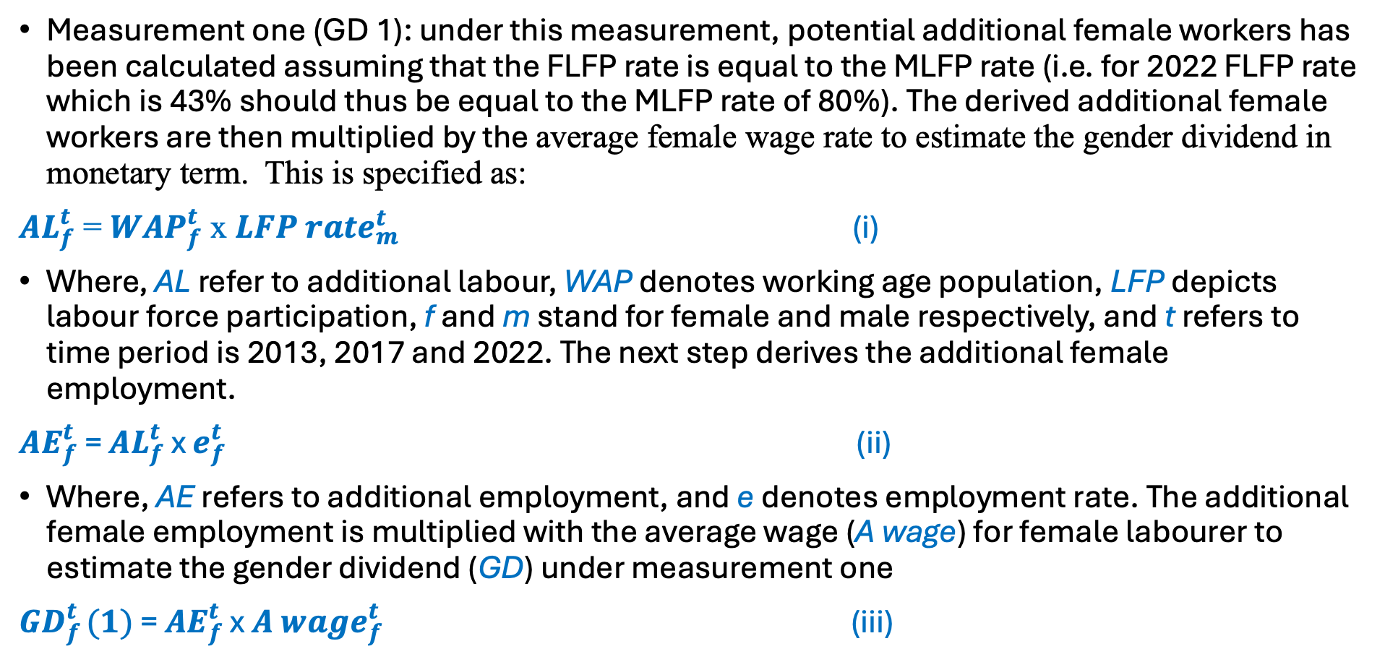
Micro-simulation Model
Measurement one (GD 1): under this measurement, potential additional female workers has been calculated assuming that the FLFP rate is equal to the MLFP rate (i.e. for 2022 FLFP rate which is 43% should thus be equal to the MLFP rate of 80%). The derived additional female workers are then multiplied by the average female wage rate to estimate the gender dividend in monetary term. This is specified as:
${AL}_{f}^{t}$ = ${WAP}_{f}^{t}$ x ${LFP rate}_{m}^{t}$ (i)
Where, AL refer to additional labour, WAP denotes working age population, LFP depicts labour force participation, f and m stand for female and male respectively, and t refers to time period is 2013, 2017 and 2022. The next step derives the additional female employment.
${AE}_{f}^{t}$ = ${AL}_{f}^{t}$ x $e_{f}^{t}$ (ii)
Where, AE refers to additional employment, and e denotes employment rate. The additional female employment is multiplied with the average wage (A wage) for female labourer to estimate the gender dividend (GD) under measurement one
${GD}_{f }^{t}(1)$ = ${AE}_{f}^{t}$ x ${A wage}_{f}^{t}$ (iii)

Slide 11
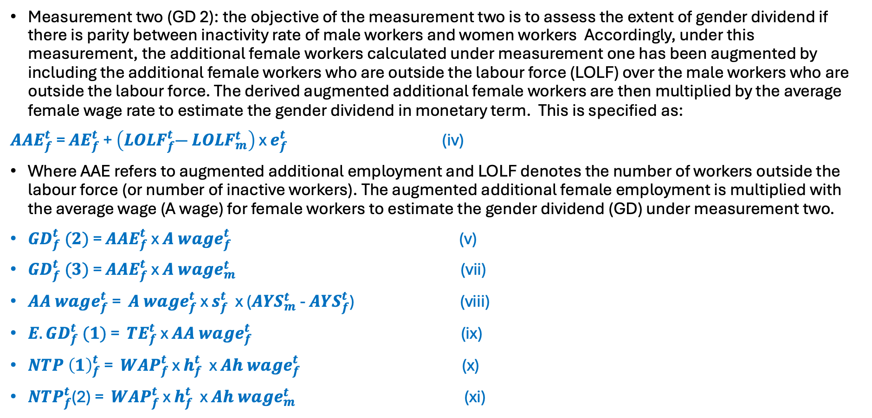
Micro-simulation Model
Measurement two (GD 2): the objective of the measurement two is to assess the extent of gender dividend if there is parity between inactivity rate of male workers and women workers Accordingly, under this measurement, the additional female workers calculated under measurement one has been augmented by including the additional female workers who are outside the labour force (LOLF) over the male workers who are outside the labour force. The derived augmented additional female workers are then multiplied by the average female wage rate to estimate the gender dividend in monetary term. This is specified as:
$A{AE}_{f}^{t}$ = ${AE}_{f}^{t}$ + $\left({LOLF}_{f}^{t}― {LOLF}_{m}^{t}\right)$ x $e_{f}^{t}$ (iv)
Where AAE refers to augmented additional employment and LOLF denotes the number of workers outside the labour force (or number of inactive workers). The augmented additional female employment is multiplied with the average wage (A wage) for female workers to estimate the gender dividend (GD) under measurement two.
${GD}_{f}^{t} (2)$ = ${AAE}_{f}^{t}$ x ${A wage}_{f}^{t}$ (v)
${GD}_{f}^{t} (3)$ = ${AAE}_{f}^{t}$ x ${A wage}_{m}^{t}$ (vii)
${AA wage}_{f}^{t}$ = ${A wage}_{f}^{t}$ x $s_{f}^{t}$ x (${AYS}_{m}^{t}$ - ${AYS}_{f}^{t}$) (viii)
${E.GD}_{f}^{t} (1)$ = ${TE}_{f}^{t}$ x ${AA wage}_{f}^{t}$ (ix)
${NTP \left(1\right)}_{f}^{t}$ = ${WAP}_{f}^{t}$ x $h_{f}^{t}$ x ${Ah wage}_{f}^{t}$ (x)
${NTP}_{f}^{t}$(2) = ${WAP}_{f}^{t}$ x $h_{f}^{t}$ x ${Ah wage}_{m}^{t}$ (xi)

Slide 12
Gender Dividend in Bangladesh: Estimation
Labour Force Participation
2022: MLFP (80%) > FLFP (43%) by 37 percentage points
IF
MLFP = FLFP ­­­-> GD 1
 | Billion BDT | % of GDP
2022 | 2,629 | 6.6
2017 | 3,320 | 14.3
2013 | 3,209 | 23
2017: MLFP (81%) > FLFP (36%) by 45 percentage points
2013: MLFP (82%) > FLFP (34%) by 48 percentage points
Outside Labour Force Participation (Inactive Labour Force)
2022: FLOLF > MLOLF by 22 million | Augmented FE 44 million
IF
MLOFP = FLOFP ­­­-> GD 2
 | Billion BDT | % of GDP
2022 | 5,286 | 13.3
2017 | 6,657 | 28.6
2013 | 6,465 | 46.4
2017: FLOLF > MLOLF by 23 million | Augmented FE 45 million
2013: FLOLF > MLOLF by 24 million | Augmented FE 48 million
Notes:
✅ If women’s participation equaled men’s, Bangladesh’s GDP could have been about 7% higher in 2022. ✅ The gender dividend (GD 1) has decreased over time, likely because FLFP has improved slightly.
✅ If the inactive female workforce joined the economy, Bangladesh could add 44 million new workers.
Bangladesh’s GDP could increase by 13% (2022). The gender dividend (GD 2) has declined over time, indicating that fewer women remain inactive compared to previous years.

Slide 13
Gender Dividend in Bangladesh: Estimation
G2 with Gender Wage
2022: M wage > F wage 23 %
IF
M wage = F wage ­­­-> GD 3
 | Billion BDT | % of GDP
2022 | 6,518 | 16.4
2017 | 7,378 | 31.7
2013 | 6,747 | 48.4
2017: M wage > F wage 11 %
2013: M wage > F wage 4.4 %
Notes:
✅ The gender wage gap has widened significantly, with men earning 23% more than women in 2022. ✅ Closing the wage gap could increase GDP by over 16.4% in 2022.
✅ The economic cost of the gender wage gap has declined over time, possibly due to more women entering the workforce

Slide 14
Gender Dividend in Bangladesh: Estimation
Unpaid Household Work
2019: Unpaid Hours Work (Male 0.8) < (Female 5.9) less by 5.1 hours
Value of Unpaid work
GD 4
 | Billion BDT | % of GDP
2022 | 5,401 | 13.6
2017 | 5,965 | 25.7
2013 | 4,436 | 31.8
2012: Unpaid Hours Work (Male 1.2) < (Female 4.9) less by 3.7 hours
GD 4 with Gender Wage Equal
Value of Unpaid work (wage equal)
GD 5
 | Billion BDT | % of GDP
2022 | 6,659 | 16.8
2017 | 6,612 | 28.5
2013 | 4,629 | 33.2
Notes:
✅ Unpaid work contributed nealry 14% of GDP in 2022.
✅ If unpaid work was valued at equal wages to paid work, it would significantly boost GDP.
✅ If unpaid work was compensated at market wages, it would add around 17% to GDP in 2022.

Slide 15
Gender Dividend in Bangladesh: Estimation
Education Attainment
Years of Schooling: in 2016 (Male 8.5) > (Female 6.8) less by 37 % | in 2010 (Male 7.8) > (Female 6.2) less by 37 %
Educational Attainment
GD 6
 | Billion BDT | % of GDP
2022 | 814 | 2.1
2017 | 1,025 | 4.4
2013 | 936 | 4.4
Returns to additional years of schooling: (Female 9%) > (Male 4.9%) higher by 4 percentage points
GD 6 with Gender Wage Equal
Educational attainment (wage equal)
GD 7
 | Billion BDT | % of GDP
2022 | 1,004 | 2.5
2017 | 1,136 | 4.9
2013 | 977 | 4.6
Notes:
✅ Women receive fewer years of schooling, limiting their earning potential. ✅ Closing the education gap would increase GDP, but wage equality would have an even bigger impact. ✅ The economic benefit of educational parity has declined slightly over time, likely due to rising female education rates.

Slide 16
Gender Dividend in Bangladesh: Insights
GD sizes are not small
Almost similar across years
But falling as % of GDP
Notes:
"GD sizes are not small" → Gender dividends contribute substantially to economic output.
"Almost similar across years" → The absolute value of gender dividends has remained relatively stable over the years.
"But falling as % of GDP" → Despite their stability, gender dividends are becoming a smaller share of the total GDP,
- suggesting that GDP growth is outpacing gender dividend contributions.

Slide 17
Gender Dividend in Bangladesh: Insights
Slow Convergence
Fast Divergence
Labour Market
Notes:
✔ Labor force participation is improving, but at a slow pace. ✔ Inactivity rates are decreasing, meaning more women are entering the workforce. ✔ Wage inequality has worsened significantly, signaling an urgent need for gender-equitable pay policies. ✔ Policy interventions are needed to accelerate gender parity in the labor force and close the wage gap.

Slide 18
Gender Dividend in Bangladesh: Insights
Convergence ?
Fast Divergence
Progress in educational attainment noted with scopes for improvement
38%
Time Use
Education
Notes:
✔ Gender gap in household work is worsening, meaning women continue to take on more unpaid labor compared to men. ✔ Education is improving for women, but not enough to ensure full gender parity in the labor market or economic opportunities. ✔ Addressing the gender dividend requires policies to reduce women’s unpaid work burden and enhance education-to-employment transitions.

Slide 19
Recommendations
Bangladesh should prioritize investments in women-intensive sectors through strategic planning and financial incentives.
A community-based care services model, backed by public-private financing, can support women by creating jobs and freeing up time for paid work.
Digital platforms can integrate women entrepreneurs into value chains, supported by affordable internet, financial literacy, and easier access to credit.
Expanded skill training, STEM education.
Safe transportation and workplaces are essential for higher female participation.
Address wage equality.

Slide 20
Thank you!

