Slide 1
Regional Disparity in Demographic Dividend
Maliki, Widaryatmo, hariyadi
Director for Poverty Alleviation and Community Empowerment
Ministry of National Development Planning/ National Development Planning Agency (BAPPENAS)
17th Global Meeting of the National Transfers Account
Paris, 14th February 2023

Slide 2
OUTLINE
Economic Contribution among the Region
Human Capital Investment
Disparity in Dividend

Slide 3
Motivation
Indonesia has been trapped as middle income country in 30 years.
Twenty years planning to aim Indonesia becomes high income country in 2045.
Can Demographic dividend become key for Indonesia to escape from middle income countries?
22 YEARS
1993: Indonesia graduated from Low Income Country
2019: Indonesia became Upper-Middle Income Country
7 %
2020-2021: Indonesia back to Lower-Middle Income Country due to pandemic
6 %
1998-2002: Indonesia back to Low Income Country due to crisis
Proyeksi Threshold High Income*
5 %
Threshold Upper-Middle Income
Threshold Low Income
Sumber: World Bank (2022), Proyeksi Bappenas per Desember 2022
3
*Proyeksi Threshold High Income dihitung dari trend inflasi SDR

Slide 4
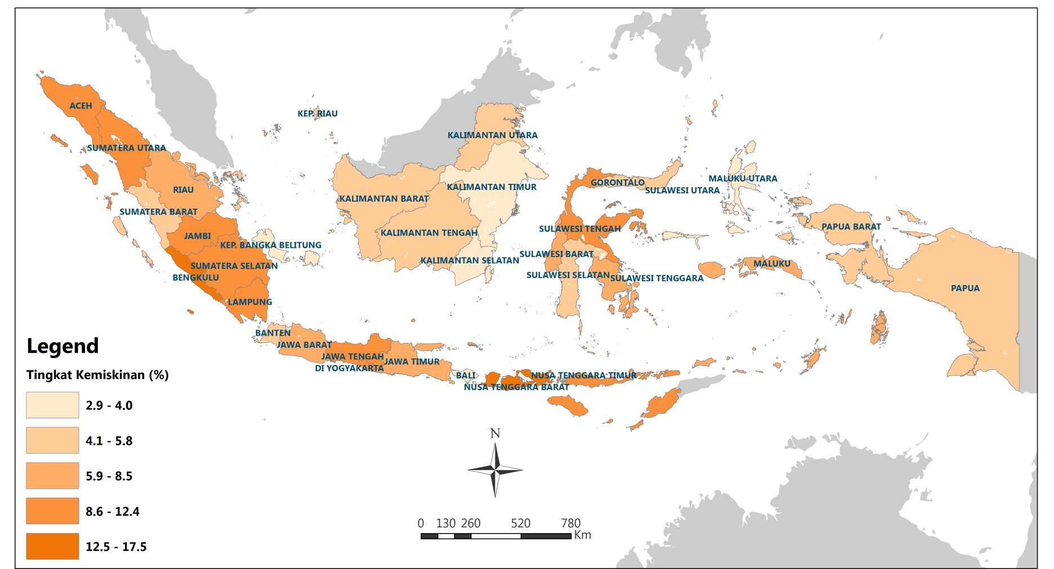
CHALLENGES: ECONOMIC CONTRIBUTION OF THE EASTERN INDONESIA HAS BEEN STAGNANT
2%
58%
of GDP
Poverty Rate (%)
3%

Slide 5
DISPARITY BEGAN SINCE BEGINNING
TFR National = 2,28
UHH National = 70,8 years

Slide 6
OUR TARGET IN 2045 –
HOW TO CONVERGE LEFT BEHIND PROVINCES
80
National TFR = 2
National Life Expectancy = 80 years

Slide 7
DEMOGRAPHIC DIVIDEND, AN OPPORTUNITY TO ERRADICATE POVERTY
Consequences of high population growth:
Low economic growth
Poverty and inequality
Quality of education and health
Food security
Environment
Informal migration

Slide 8
Education and Health Consumption by Region, 2019

Slide 9
Comparison Education and Health Consumption per Region, 2022

Slide 11
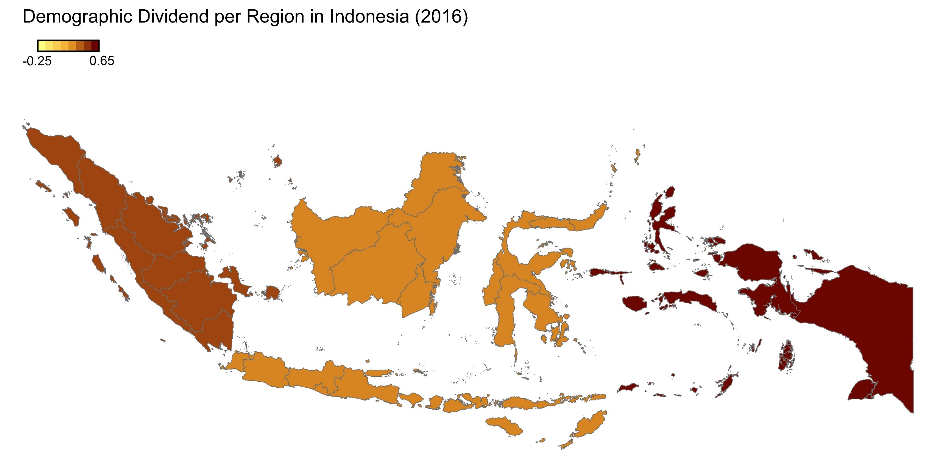
DEMOGRAPHIC DIVIDEND PER REGION IN INDONESIA
Demographic dividend per region using Y-C National 2012, 2016
Notes:
pembangunan SDM untuk semua yang berkualitas, Pemenuhan pelayanan dasar dan pembangunan fondasi Sumber Daya Manusia (SDM)
Tahap 1 → pelayanan dasar semua terpenuhi
Tahap 4 →

Slide 12

DEMOGRAPHIC DIVIDEND PER REGION IN INDONESIA (2020)
Demographic dividend per region using Y-C National 2012, 2020
Notes:
pembangunan SDM untuk semua yang berkualitas, Pemenuhan pelayanan dasar dan pembangunan fondasi Sumber Daya Manusia (SDM)
Tahap 1 → pelayanan dasar semua terpenuhi
Tahap 4 →

Slide 13
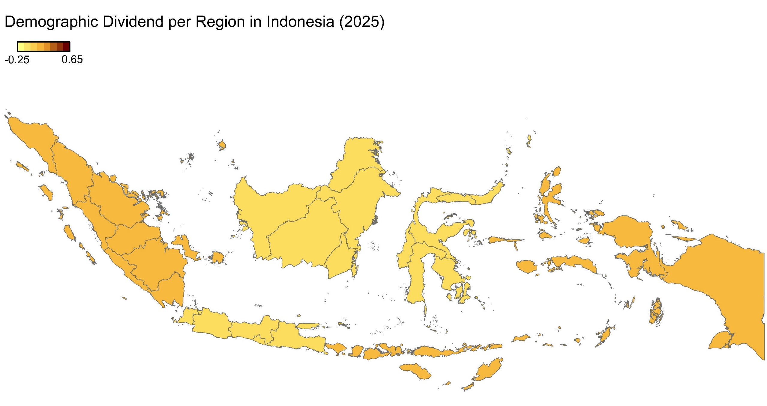
DEMOGRAPHIC DIVIDEND PER REGION IN INDONESIA (2025)
Demographic dividend per region using Y-C National 2012, 2025
Notes:
pembangunan SDM untuk semua yang berkualitas, Pemenuhan pelayanan dasar dan pembangunan fondasi Sumber Daya Manusia (SDM)
Tahap 1 → pelayanan dasar semua terpenuhi
Tahap 4 →

Slide 14
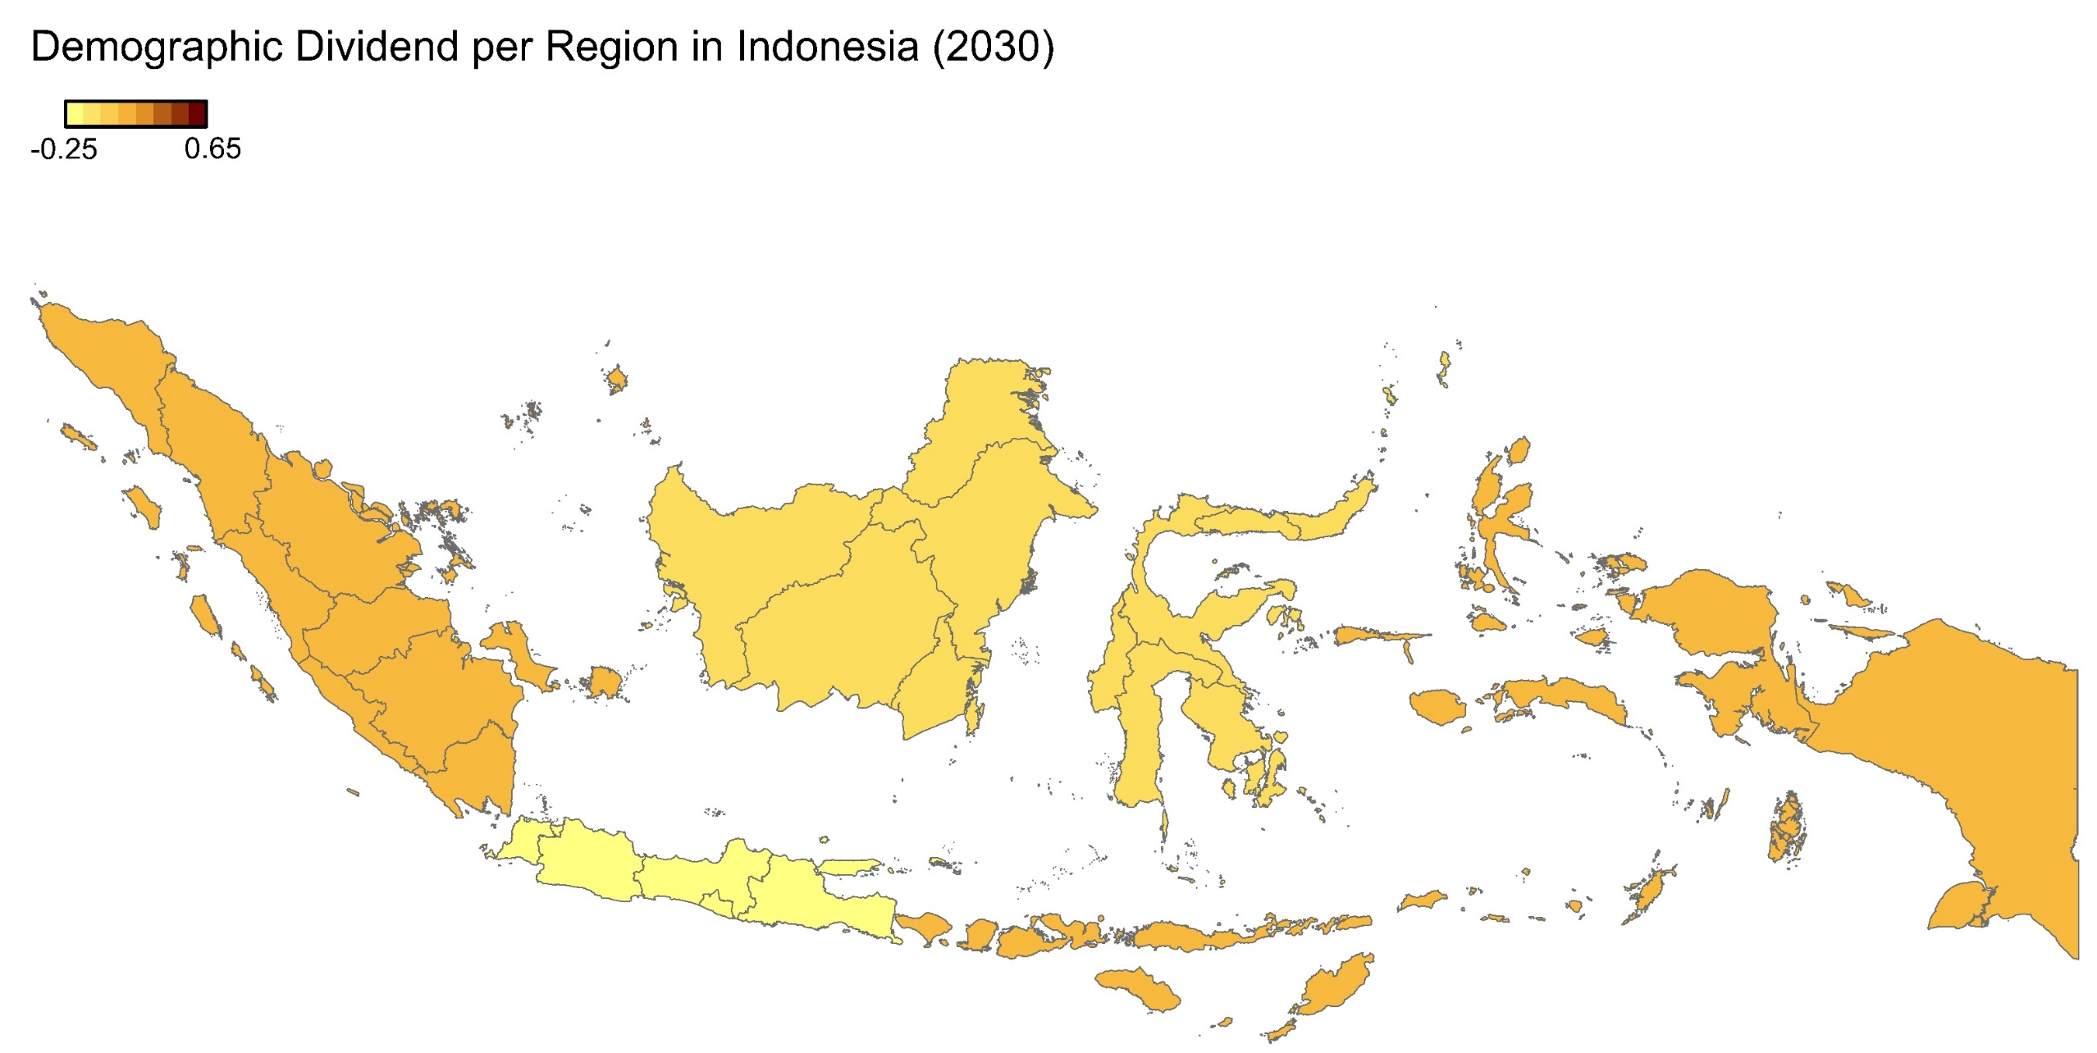
DEMOGRAPHIC DIVIDEND PER REGION IN INDONESIA (2030)
Demographic dividend per region using Y-C National 2012, 2030
Notes:
pembangunan SDM untuk semua yang berkualitas, Pemenuhan pelayanan dasar dan pembangunan fondasi Sumber Daya Manusia (SDM)
Tahap 1 → pelayanan dasar semua terpenuhi
Tahap 4 →

Slide 15
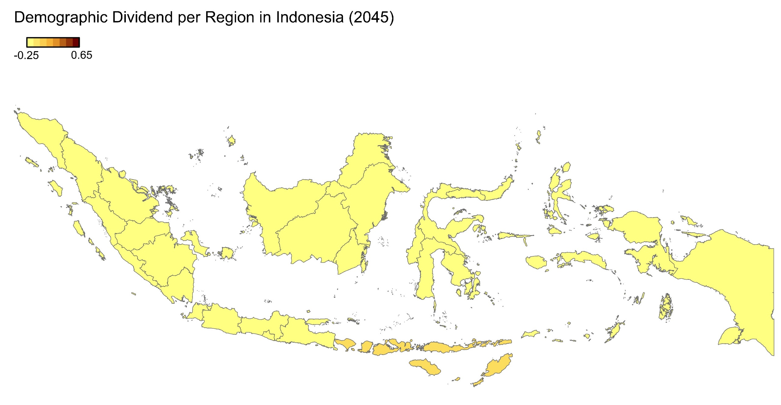
DEMOGRAPHIC DIVIDEND PER REGION IN INDONESIA (2045)
Demographic dividend per region using Y-C National 2012, 2045
USING Y-C National, first demographic dividend will be negative in all regions in 2045
Notes:
pembangunan SDM untuk semua yang berkualitas, Pemenuhan pelayanan dasar dan pembangunan fondasi Sumber Daya Manusia (SDM)
Tahap 1 → pelayanan dasar semua terpenuhi
Tahap 4 →

Slide 16
Differences in Productivity Between Provinces as One of the Causes of Inequality, 2012

Slide 17
LOOK MORE CLOSELY TO PROVINCIAL LEVEL: WHAT IS POLICY IMPLICATION ? (1/2)
First demographic dividend in Jakarta has already high;
1st DD will end soon.
Can it be extended but gradually increase its productivity ?

Slide 18
LOOK MORE CLOSELY TO PROVINCIAL LEVEL: WHAT IS POLICY IMPLICATION ? (2/2)
First demographic dividend in NTT is relatively low due to its low productivity;
Because its population is younger, and there is possibility to improve the productivity.
Consequently, the 1st DD can be increased.

Slide 19
QUESTIONS
Can demographic dividend be one of the key to take one country becoming advance country ?
What should we do with the disparity: TFR, human capital investment, productivity

Slide 20


Thank you
Medium Term Development Plan 2015-2019
(RPJMN)

Slide 21
FAMILY DEVELOPMENT ENTERING A NEW ERA
The number of children per woman of childbearing age continues to decline.
Opportunity to improve the quality of human resources.

