Slide 1
Colombia’s National Transfer Accounts:
Insights and results
Manuel Hernando Pava Guzmán
NTA Advisor – National Accounts Directorate
February / 2023

Slide 2



Special Thanks for:

Slide 3
Content
Timeline of the NTA’s in Colombia
How we built NTA for the first time at DANE
NTA results for 2017
Main Highlights & conclusions

Slide 4
Timeline
National Transfer Accounts in Colombia

Slide 5

Timeline NTA’s for Colombia
National Transfer Accounts for Colombia 2008
Drs, Piedad Urdinola and Jorge Tovar, develop from academic sector, the first measurement of the NTA for Colombia.
The project for the development of the NTA’s was included on the National Statistical Plan 2020-2022
Drs. Piedad Urdinola & Jorge Tovar published of National Transfer Accounts for Colombia 2014
2018
2019
2020
2021
25th International Conference On Population and Development (Nairobi)
DANE acquire the commitment of making the demographic transitions and its economic impact visible though the development of NTA
Development of the NTA Project for Colomnbia
The Project aimed to measure NTA’s for Colombia Was supported the technical Assistance provided by CELADE and ECLAC, and NTA network.
NTA Project for Colombia:
Introductory workshop and technical training for DANE
Estimation of NTA’s for Colombia within the framework of the GSBPM* model
Analysis and presentation of results
* Generic Statistic Business Process Model

Slide 6
How Are The 2017 NTA’s For Colombia Calculated?
The development of the NTA measurement for Colombia for the first time, we generated an articulated work between the different technical divisions of DANE, and with the full support of the Latin American and Caribbean Demographic Centre, through the consultant Piedad Urdinola and the NTA network.
National Household Budget Survey (ENPH) 2016/2017
Provides an exhaustive level of detail for income items and their origins, as well as for expenses, in most cases with information by individual.
Per capita profiles of the NTA’s
Income
Consumption
Transfers
Reallocations
Administrative Records:
• Financial Superintendence of Colombia financial information on
Management companies of Pension and Severance Funds, 2017.
• Colpensiones Financial Report 2017
Integrated Economic Accounts 2017
Annual National Accounts by Institutional Sector

Slide 7
NTA Results
2017

Slide 8
Labor income per capita
Income profiles of employees, self-employed, and labor benefits by age
2017
$21,6 millons COP
~ 7320 USD
Source: DANE, National Accounts Directorate. NTA 2017
Notes:
El nivel máximo de ingreso laboral se obtiene a los 40 años con 21,6 millones de pesos al año.

Slide 9
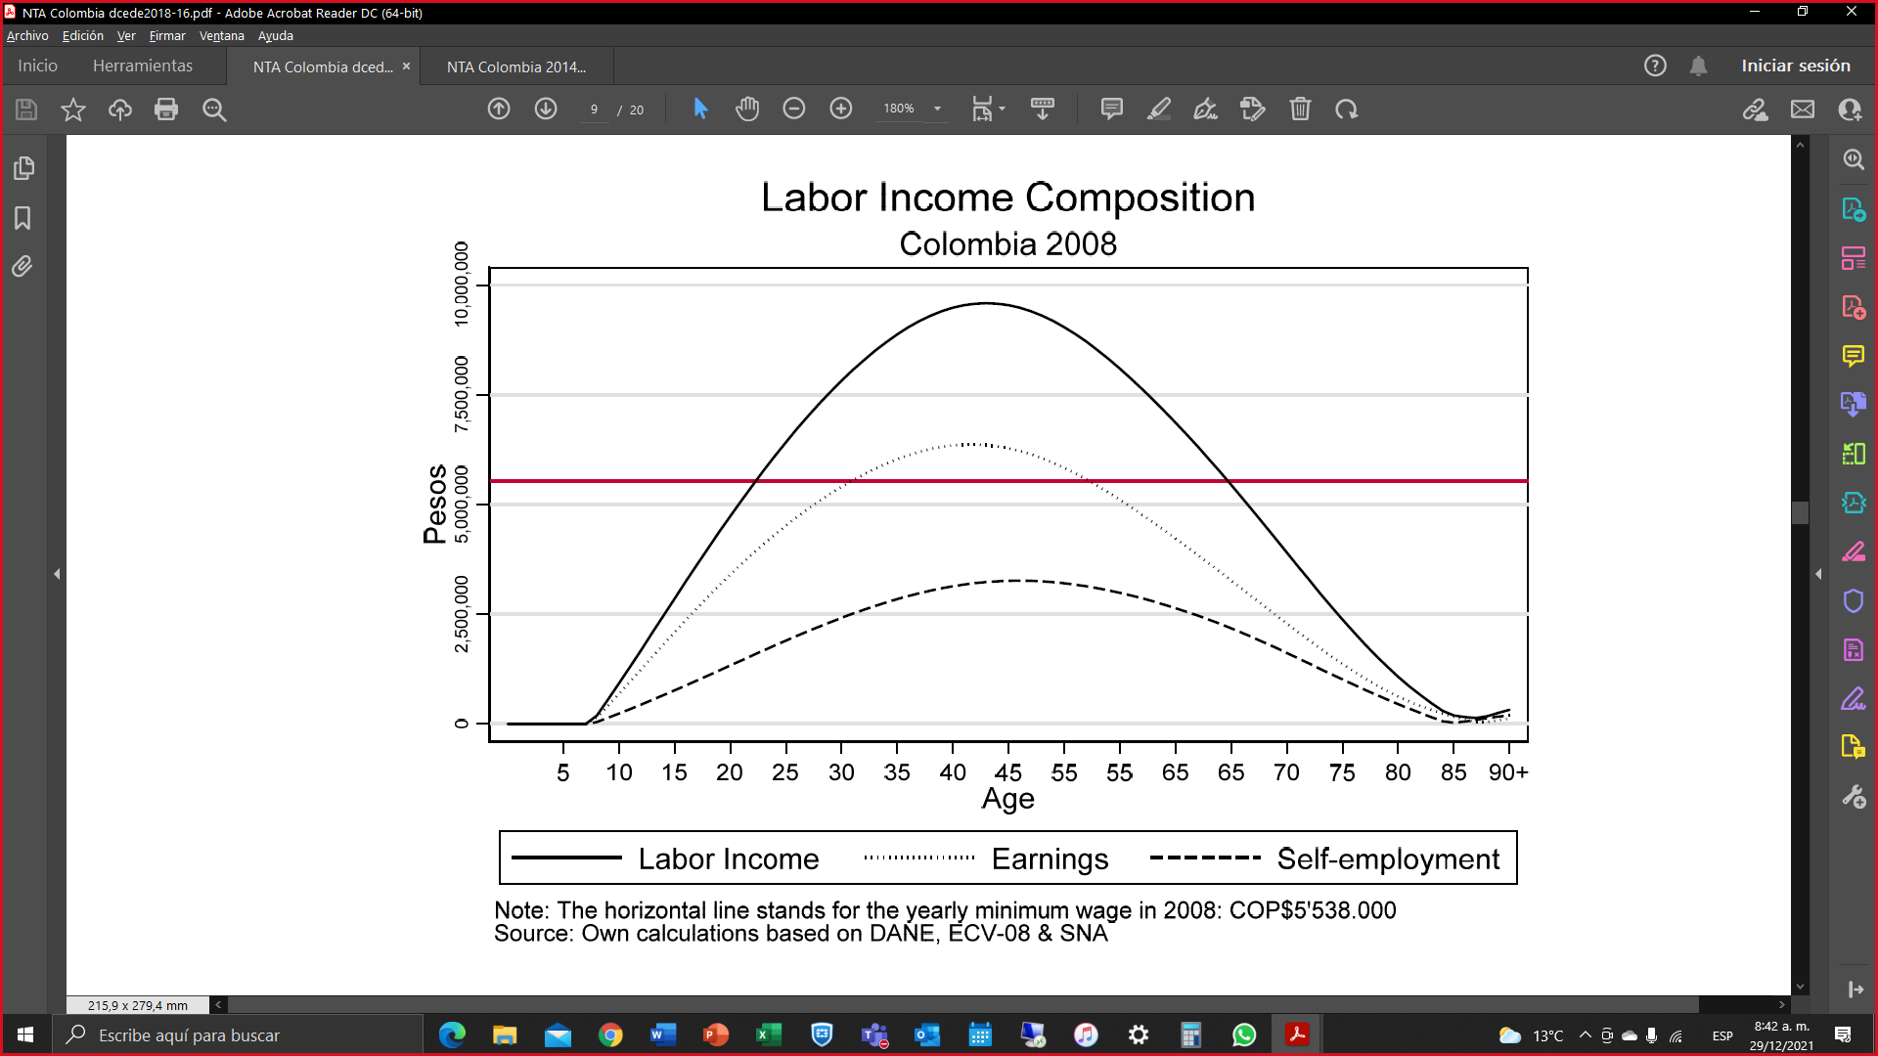
Labor income per capita
Comparison of income profiles of employees, self-employed
2008 - 2017
43
42
46
Source: Piedad Urdinola, Jorge Tovar. Serie Documentos Cede, 2018-16 ISSN 1657-7191 Edición electrónica. Febrero 2018. National Transfer Accounts for Colombia
Notes:
El nivel máximo de ingreso laboral para 2008 se obtiene a los 42 años con unos ingresos cercanos a los 10 millones por año

Slide 10
Per capita consumption
Consumption profile, public consumption and private consumption by age
2017
$15,9 millons COP
~ 5400 USD
Source: DANE, National Accounts Directorate. NTA 2017
Notes:
Desde los 5 años hasta la edad de 10 años, son las únicas edades donde el consumo público supera al consumo privado. La edad donde se genera el mayor nivel de consumo para el 2017 es 49 años con 15,9 millones de pesos anuales

Slide 11
Public consumption per capita Public consumption profiles and their components by age 2017
8 / $2,5 millons
8 / $4,9 millions
Source: DANE, National Accounts Directorate. NTA 2017
Notes:
El máximo nivel de consumo público se da a los 8 años con 4,9 millones de pesos al año

Slide 12
Economic life cycle per capita Average profiles by age of labor income and consumption – deficit stages and surplus stage 2017
Source: DANE, National Accounts Directorate. NTA 2017

Slide 13
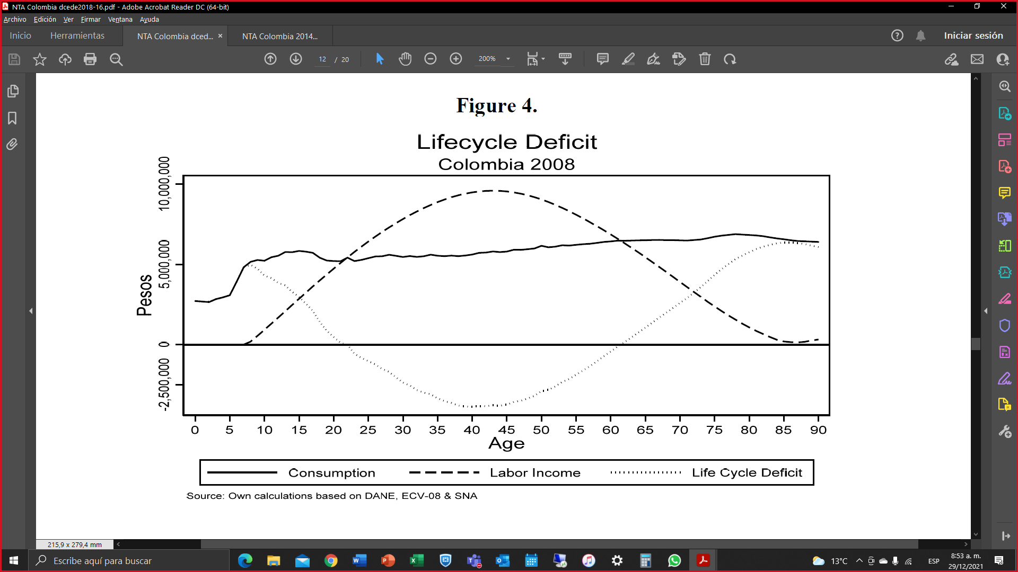
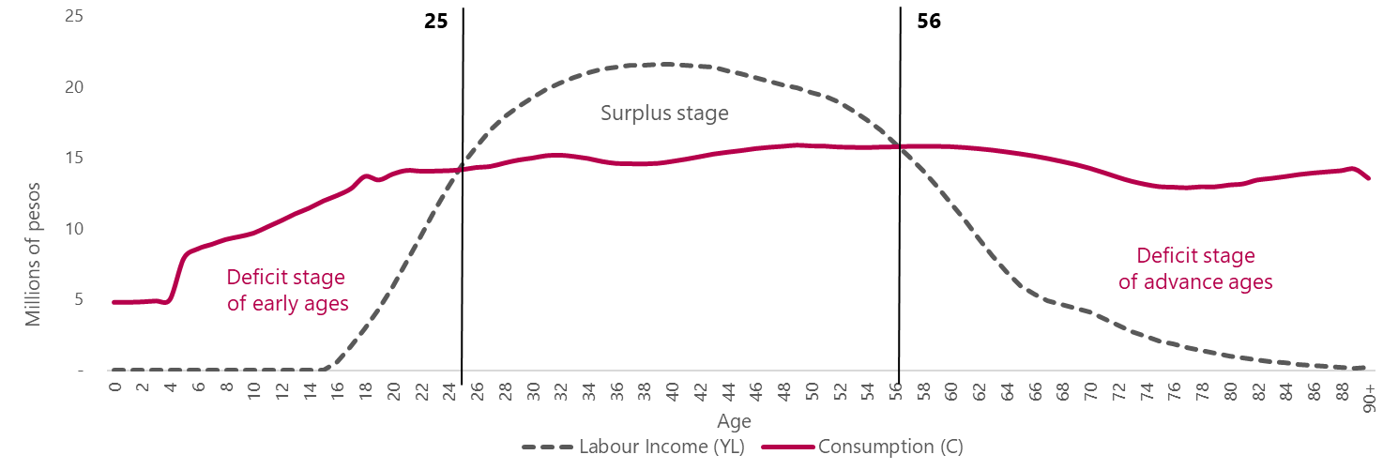
Economic life cycle per capita Comparison of average profiles by age of labor income and consumption – Life cycle 2008 - 2017
40 ages
32 ages
23
62
Source: Piedad Urdinola, Jorge Tovar. Serie Documentos Cede, 2018-16 ISSN 1657-7191 Edición electrónica. Febrero 2018. National Transfer Accounts for Colombia

Slide 14
$14,1 millones
$-4,9 millones
Economic life cycle deficit per capita Profiles per capita by age 2017
$14,1 millions / 89
15 / $11,97 millons
39 / $-4,9 millons
Source: DANE, National Accounts Directorate. NTA 2017
Notes:
La edad con mayor déficit es a los 89 año con 14,1. También cabe resaltar que en las edades antes de los 25 años, en la edad de 15 años es donde se presenta el mayor déficit con 11,97 millones

Slide 15
Public transfers per capita Average profiles by age of inputs and outputs of public transfers 2017
70 / $9,6 millions
50 / $8,6 millions
Source: DANE, National Accounts Directorate. NTA 2017
Notes:
El máximo nivel de entradas de transferencias públicas se da a los 70 años con 9,57 millones de pesos al año, el máximo nivel de salidas de transferencias públicas se da a los 50 años con 8,58 millones de pesos al año

Slide 16
Private transfers per capita Average age profiles of private, household and intra-household transfers 2017
+90 $4,3 millones
15 / $7,1 millions
$4,3 miilions / 90+
40 / $6 millions
Source: DANE, National Accounts Directorate. NTA 2017

Slide 17
Main Highlights & Conclusions

Slide 18
Insights of the Colombian Experience
The NTA require to guarantee a higher frequency of income and expense surveys or to have a statistical operation to meet this information need.
A strong institutional framework is an enabler for ensuring the continuity of the measurement of NTA.

Slide 19
Insights of the Colombian Experience
NTA as tool for public policies. Dissemination is very important for this.
One of the remaining challenges with the statistical production of the NTA’s is the disaggregation of results

Slide 20



“Old age begins when start to say: I have never felt so young”
Jules Renard
Thanks a lot!
Merci beaucup!
February / 2023

