Slide 1
Changing Pattern of Intergenerational Support for Elderly in India: Evidence from 2004-05 and 2011-12 NTA
Fourteenth Meeting of National Transfer Accounts Network
Universite Paris Dauphine PSL
February 14-17, 2023
Laishram Ladusingh
Vice-Chancellor
Bodoland University, India

Slide 2
Public Policies Initiaves Post 2005
Unorganized Sector Workers Social Security Act (USWSSA) 2008
- Provides life and disability cover, health and maternity benefits, old age protection
- Schemes under the act includes Rashtriya Swasthya Bima Yojana (RSBY) by MoLE, Aam Admi Bima Yojana (AABY) by Department of Financial Services, Indira Gandhi National Old Age Pension Scheme( IGNOAPS) by MoRD
- Single point of contact for unorganized sector workers to have access to social security and issued Smart Card

Slide 3
Public Policies Initiative Post 2005
The National Rural Employment Guarantee Act, 2005
Provides livelihood security of households in rural areas by providing minimum of 100 days employment in a year to adult members volunteer for unskilled manual work
It is now renamed as MGNAREGA
The Central Government bears the entire cost of unskilled manual workers, 75% cost of materials, skilled, semi-skilled workers and administrative cost
The State Government bears 25% cost of materials, skilled and semi-skilled workers

Slide 4
Public Policies Initiaves Post 2005
National Rural Health Mission
- Implemented during 2005-2012 to provide effective healthcare in the country with focus in 18 states with poor health indicators
- National flagship program to meet then MDG
-Strengthen health facilities more particularly in rural areas as par IPHS
- Extended health outreach in villages through Panchayats and female health activist ASHA
- Provide incentives for institutional maternal healthcare

Slide 5
Shift in Per Capita Income

Slide 6
Changes in Per Capita Consumption

Slide 7
Changing Lifecycle Deficit

Slide 8
Changes in Familial Support

Slide 9
Changing Consumption Share of Elderly
Consumption | 2004-05 | 2011-12
Public Total | 6.2 | 6.9
Public Health | 8.9 | 9.5
Private Total | 9.0 | 8.12
Private Health | 14.2 | 10.3
Public Transfer
In Kind | 5.88 | 6.25
In Cash | 8.76 | 11.96

Slide 10
Changes in Support for LCD

Slide 11
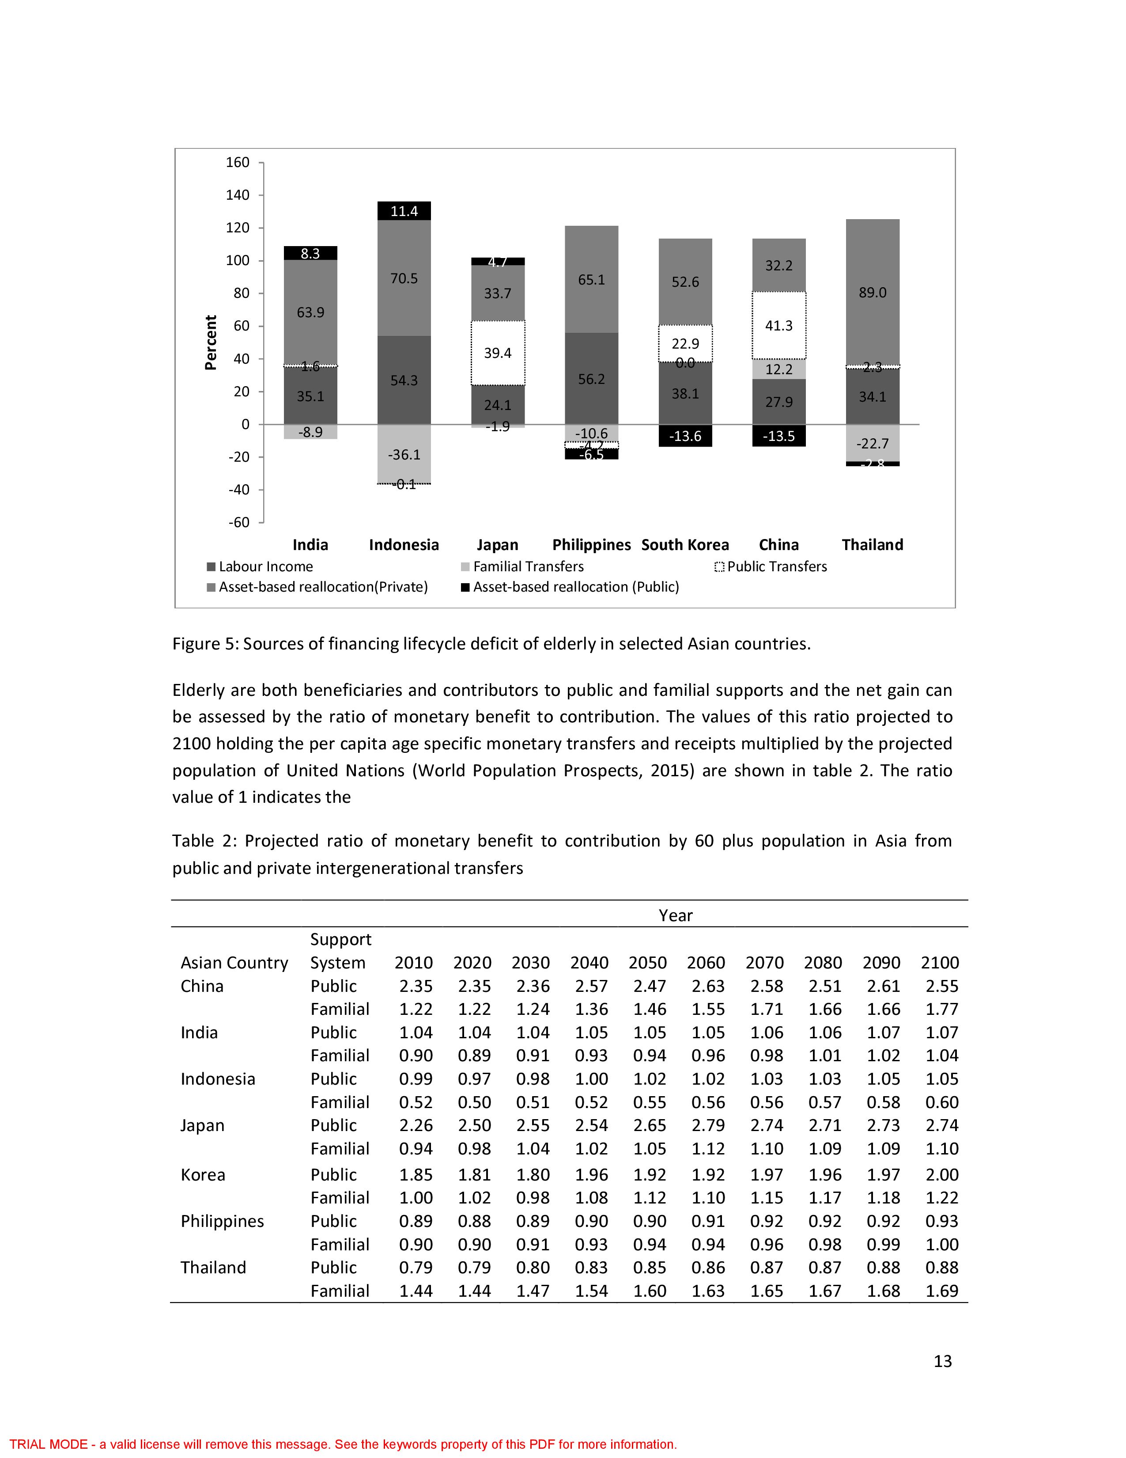
Support to LCD in Asian Countries

Slide 12
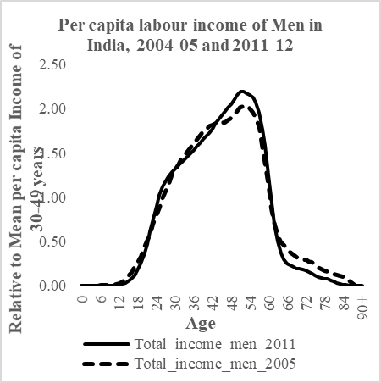
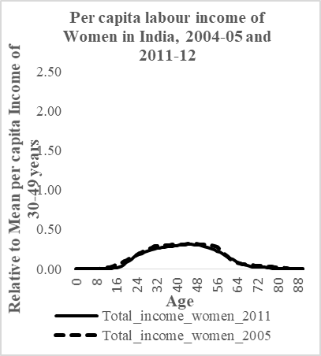
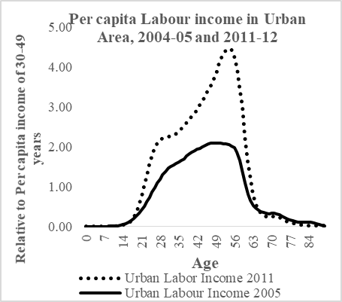
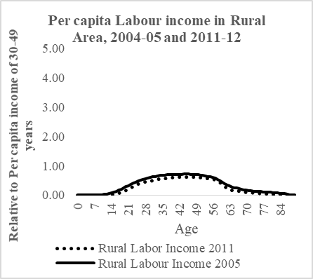
Changing Income by Sex and Residence

Slide 13
Change in LCD by Sex

Slide 14
LCD by Social Groups

Slide 15
Thank You

