Slide 1

Gendered differences in paid and unpaid labor, barriers to economic participation and wealth accumulation throughout the Lifecyle in Morocco
Presented at the 14th Global Meeting of the NTA Network
Building Sustainable Generational Economies
El Mekkaoui Najat** Loukili Sara*
Paris Dauphine University
Wednesday, February 15th , 2023

Slide 2
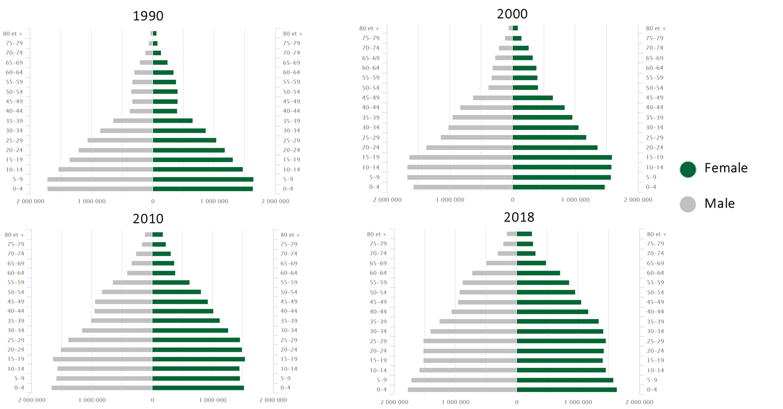
Demographic changes in Morocco are rapid triggering irreversible effects in absence of timely reforms

Slide 3
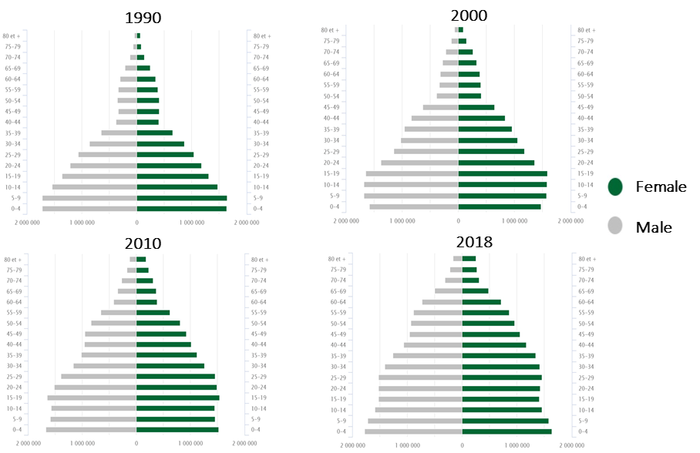
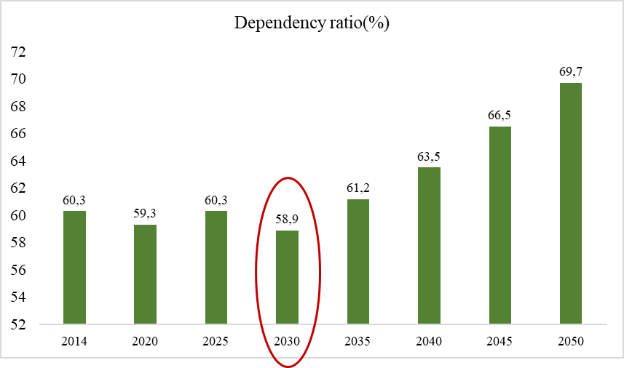
Demographic changes in Morocco are rapid triggering irreversible effects in absence of timely reforms

Slide 4
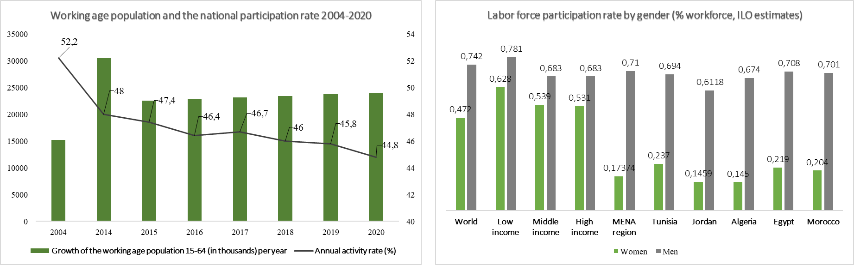
A sluggish labour market limits the benefits of the demographic dividend

Slide 5
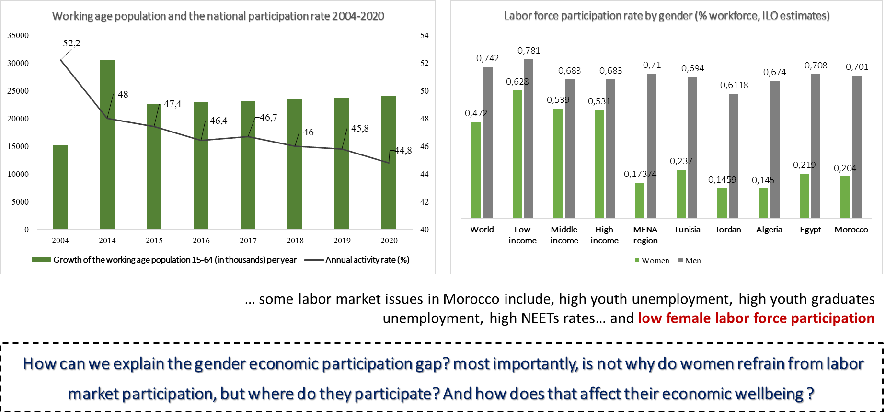
A sluggish labour market limits the benefits of the demographic dividend

Slide 6
Overview of approach and results
What we do
Using the National Transfer Accounts methodology, we analyze the age profiles for Morocco and draw gender differentials by age that are labor related
Research hypothesis :
  The low labor participation affects women’s economic position throughout the lifecycle
  Women’s paid work time is replaced by unpaid labor that further deepens the gender economic gap throughout the lifecycle (i.e, no pension income, higher dependence on informal self-insurance mechanisms throughout the lifecycle and more in old age…)
The National Time Transfer Accounts methodology will then be used to illustrate gender differences in transfers of paid and unpaid labor throughout the lifecycle
What we find
The gender gap in labor participation is related to an intricate web of xxx
Women’s transfers are, in fact, replacing transfers that should be provided by social insurance measures (i.e, childcare sevices, sick and old age care services…etc)
Potential contributions
Provide perspective on female labor force participation paradox in Morocco
Clarify nuances between paid and unpaid labor performed by women
Analyze how these dynamics affect women’s economic wellbeing

Slide 7
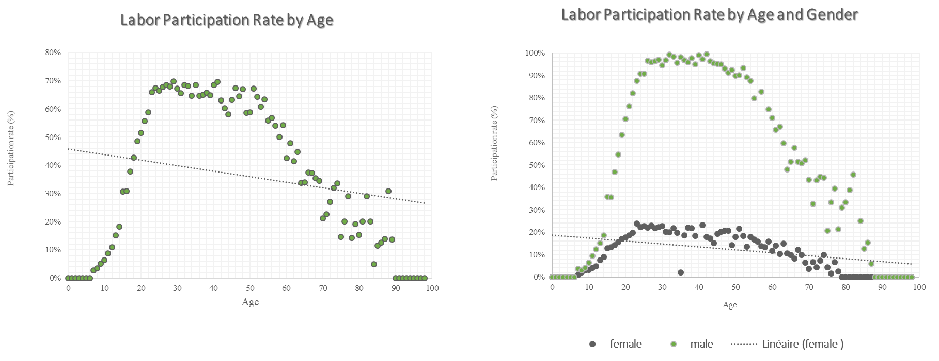
In sample labor force participation by age and gender show significant differences

Slide 8
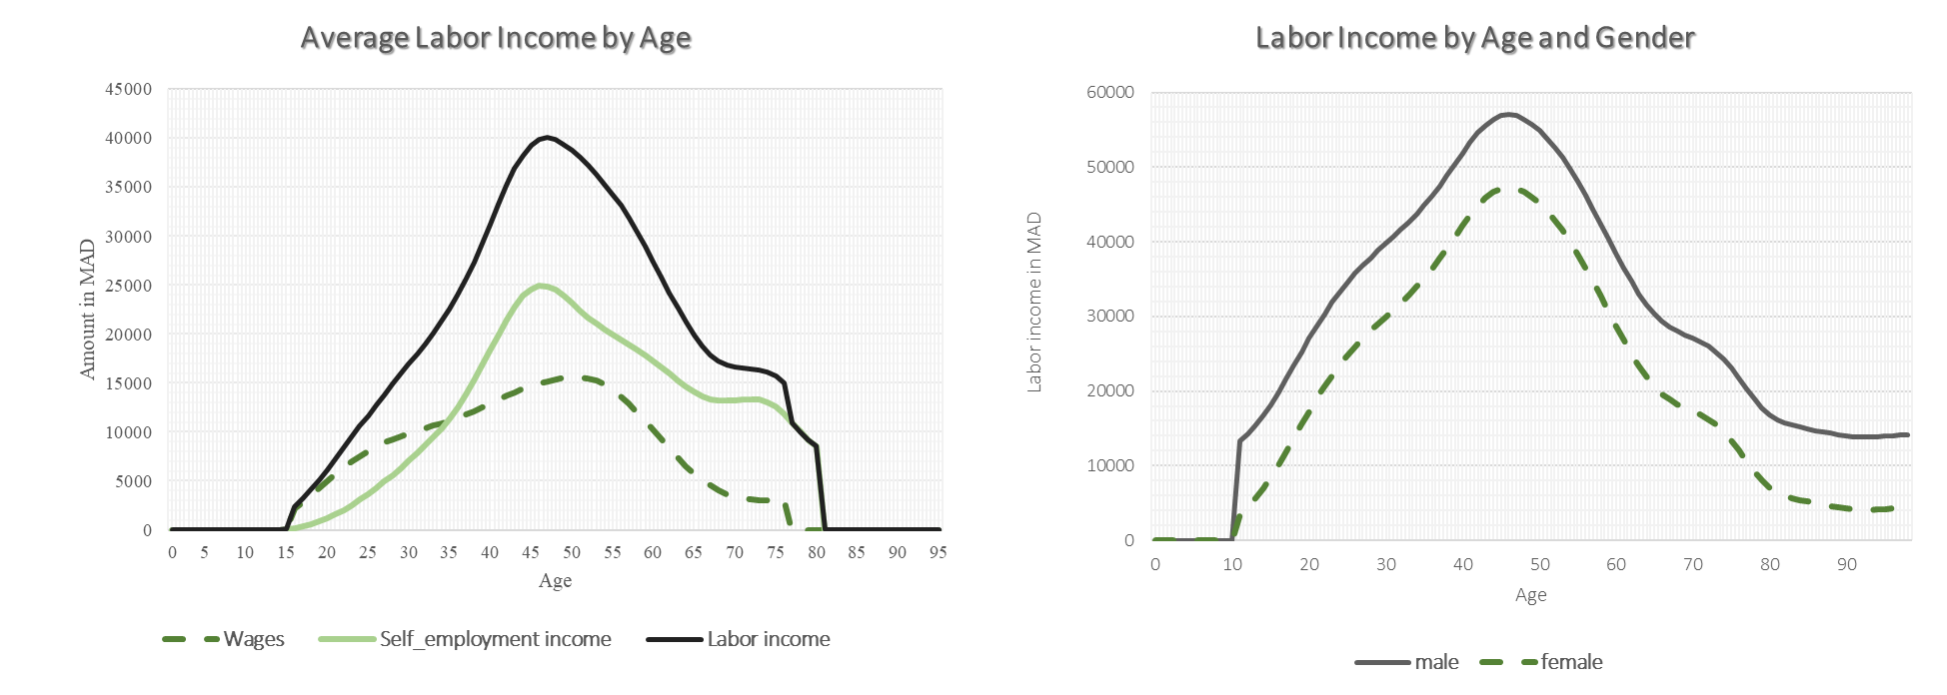
Gender differentials in age labor income profiles for those who participate in the labor market

Slide 9
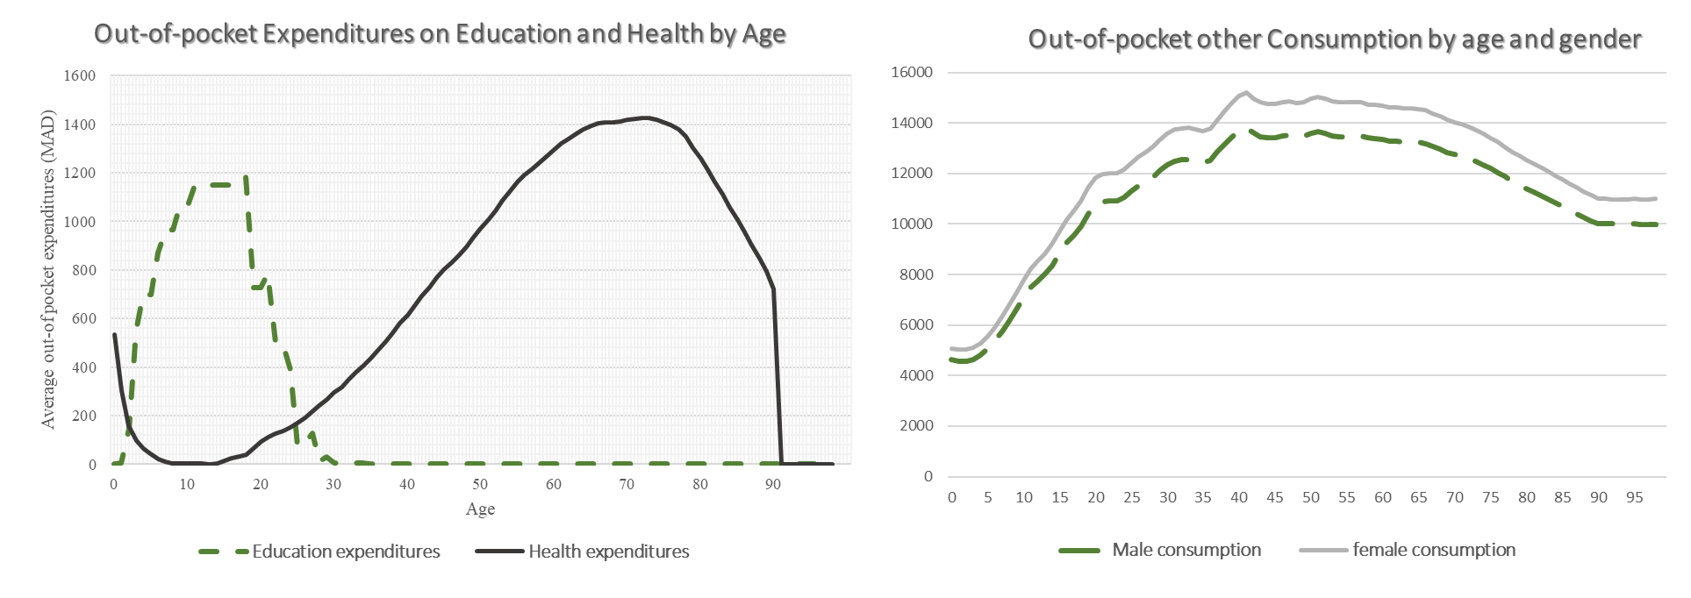
Gender differentials in consumption mean that women on average occur more expenses during their lifetime than they make income

Slide 10
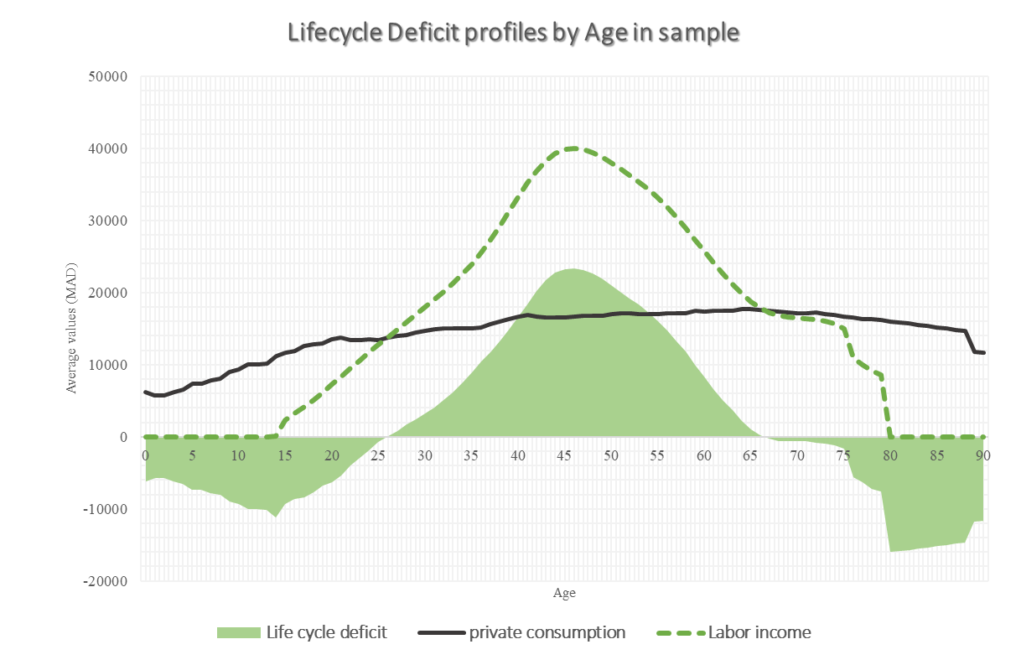
The lifecycle profiles show that deficit is particularly greater in old age than it is for early ages

Slide 11
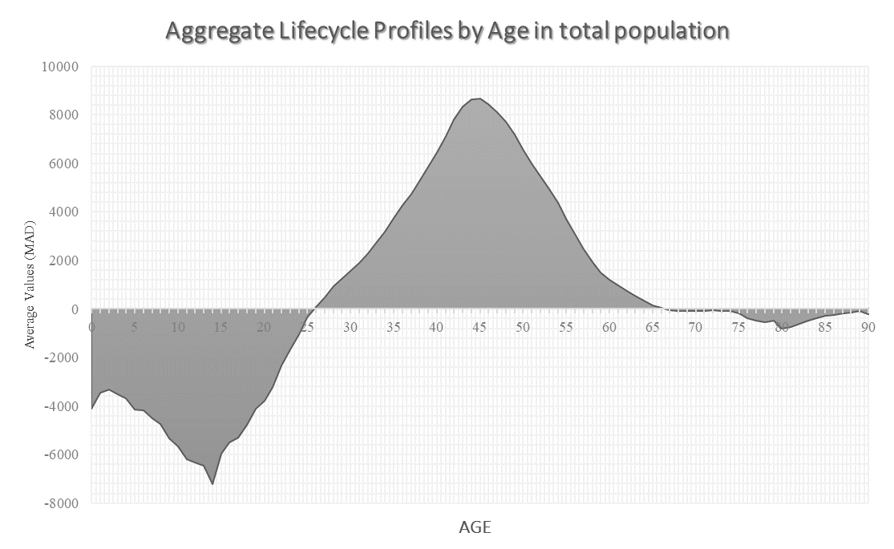
The aggregate lifecycle profiles show that deficit is mainly in early ages, but this trend is likely to reverse due to the demographic transition

Slide 12
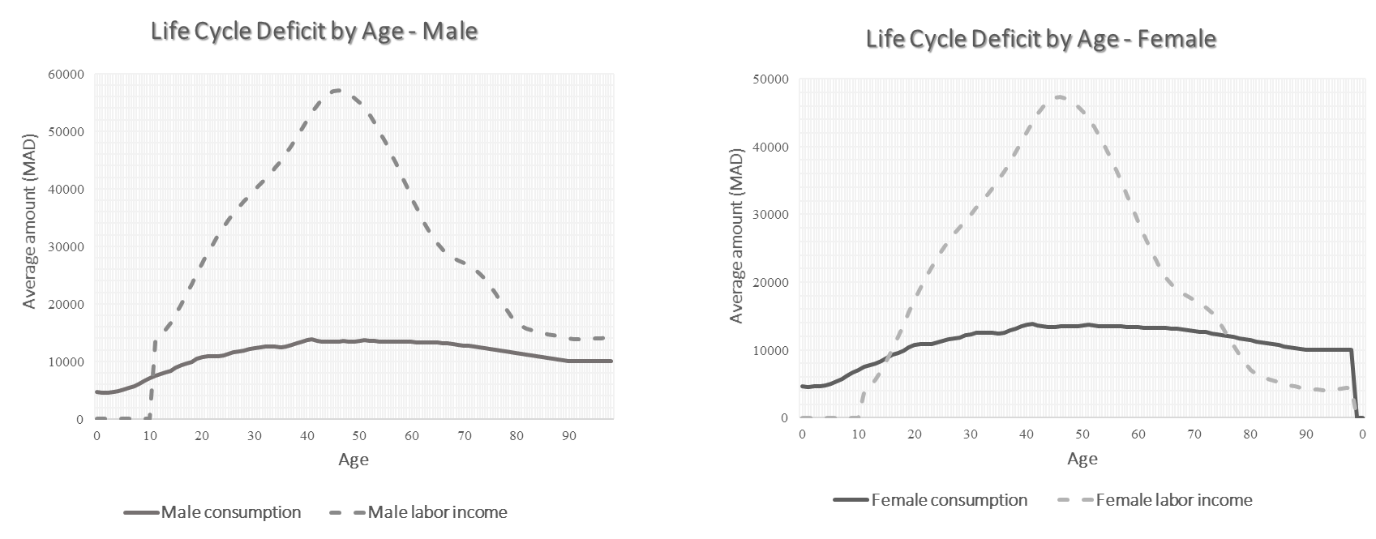
Gender differentials in lifecycle deficit by age suggest that women might accumulate more deficit than men

Slide 13
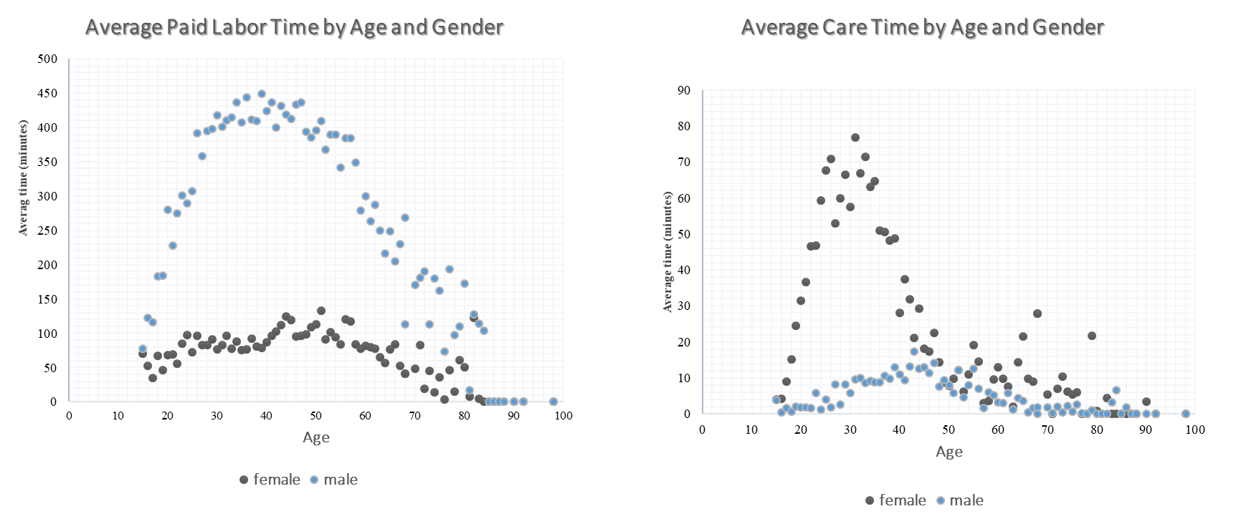
Gender differentials in time allocations might help explain the gap in lifecycle deficits

