Slide 1

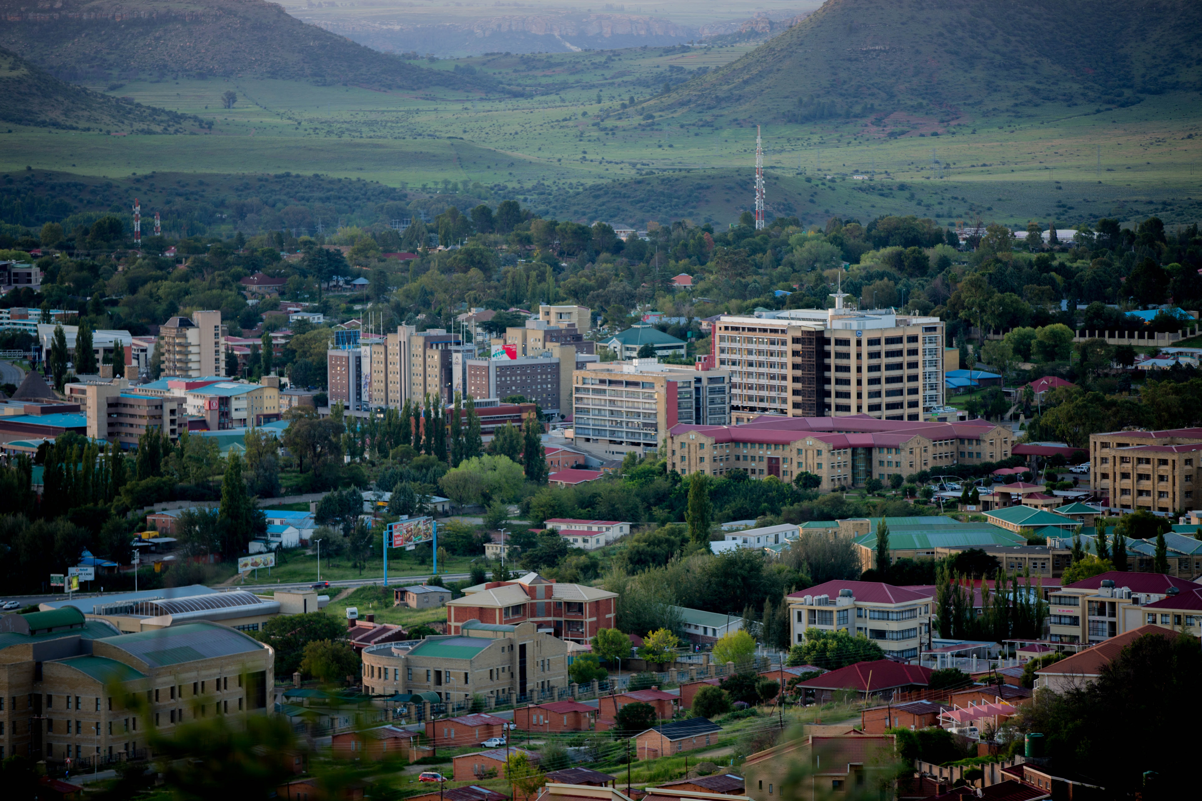
Building contextual development challenges into the national transfer accounts (NTA) approach to demographic divided estimation: A case study of the HIV epidemic in Lesotho
Angela Baschieri*; Willis Odek*; Marc Derveeuw**; Morné Oosthuizen***; Fredrick Okwayo*; Chinwe Ogbonna*; Nteboheng Mahlaha**; Clifford Odimegwu****; Sasha Frade****
14th Global Workshop of the National Transfer Accounts Research Network, February 14-17, 2023, Paris, France

Slide 2
Outline
Lesotho’ demographic context
Lesotho’s demographic dividend (DD) and the lifecycle deficit
The HIV epidemic and its implications for DD in Lesotho
NTA DD estimation integrating different HIV service coverage scenarios
Key takeaways

Slide 3
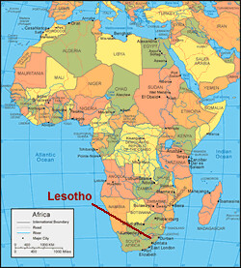
Lesotho’s demographic context
The Kingdom of Lesotho is located in the Southern part of Africa and is geographically surrounded by South Africa.
The country’s population in 2016 (national population and housing census) was 2.007 million
Population projections [United Nations (2019), medium fertility variant]
2.176 million (2022)
2.246 million (2026)
2.436 million (2036)
(Annual average growth rate 0.8%)

Slide 4
Lesotho population age structure

Slide 5
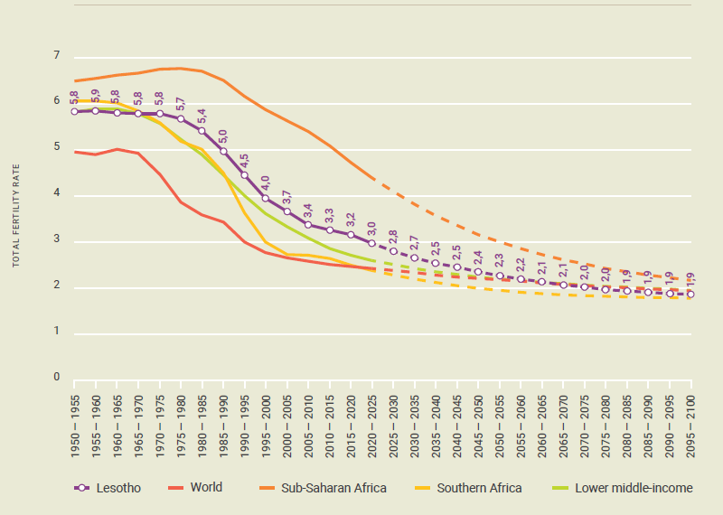
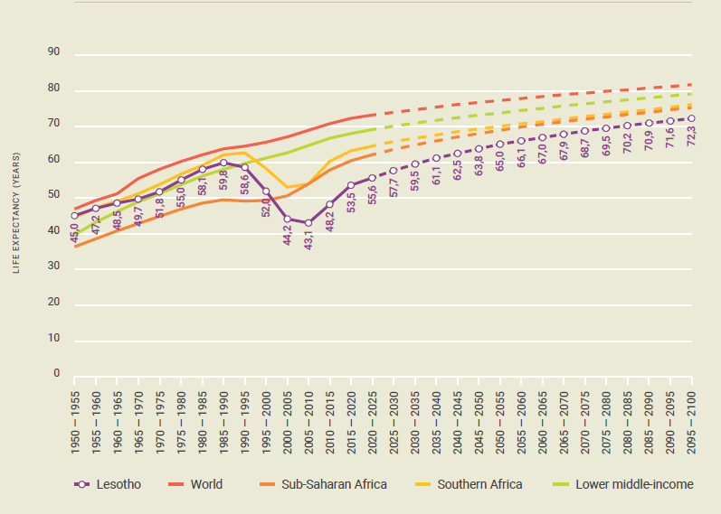
Fertility and mortality trends support the changing population age structure
TFR, Lesotho, 1950-2100
Life expectancy at birth, Lesotho, 1950-2100

Slide 6
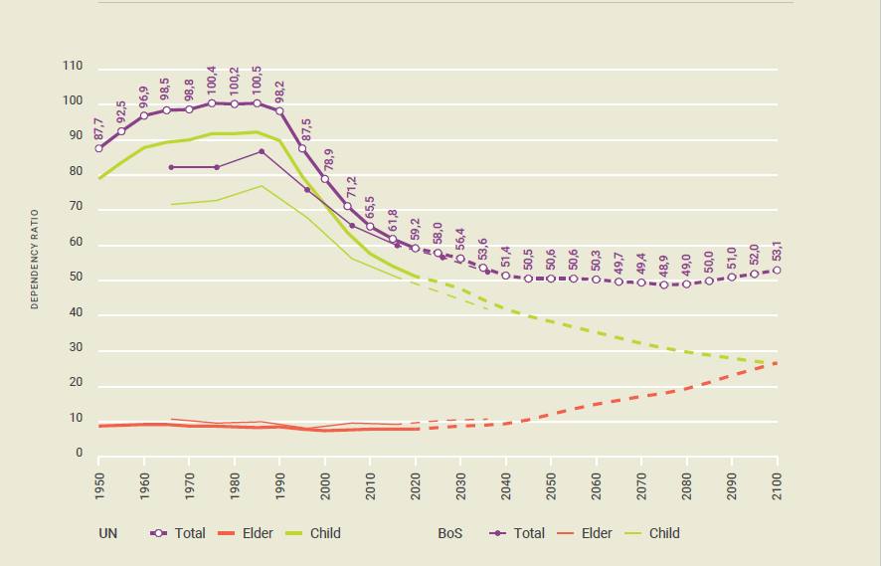
Lesotho’s population age structure change and the demographic dividend
Dependency Ratios in Lesotho, 1950-2100
UN definition of DD – the period when the proportion of children and youth under 15 years falls below 30% and the proportion of people 65 years and older is still below 15%.
Lesotho’s window of opportunity
is projected to open in around 2033
(child dependency ratio of 29.7% and old age dependency ratio of 5.7%), and to close in 2089 (child dependency ratio of 18.7% and old age dependency ratio of 15.1%).

Slide 7
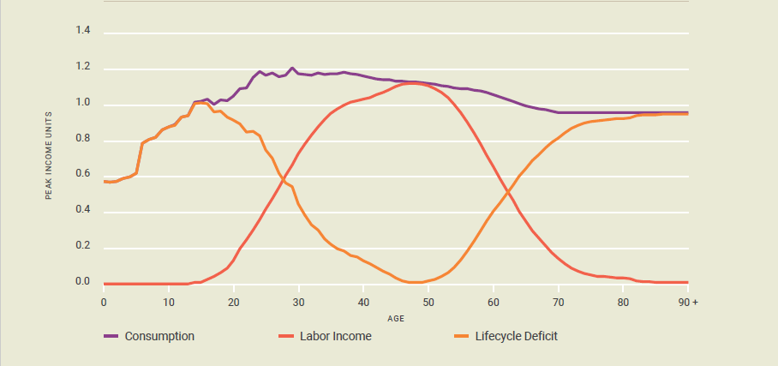
However, the NTA demonstrates lifecycle deficit in Lesotho at all ages
The Lifecycle Deficit in Lesotho, 2018
Per capita consumption exceeds labor income for all age cohorts, producing a lifecycle deficit
International labor migration, particularly to South Africa, largely explains the lifecycle deficit
Remittance flows were equivalent to 21.3% GDP in 2019; but primarily used for consumption - food and clothing (89.5%) and education (7.2%)
Consumption appears higher than it might have been without remittances
Data used: Lesotho 2017/2018 Continuous Multi-Purpose and Household Budget Survey

Slide 8
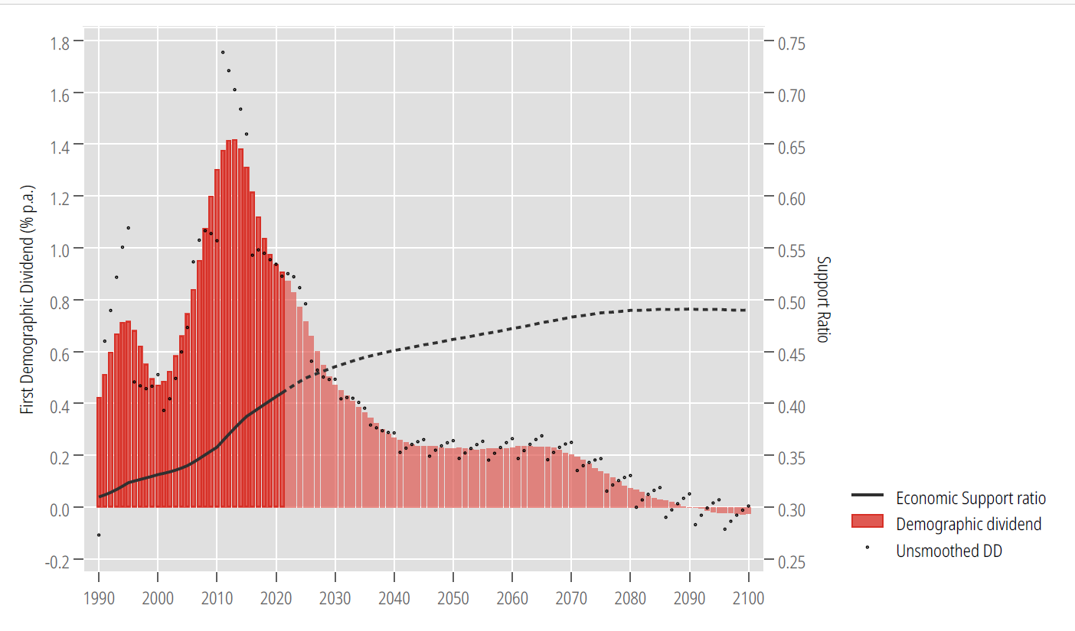
Lesotho’s economic support ratio and the demographic dividend
The Demographic Dividend in Lesotho, 1990-2100
From the NTA analysis, Lesotho’s DD remains positive as the economic support ratio – ESR - (i.e. total labor income to consumption) rises until around middle 2080s when it peaks.
From 1990, the first DD has been increasing - 0.424% p.a. in 1990 to a peak of 0.717% p.a. in 1995, before dropping to 0.472% p.a. in 2000 and rebounding to 1.4% p.a. in 2012/13.
Declines in DD from mid-1990s were shaped largely by the HIV epidemic; further declines will be shaped by changes in the population age structure.

Slide 9
The HIV epidemic is a key contextual factor for Lesotho’s DD
Key indicators | Data (UNAIDS, 2021)
Adult aged 15 to 49 HIV prevalence rate | 20.9% [19.2 - 21.1]
Women aged 15 to 49 HIV prevalence rate | 26.1% [24.0 - 27.0]
Men aged 15 to 49 HIV prevalence rate | 15.7% [13.1 - 16.7]
HIV incidence per 1000 population (adults 15-49) | 8.10 [7.66 - 8.10]
Epidemic transition metrics
Percent change in new HIV infections since 2010 | -61%
Percent change in AIDS-related deaths since 2010 | -48%

Slide 10
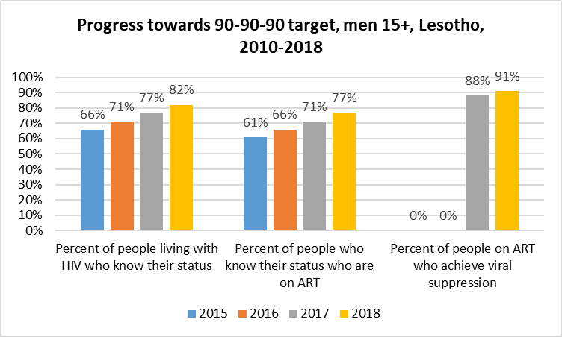
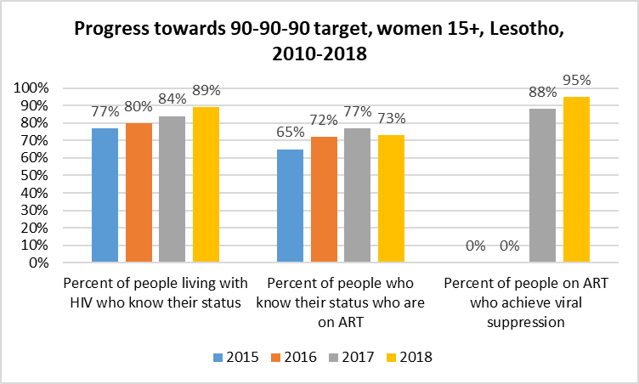
Sustainable HIV response financing is integral to DD in Lesotho

Slide 11
Potential pathways of effect of the HIV epidemic on demographic dividend
HIV has an overall effect on human capital development through at least two pathways - demographic and economic – with gender dimensions.
Demographic pathways | Economic pathways
Population size and growth | Micro-level
Mortality | Labor force, reduced savings and investments for households due to increased health expenditures Education and productivity
Life expectancy at birth | Macro-level
 | Diversion of public spending from investment and human capital development Deepening of poverty - drop in per capita income

Slide 12
NTA DD estimation integrating HIV
Primary question: What is the potential impact of the HIV epidemic on Lesotho’s DD under different scenarios of long-term funding of HIV prevention and treatment programs?
Method
Modelling of demographic impact of HIV on population age structure using the AIDS Impact Module in the Spectrum Software
AIMS module focuses on level of coverage of Prevention of Mother to Child Transmission (PMTCT) and Child and Adult antiretroviral treatment programs
Two scenarios assuming 50% and 100% reduction in coverage from the 2018 baseline to 2060 due to constraints to sustainable financing of HIV response are analyzed
Population projections produced by the three HIV scenarios are applied to the 2018 labor income and consumption profiles to estimate the DD using the NTA approach

Slide 13
Population age struture under different HIV service coverage scenarios

Slide 14
Lesotho’s DD timing under different HIV scenarios
Lesotho’s DD under alternative HIV scenarios,
2000-2100
Under the baseline HIV coverage scenario, the first demographic dividend peaks at 1.48% p.a. by 2011 then falls steeply to 0.80% by 2019 and 0.3% by 2040s.
With 100% reduction in HIV service coverage, the DD falls below 0.3% by 2034 and remains between 0.2-0.3% until 2056.

Slide 15
Lesotho’s demographic DD under different HIV scenarios
 | Cumulative DD (2020-2060) – AIDS Impact Module | Average Annual Growth Rate (%) – 2020-2060
With no consideration to HIV | 18.4 | 0.40
Baseline HIV scenario | 17.8 | 0.39
50% coverage reduction | 18.5 | 0.40
100% coverage reduction | 15.3 | 0.34

Slide 16
Key takeaways
Even under the current (baseline) level of HIV service coverage, HIV has implications for the demographic dividend in Lesotho.
100 percent reduction (or elimination) of HIV service coverage from the current baseline scenario sees the cumulative DD decline from 18.4% (equivalent to an average annual growth rate of 0.40%) to 15.3 percent (with an average annual growth rate of 0.34% per annum) for the period 2020-2060.
These estimates only model the effect of disruption to HIV service coverage on the population age structure. More nuanced impacts of such a disruption need to be considered:
Changes in private consumption of health
Quality of life
Labor force participation and productivity
Education and gender disparities, including for care for those living with HIV
More analyses are required from other countries in a similar situation.

Slide 17
Acknowledgements
Angela Baschieri*
Willis Odek*
Marc Derveeuw**
Morné Oosthuizen***
Fredrick Okwayo*
Chinwe Ogbonna*
Nteboheng Mahlaha**
Clifford Odimegwu****
Sasha Frade****
*United Nations Population Fund (UNFPA), East and Southern Africa Regional Office, Johannesburg, South Africa.
**UNFPA, Lesotho Country Office, Maseru, Lesotho.
***University of Cape Town, School of Economics, Development Policy Research Unit, Cape Town, South Africa.
**** University of the Witwatersrand, Johannesburg, South Africa
Government of Lesotho

Slide 18
THANK
YOU!

